Slide 1
RESILIENT ROCKAWAY
Caring for Our Peninsula

Slide 2
Key Terms
Ecosystem: a community of living things and their physical environment interacting with each other.

Slide 3
Key Terms
Ecosystem: a community of living things and their physical environment interacting with each other.
Climate change: change in the average conditions in a place over time (temperatures, weather patterns, etc.). Long-term climate change is caused by human activity.

Slide 4
Key Terms
Ecosystem: a community of living things and their physical environment interacting with each other.
Climate change: change in the average conditions in a place over time (temperatures, weather patterns, etc.). Long-term climate change is caused by human activity.
Climate resilience: The ability to prepare for, recover from, and adapt to the impacts of climate change.

Slide 5
Key Terms
Ecosystem: a community of living things and their physical environment interacting with each other.
Climate change: change in the average conditions in a place over time (temperatures, weather patterns, etc.). Long-term climate change is caused by human activity.
Climate resilience: The ability to prepare for, recover from, and adapt to the impacts of climate change.
Dune: there are multiple kinds of dunes. In Rockaway, we have beach dunes - mounds of sand formed by wind that protect coastal communities from storms.

Slide 6
Key Terms
Ecosystem: a community of living things and their physical environment interacting with each other.
Climate change: change in the average conditions in a place over time (temperatures, weather patterns, etc.). Long-term climate change is caused by human activity.
Climate resilience: The ability to prepare for, recover from, and adapt to the impacts of climate change.
Dune: there are multiple kinds of dunes. In Rockaway, we have beach dunes - mounds of sand formed by wind that protect coastal communities from storms.
Native plant: plants that have evolved in / occur naturally in a particular region or ecosystem.

Slide 7
Key Terms
Ecosystem: a community of living things and their physical environment interacting with each other.
Climate change: change in the average conditions in a place over time (temperatures, weather patterns, etc.). Long-term climate change is caused by human activity.
Climate resilience: The ability to prepare for, recover from, and adapt to the impacts of climate change.
Dune: there are multiple kinds of dunes. In Rockaway, we have beach dunes - mounds of sand formed by wind that protect coastal communities from storms.
Native plant: plants that have evolved in / occur naturally in a particular region or ecosystem.
Stewardship: careful, responsible management of the environment.

Slide 8
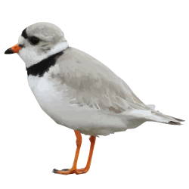
Hi, I’m Piper!
I am a Piping Plover, a small bird that spends every summer on the beach in Rockaway. I am an endangered species.
I’ve been wondering: what makes Rockaway so special? Let’s explore that question together today.
Hello!

Slide 9
Create your own map of Rockaway, and locate five key features.
Mapping Rockaway

Slide 10
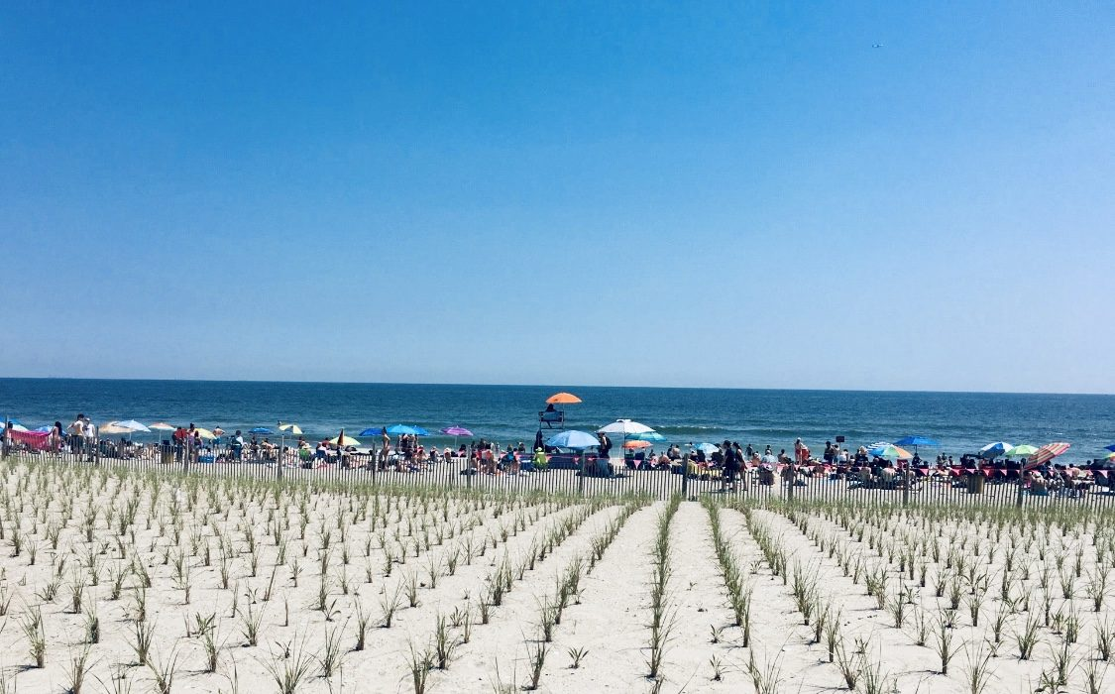
Did you know…
Rockaway Beach is the largest urban beach in the US?

Slide 11
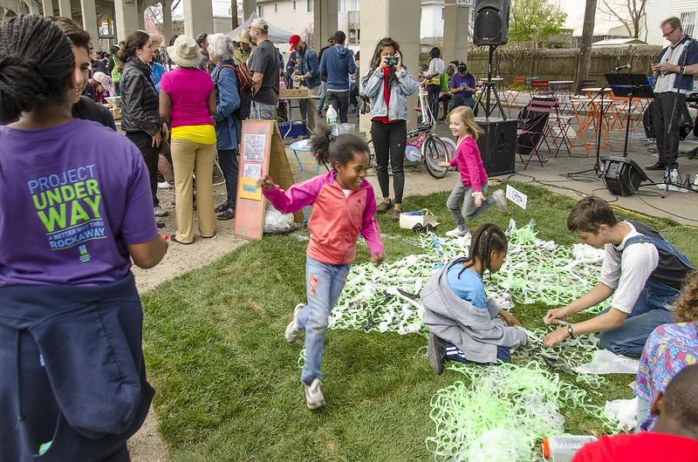
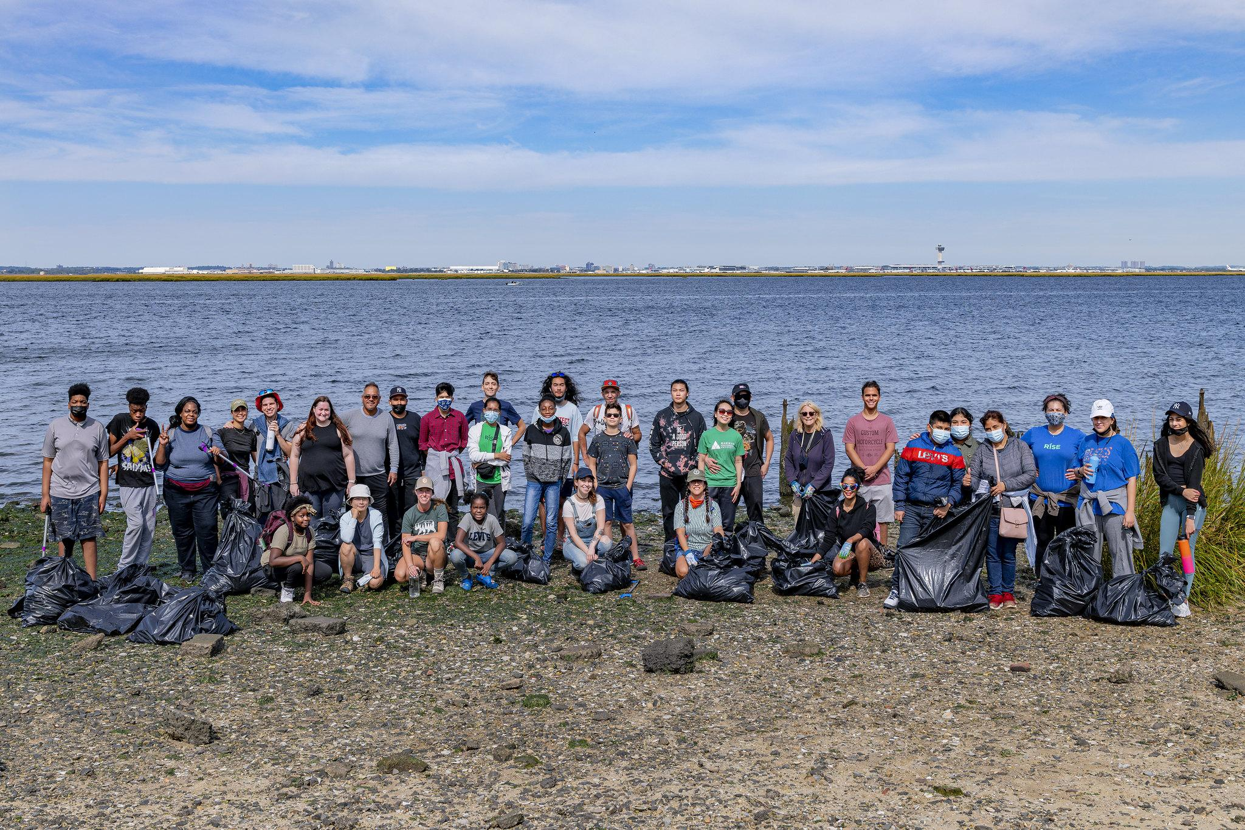
Did you know…
Queens holds the Guinness World Record for “most ethnically diverse urban area on the planet?”
Notes:
Photo source: RISE

Slide 12
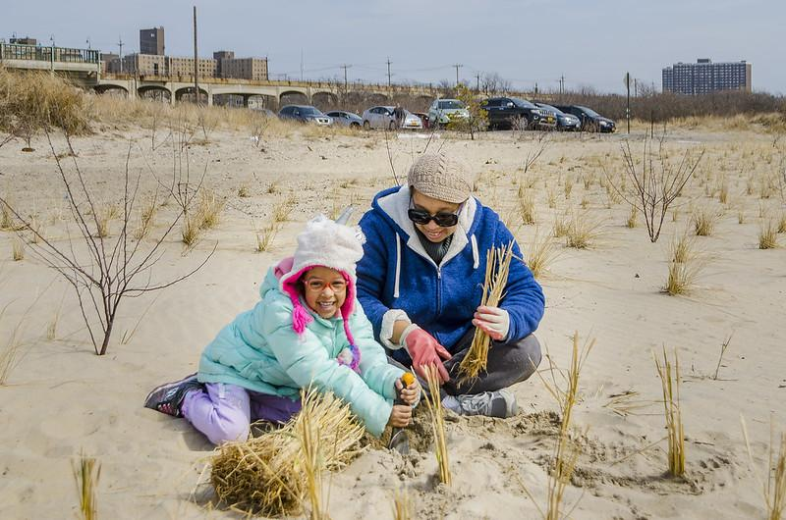
Did you know…
RISE serves thousands of students from 10 local schools every year!
There are over 1,300 native plant species in Rockaway?
Notes:
Photo Source: RISE
Fact sources: Jamaica Bay-Rockaway Parks Conservancy, RISE

Slide 13
Did you know…
There are only around 8,000 piping plovers left in the world– making them one of the most endangered shorebirds? :(
Notes:
Jamaica Bay is

Slide 14
Mapping Rockaway
How well do you think you know Rockaway? In this activity, we will create our own maps of Rockaway!

Slide 15
Mapping Rockaway
On the next few slides, I’ll explain different Rockaway features to add to your maps!

Slide 16
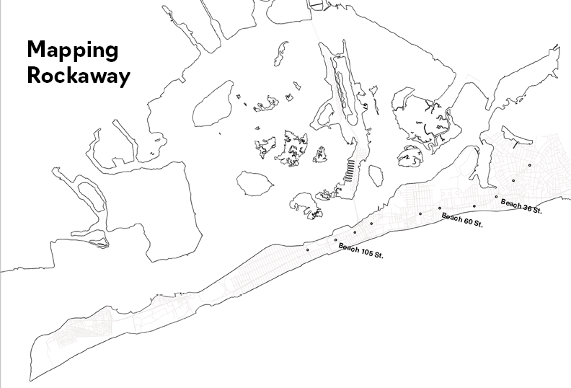
Mapping Rockaway
Get your map worksheets ready!

Slide 17
Feature 1: Peninsula
Question:
What is a peninsula?
Notes:
Apple plant drawing stock photos, royalty-free images, vectors, video (adobe.com)

Slide 18
Feature 1: Peninsula
Question:
What is a peninsula?
A body of land surrounded by water on three sides. Rockaway is a peninsula.
Notes:
Apple plant drawing stock photos, royalty-free images, vectors, video (adobe.com)

Slide 19
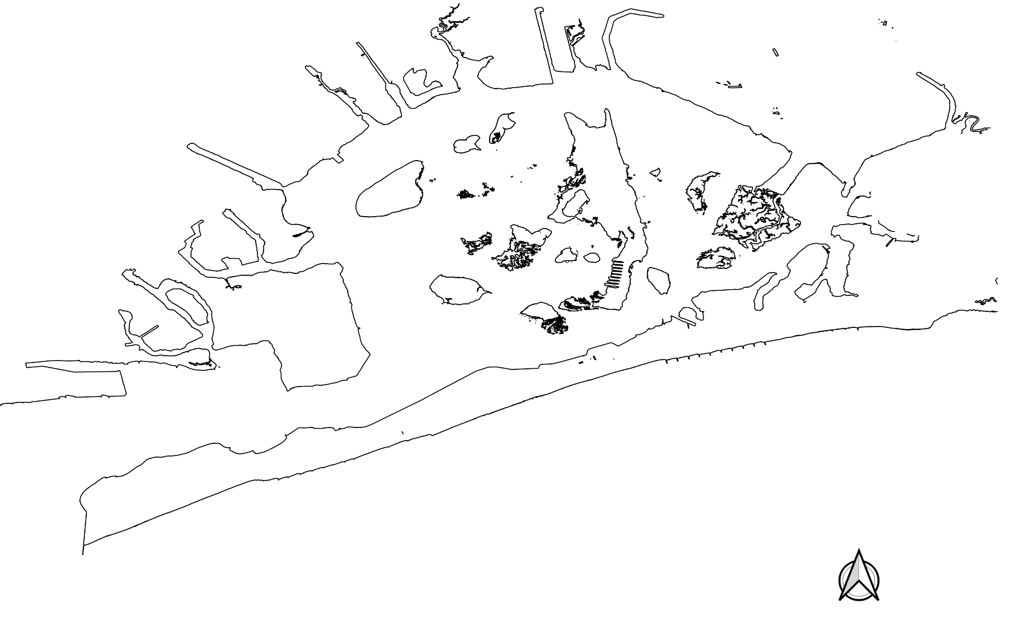
Feature 1: Peninsula
Add the outline of the Rockaway Peninsula to your map. Color it in, outline it, and/or label it.
Notes:
Apple plant drawing stock photos, royalty-free images, vectors, video (adobe.com)

Slide 20
Feature 2: Bay
Question:
What is a bay?
Notes:
Apple plant drawing stock photos, royalty-free images, vectors, video (adobe.com)

Slide 21
Feature 2: Bay
Question:
What is a bay?
A body of water that is partly surrounded by land. In Rockaway, our bay is called Jamaica Bay.
Notes:
Apple plant drawing stock photos, royalty-free images, vectors, video (adobe.com)

Slide 22
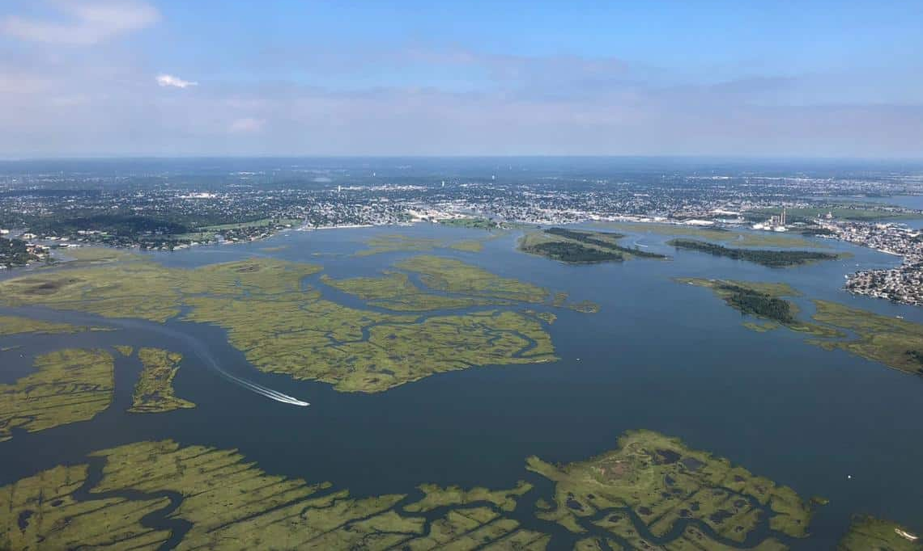
Feature 2: Bay
Here’s a pic from when I was flying over the bay the other day :)
Notes:
Photo source: US Geological Society

Slide 23
Feature 2: Bay
Add Jamaica Bay to your map of Rockaway.
Jamaica Bay includes islands, ponds, and meadowlands.
It is home to over 325 species of birds, 50 species of butterflies, and 100 species of fish.
Notes:
Apple plant drawing stock photos, royalty-free images, vectors, video (adobe.com)

Slide 24
Feature 3: Ocean
Question:
What ocean is Rockaway on?
Notes:
Apple plant drawing stock photos, royalty-free images, vectors, video (adobe.com)

Slide 25
Feature 3: Ocean
Question:
What ocean is Rockaway on?
The Atlantic Ocean
Notes:
Apple plant drawing stock photos, royalty-free images, vectors, video (adobe.com)

Slide 26
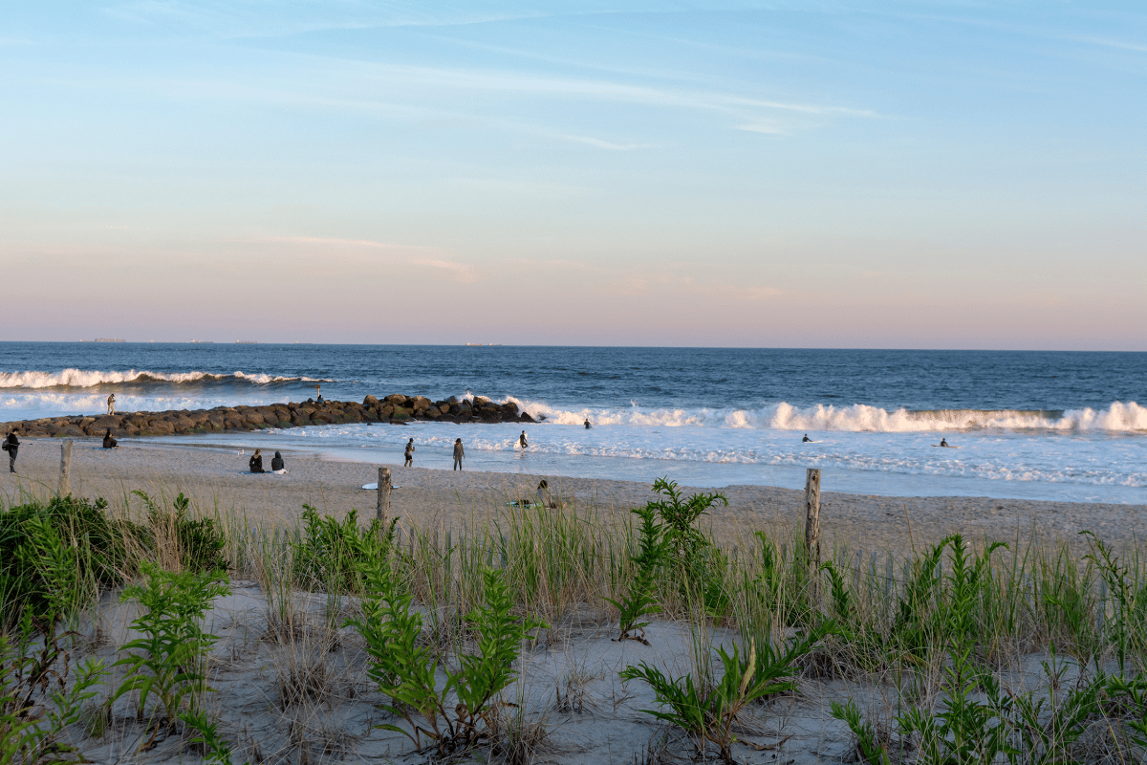
Feature 3: Ocean
Here’s some surfers I saw the other day. The Atlantic Ocean creates some nice waves sometimes!
Notes:
Photo source: Secret NYC

Slide 27
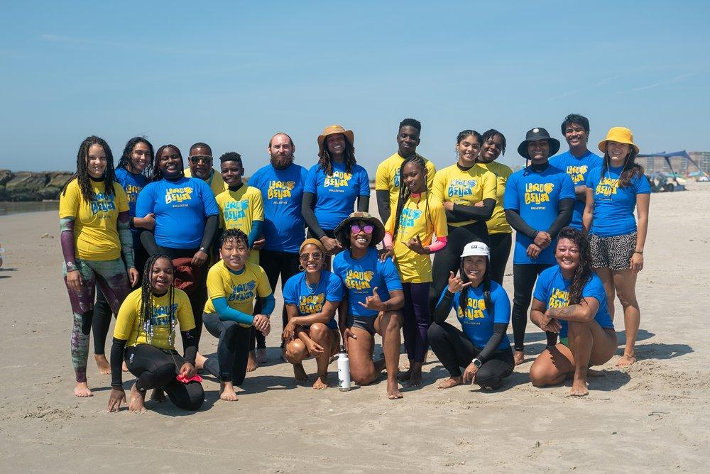
Feature 3: Ocean
Laru Beya works with young people in the Rockaways to teach surfing classes! 👀👀👀
Notes:
Photo source: Secret NYC

Slide 28
Feature 3: Ocean
Add the Atlantic Ocean to your map of Rockaway.
Did you know Humpback whales migrate through the Atlantic Ocean near Rockaway?
Notes:
Apple plant drawing stock photos, royalty-free images, vectors, video (adobe.com)

Slide 29
Feature 4: Beach
Question:
What can we find on the beach in Rockaway?
Notes:
Apple plant drawing stock photos, royalty-free images, vectors, video (adobe.com)

Slide 30
Feature 4: Beach
Question:
What can we find on the beach in Rockaway?
Playgrounds, outdoor activities, concessions, surfers, a boardwalk, plants, animals…What else have you seen?
Notes:
Apple plant drawing stock photos, royalty-free images, vectors, video (adobe.com)

Slide 31
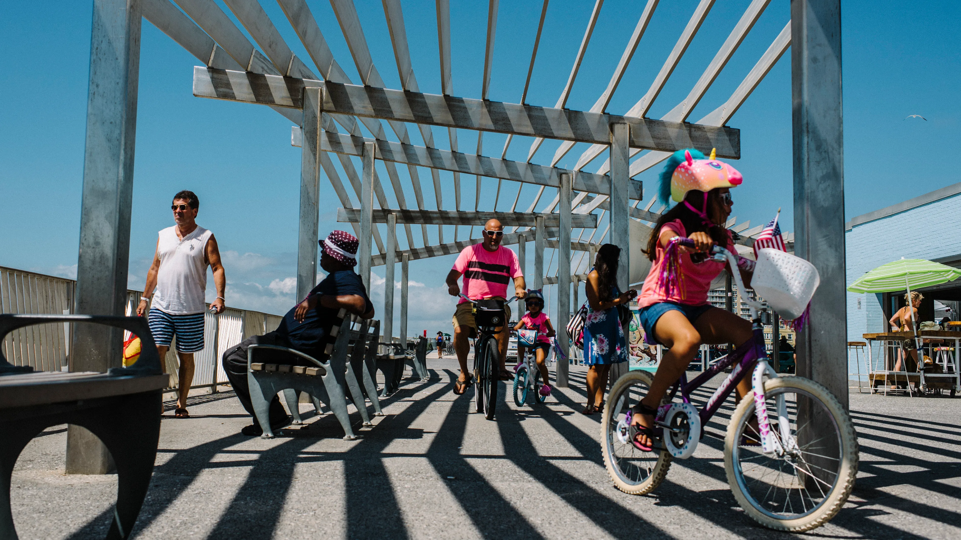
Feature 4: Beach
Rockaway Beach features a boardwalk with bike lanes, several concessions stands, and food vendors. Have you been there?
Notes:
Photo source: Bon Appetit

Slide 32
Feature 4: Beach
Add the beach to your map of Rockaway.
Can you add the boardwalk? What other features do you want to include?
Notes:
Apple plant drawing stock photos, royalty-free images, vectors, video (adobe.com)

Slide 33
Feature 5: Dunes
Question:
What is a dune?
Notes:
Apple plant drawing stock photos, royalty-free images, vectors, video (adobe.com)

Slide 34
Feature 5: Dunes
Question:
What is a dune?
Mounds of sand that form as the wind carries sand from the beach towards land.
Notes:
Apple plant drawing stock photos, royalty-free images, vectors, video (adobe.com)

Slide 35
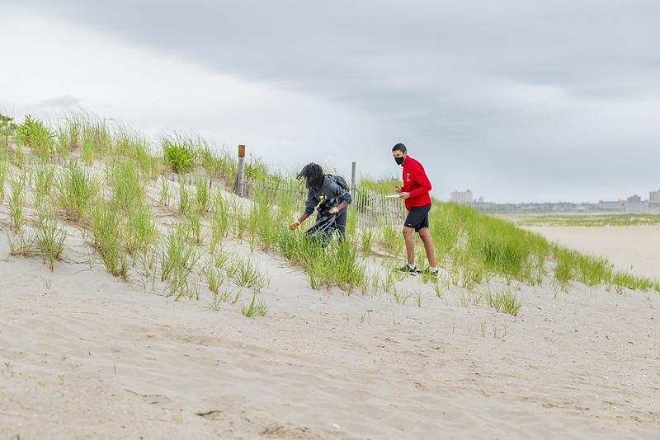
Feature 5: Dunes
Did you know dunes are one of our first lines of defense against large waves or flooding from storms?
Notes:
Photo source: RISE

Slide 36
Feature 5: Dunes
Add the dunes to your map of Rockaway.
We will be learning a lot more about dunes in a few minutes!
Notes:
Apple plant drawing stock photos, royalty-free images, vectors, video (adobe.com)

Slide 37
Personalize your map!
Okay now it’s your turn!
Add any other features you want to your map:
Your school
Your house
Landmarks
Businesses
Animals or plants
People
Notes:
Apple plant drawing stock photos, royalty-free images, vectors, video (adobe.com)

Slide 38
Think, Pair, Share
Discuss with a partner or small group:
Did you learn anything new about Rockaway in this activity?
What did you add to your map?
What do you think makes Rockaway special?
Notes:
Apple plant drawing stock photos, royalty-free images, vectors, video (adobe.com)

Slide 39
What challenges are we facing in our community and what are some possible solutions?
Climate Resilience in Rockaway

Slide 40
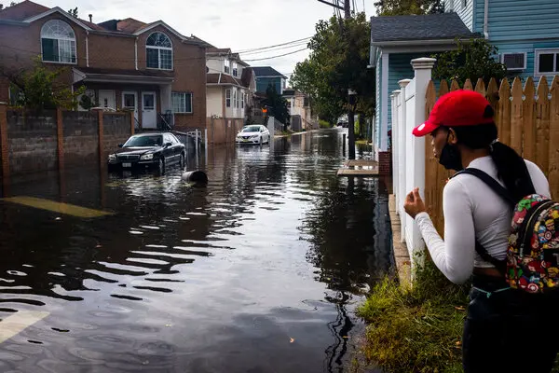
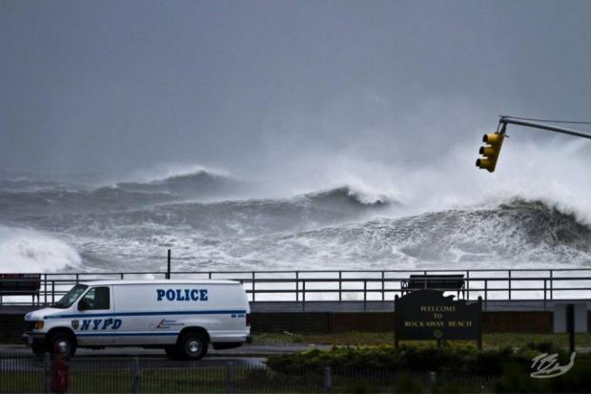
Climate Change Challenges
Sunny day or high tide flooding: flooding that happens during high tide, without a storm present. This kind of flooding is becoming increasingly common in coastal communities as sea levels rise.
Storm surge: rise in sea levels caused by intense winds during a storm. Climate change is making storms more frequent and severe.

Slide 41
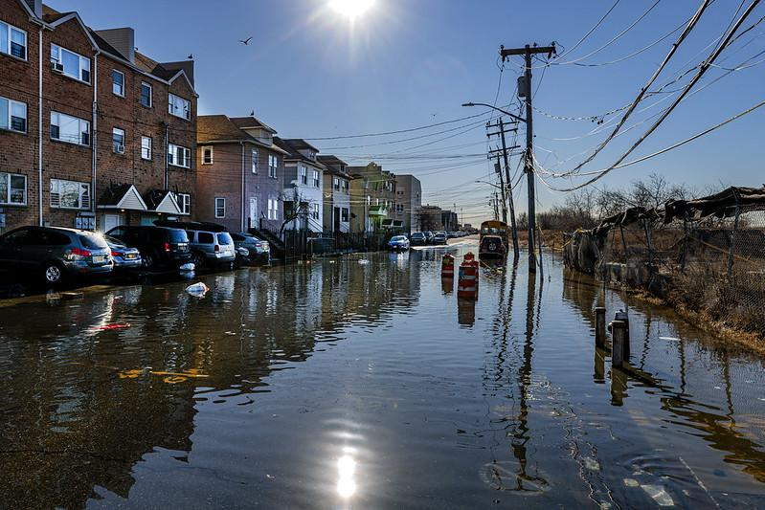
Climate Change Challenges
Question:
Do you think this sunny day flooding or storm surge?
Notes:
Photo source: RISE

Slide 42
Climate Change Challenges
Answer:
Sunny day flooding
Notes:
Photo source: RISE

Slide 43
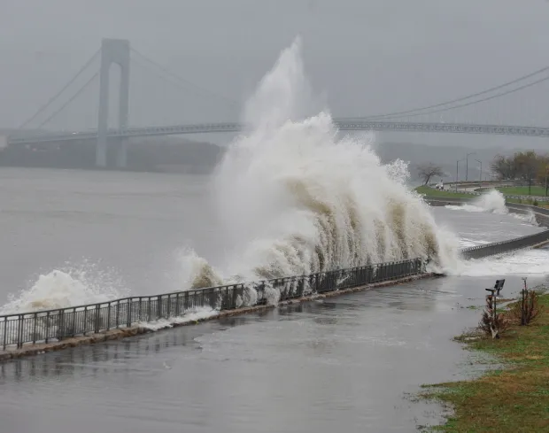
Climate Change Challenges
Question:
Do you think this sunny day flooding or storm surge?
Notes:
Photo source: NY Daily News

Slide 44
Climate Change Challenges
Answer:
Storm surge
Notes:
Photo source: NY Daily News

Slide 45
Climate Change Challenges
Have you seen either of these challenges before?
Notes:
Apple plant drawing stock photos, royalty-free images, vectors, video (adobe.com)

Slide 46
Climate Change Challenges
What have you heard about Superstorm Sandy?
Notes:
Apple plant drawing stock photos, royalty-free images, vectors, video (adobe.com)

Slide 47
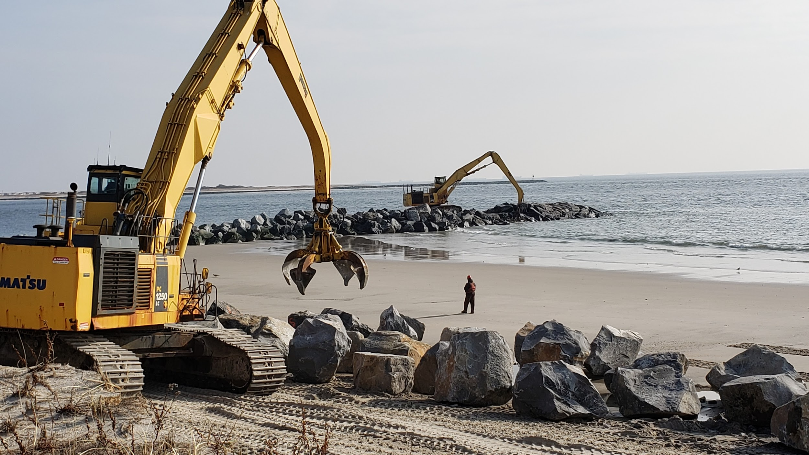
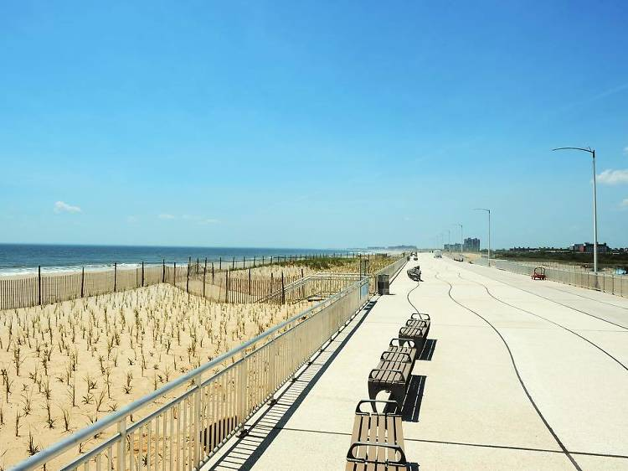
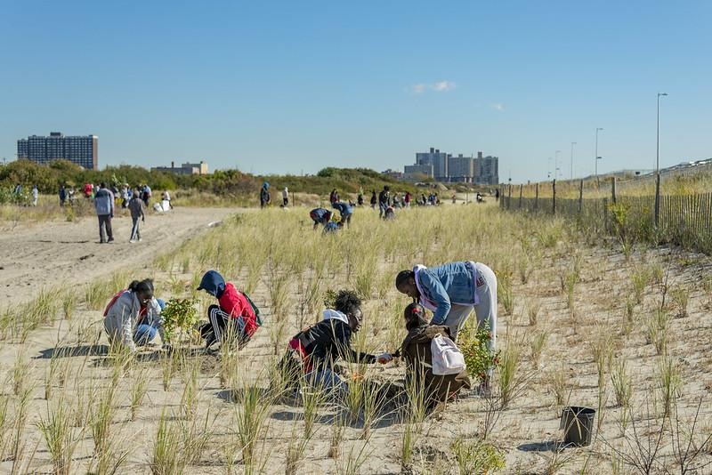
Resilience Strategies
Today, we will explore three resilience strategies taking place in Rockaway.
USACE Resiliency Plan
Boardwalk
Dune Restoration

Slide 48
Strategy: USACE Resiliency Plan
Notes:
Apple plant drawing stock photos, royalty-free images, vectors, video (adobe.com)

Slide 49
Climate Resilience Strategies
Have you seen US Army Corps working on the beach?

Slide 50
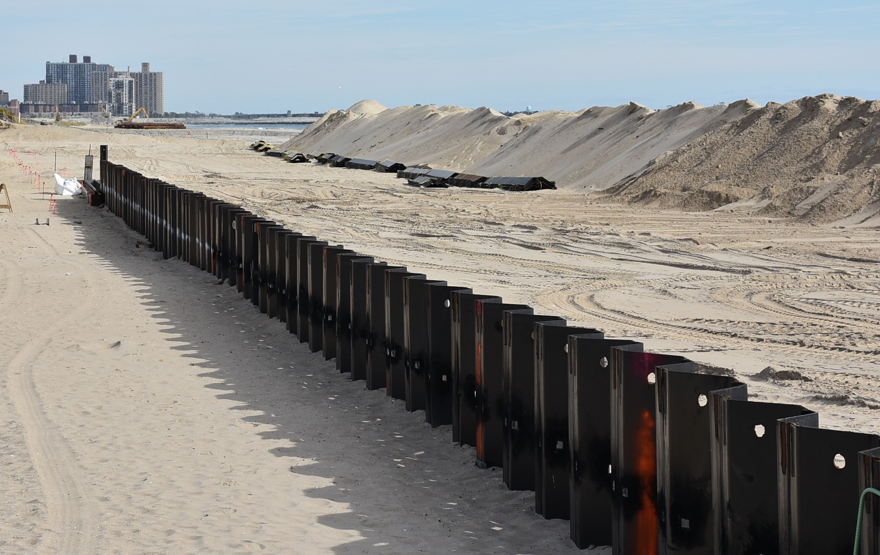
Strategy: USACE Resiliency Plan
US Army Corps is working to make Rockaway more resilient through…
Groins
Engineered dunes
Reinforced dunes/sea wall
Groins
Reinforced dunes/sea wall
Notes:
The US Army Corps of Engineers began their efforts to make the Rockaway coast more resilient in 2013, in response to Superstorm Sandy.
1. Groins are stone structures meant to trap sand and slow down beach erosion (or, wearing away of the sand). The Army Corps constructed 14 new groins as part of this work.
2. Engineered dunes: the Army Corps is installing sand to create new dunes. This is part of a process called “beach replenishment.”
3. Reinforced dunes/sea wall: they are also adding sheet pile beneath the dunes to make them stronger and create a sea wall to protect against storm surge and sea level rise
This webpage includes an announcement from USACE and some photos of the work in progress: https://www.nad.usace.army.mil/Media/News-Releases/Article/3785503/rockaway-kicks-off-beach-season-as-work-resumes/

Slide 51
Strategy: Boardwalk

Slide 52
Climate Resilience Strategies
Have you been to the Boardwalk? What did you observe there?
Notes:
[Select 1-2 students to share]

Slide 53
Strategy: Boardwalk
The Rockaway Beach boardwalk was redesigned after Sandy to make the coastline more resilient.
The project included fences, plants, and walkways to protect the dunes.

Slide 54
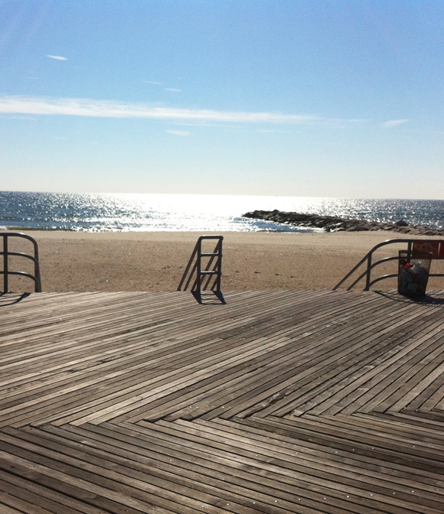
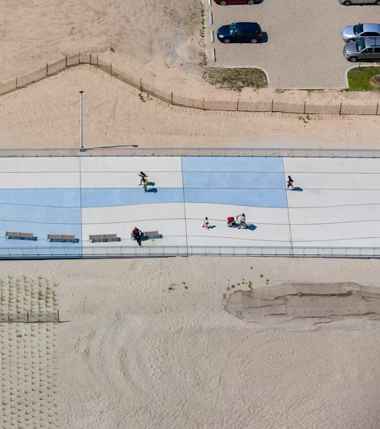
Strategy: Boardwalk
The new boardwalk is elevated above the flood line, and is built to withstand future storms.
Before
After
Notes:
The new boardwalk was designed to provide better protection for Rockaway.
The new reinforced concrete boardwalk is elevated above the 100-year floodplain, and is supplemented with over four and a half miles of retaining walls and planted sand dunes.
The new boardwalk also features amenities, gathering places, and public seating.
As shown in the photo on this slide, the old boardwalk was constructed out of teakwood and wasn't raised like the rebuilt/current boardwalk.

Slide 55
Strategy: Dune Restoration
Notes:
Dune restoration involves planting native plants on sand dunes to make them stronger

Slide 56
Climate Resilience Strategies
Have you seen or participated in a dune planting before?
Notes:
[Select 1-2 students to share]

Slide 57
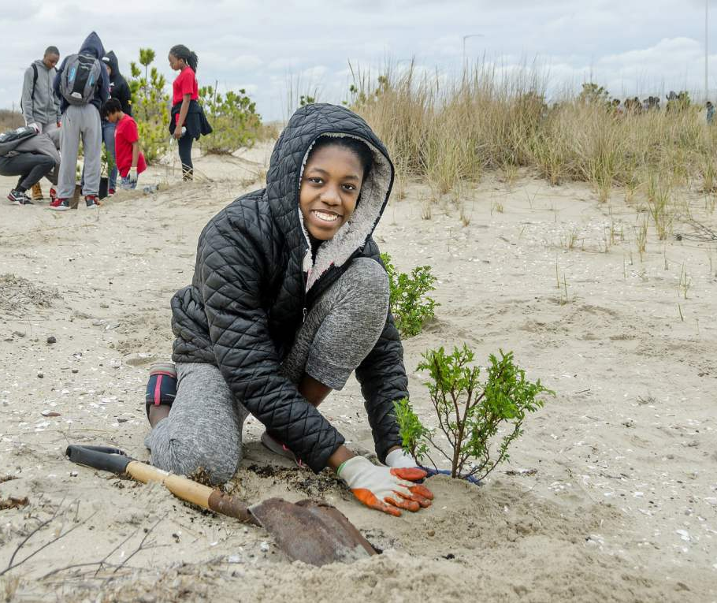
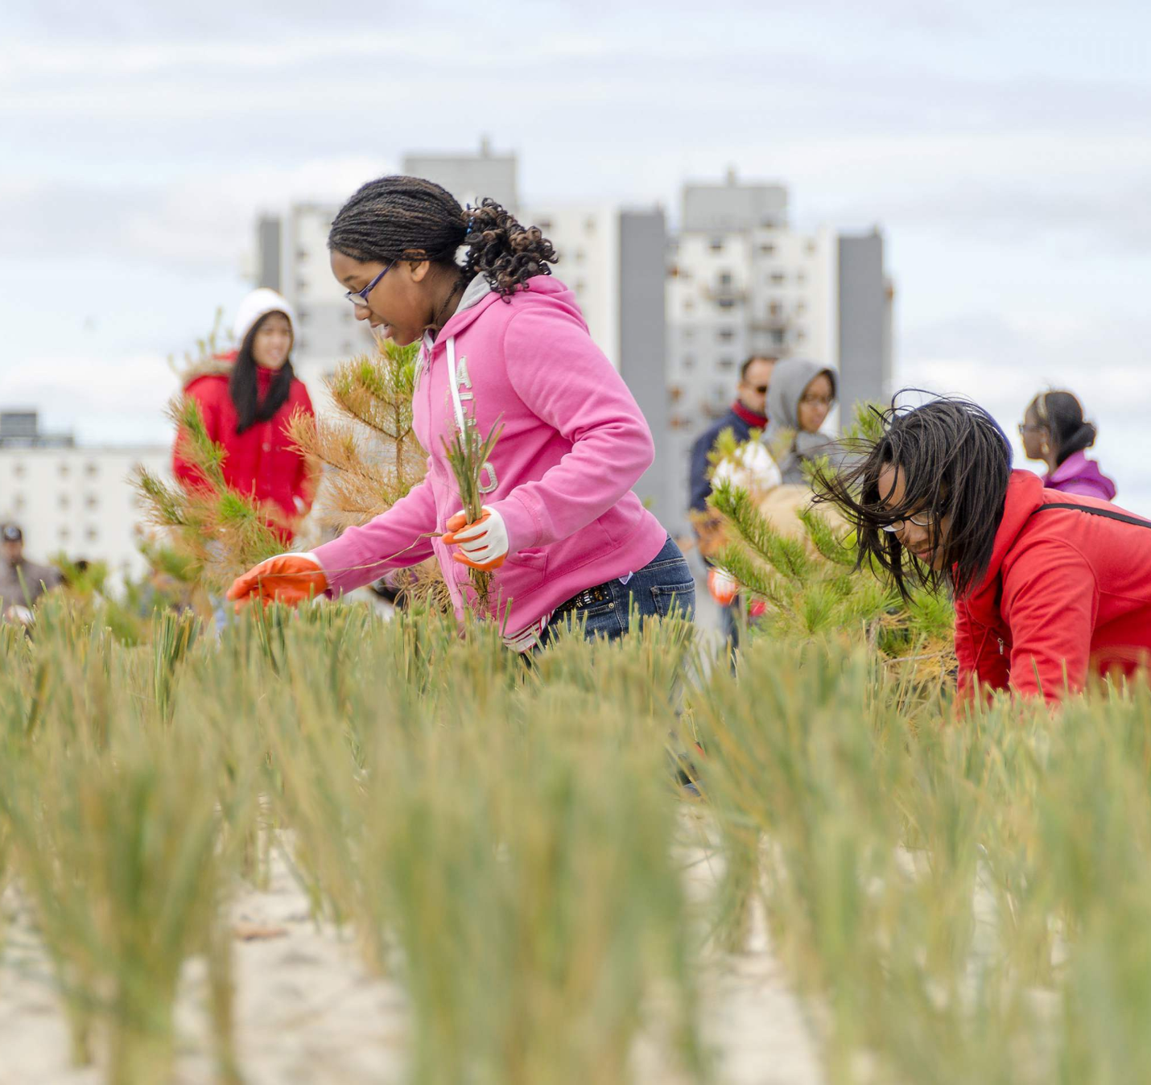
Strategy: Dune Restoration
Planting and maintaining native plants on the dunes is another way to protect Rockaway from flooding and storms.
Notes:
As we will discuss more in a few minutes, dunes play an important role in keeping coastal communities safe from storms and flooding
Plants are very important to keep dunes strong and healthy and to prevent erosion (or, when dunes break down and lose sand over time)
RISE (Rockaway Initiative for Sustainability and Equity) is a local non-profit that organizes beach clean-ups and dune plantings with the greater Rockaway community

Slide 58
Climate Resilience Strategies
Can you think of any other strategies that make Rockaway more resilient to flooding and storm surge?
Notes:
[Select 1-2 students to share]

Slide 59
Learn about a a very important part of our ecosystem!
What are dunes?

Slide 60
What kind of dune is this?
Sand dunes can be found in two places: in deserts, and in coastal areas and beaches. See if you can guess what kind of dune is shown in the following pictures.
Let’s play a guessing game!

Slide 61
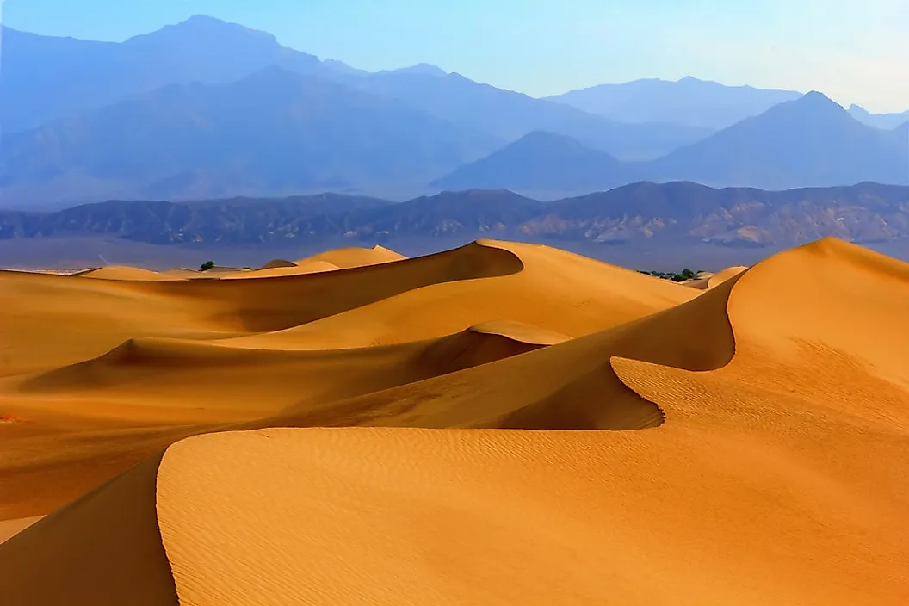
What kind of dune is this?
What kind of dune is this?
Desert dune
Beach dune
Dune the movie
Notes:
Apple plant drawing stock photos, royalty-free images, vectors, video (adobe.com)

Slide 62
What kind of dune is this?
What kind of dune is this?
Desert dune
Beach dune
Dune the movie
Notes:
Apple plant drawing stock photos, royalty-free images, vectors, video (adobe.com)

Slide 63
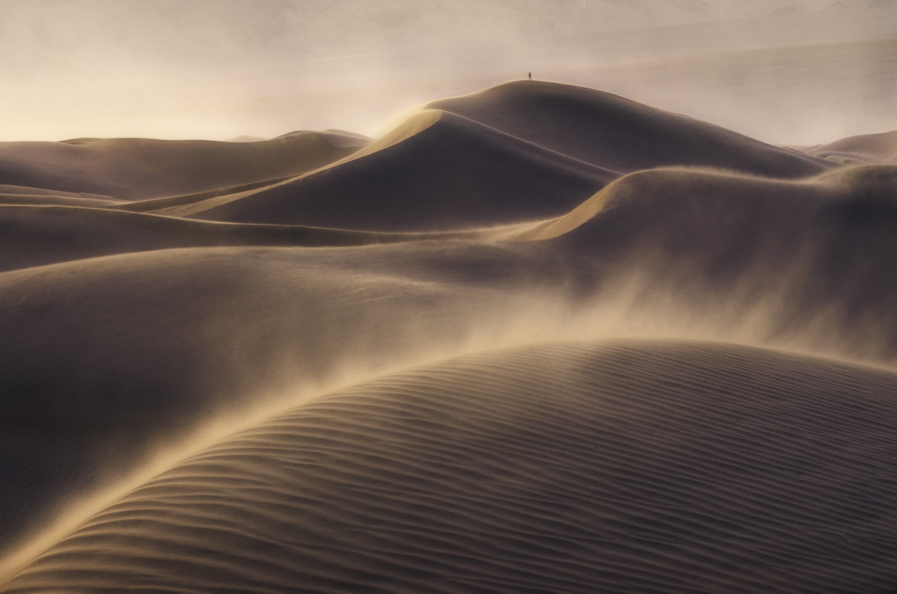
What kind of dune is this?
What kind of dune is this?
Desert dune
Beach dune
Dune the movie
Notes:
Apple plant drawing stock photos, royalty-free images, vectors, video (adobe.com)

Slide 64
What kind of dune is this?
What kind of dune is this?
Desert dune
Beach dune
Dune the movie
Notes:
Apple plant drawing stock photos, royalty-free images, vectors, video (adobe.com)

Slide 65
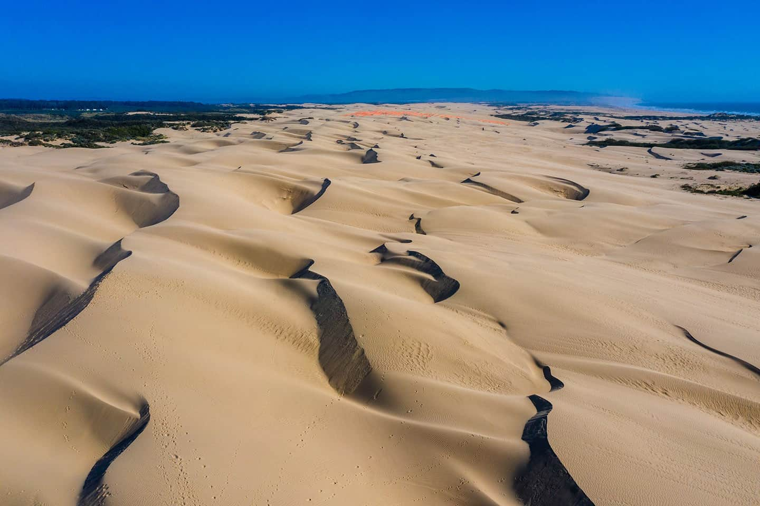
What kind of dune is this?
What kind of dune is this?
Desert dune
Beach dune
Dune the movie
Notes:
Apple plant drawing stock photos, royalty-free images, vectors, video (adobe.com)

Slide 66
What kind of dune is this?
What kind of dune is this?
Desert dune
Beach dune
Dune the movie
Notes:
Apple plant drawing stock photos, royalty-free images, vectors, video (adobe.com)

Slide 67
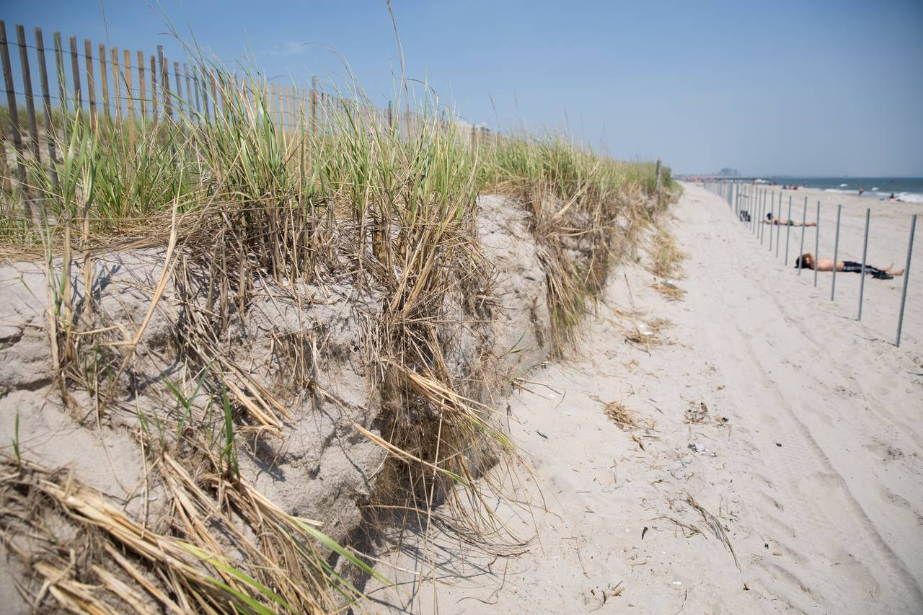
What kind of dune is this?
What kind of dune is this?
Desert dune
Beach dune
Dune the movie
Notes:
Apple plant drawing stock photos, royalty-free images, vectors, video (adobe.com)

Slide 68
What kind of dune is this?
What kind of dune is this?
Desert dune
Beach dune
Dune the movie
This dune is on Rockaway Beach!
Notes:
Apple plant drawing stock photos, royalty-free images, vectors, video (adobe.com)

Slide 69
What is a beach dune?
A mound of sand formed over time by the wind
Plants grow on dunes, and their deep roots help the dune grow and stay strong
Dunes are the “first line of defense” during coastal storms and high waves
Dune!

Slide 70
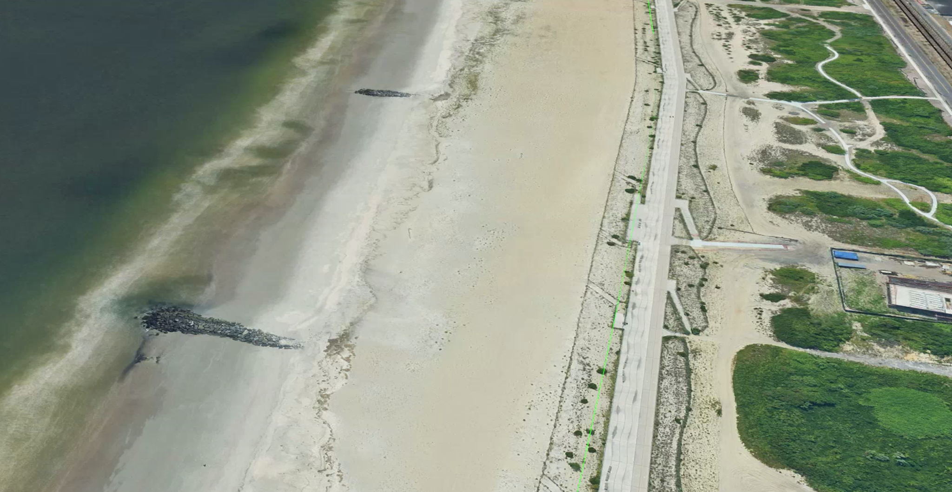
What is a beach dune?
In Rockaway, there are four main parts of the beach.
Secondary
Dune
Primary Dune
Lower Beach
High Beach
BOARDWALK
Notes:
In Rockaway, there are four main parts of the beach:
Lower beach: this is the part of the beach that is closest to the ocean, and least stable. The sand here moves often due to wind and waves.
High beach: farther from the ocean, this part of the beach includes more stable sand and includes small dunes that are just starting to form
Primary dune: these are defined dunes with smaller plants; primary dunes are the first line of defense, and are less strong than secondary dunes since the plant root systems are smaller.
Secondary dune: secondary dunes are farthest from the ocean and most stable. They have the most diverse plant communities, including larger plants with deep roots that help to hold the dunes in place. In Rockaway, the secondary dunes are to the north of the boardwalk.

Slide 71
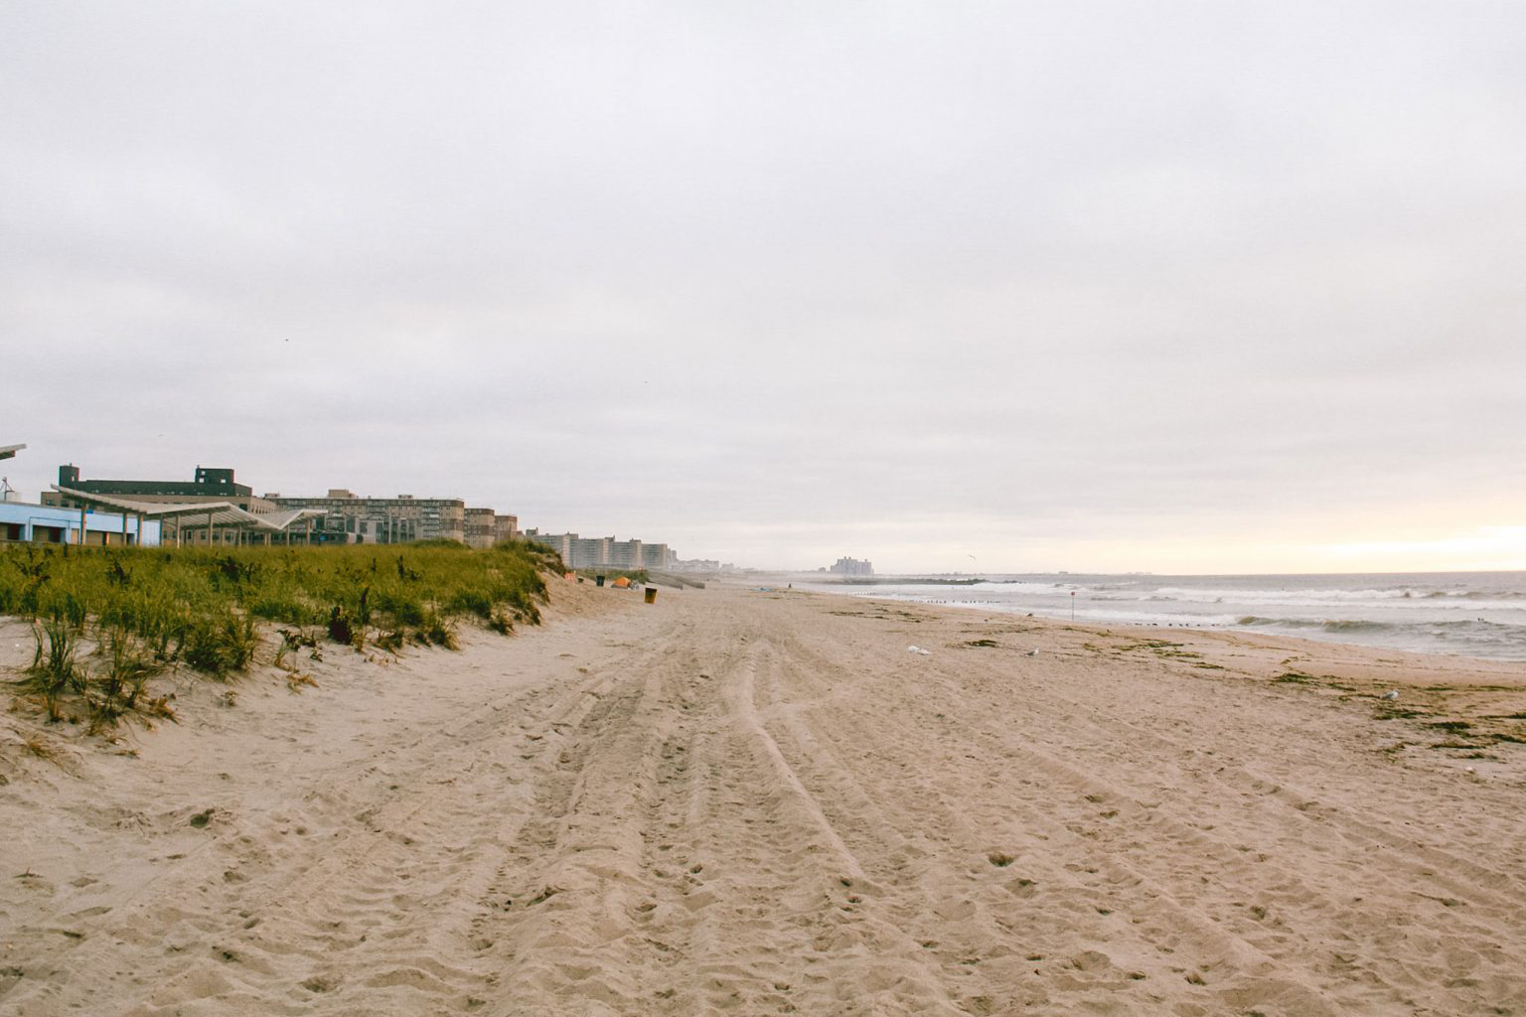
What is a beach dune?
Here’s another look with the first three parts.
Lower Beach
Primary Dune
High Beach
Notes:
Here is a closer look at these different parts of the beach.
In this photo, the secondary dunes would be to the right of the photo, north of the boardwalk.
However, in some parts of Rockaway, there are only primary dunes, not secondary ones.
This is generally true where there is development on the secondary dune habitat.
In places like Fort Tilden and the Arverne East nature preserve, there are extensive secondary dunes.

Slide 72
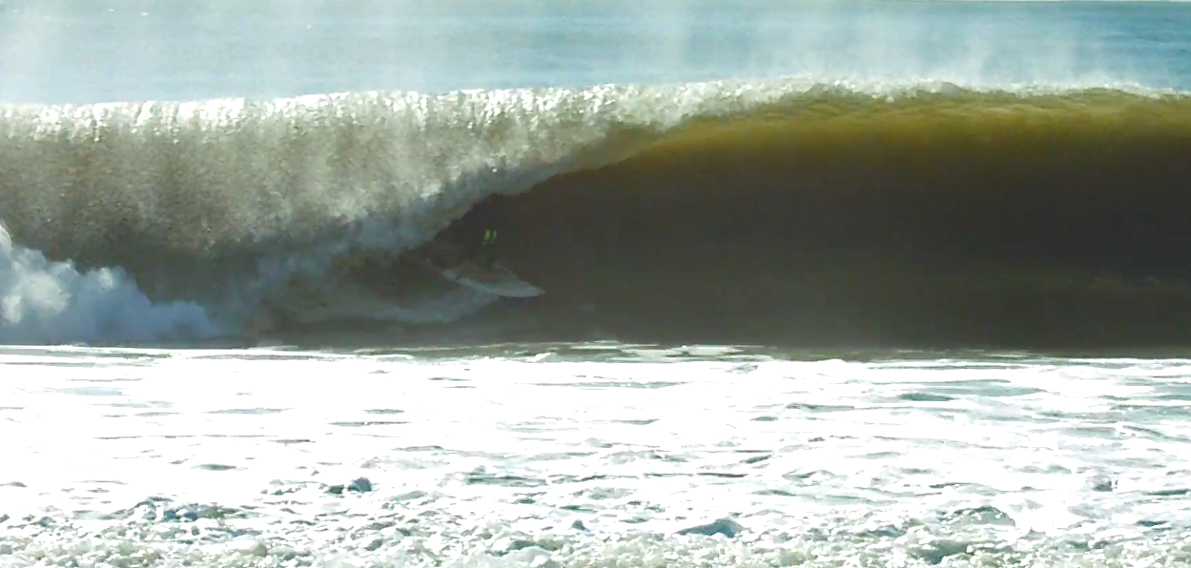
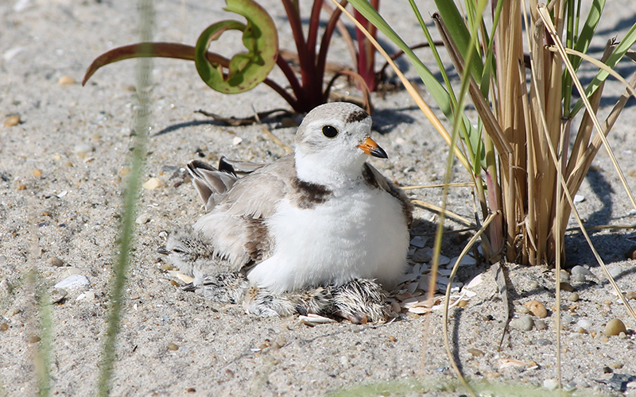
Why are dunes important?
Protection
Habitat
Notes:
Dunes serve two important roles in the beach ecosystem:
1. Protection: dunes protect plants, animals, and humans from high waves and storms. They help prevent flooding and damage to buildings.
Coastal communities with healthy sand dunes often see less damage during storms.
2. Habitat: dunes are a home for many animals and plants. Some birds, sea turtles, and other animals make their nests in dunes.
Photo sources: WildLife NYC

Slide 73
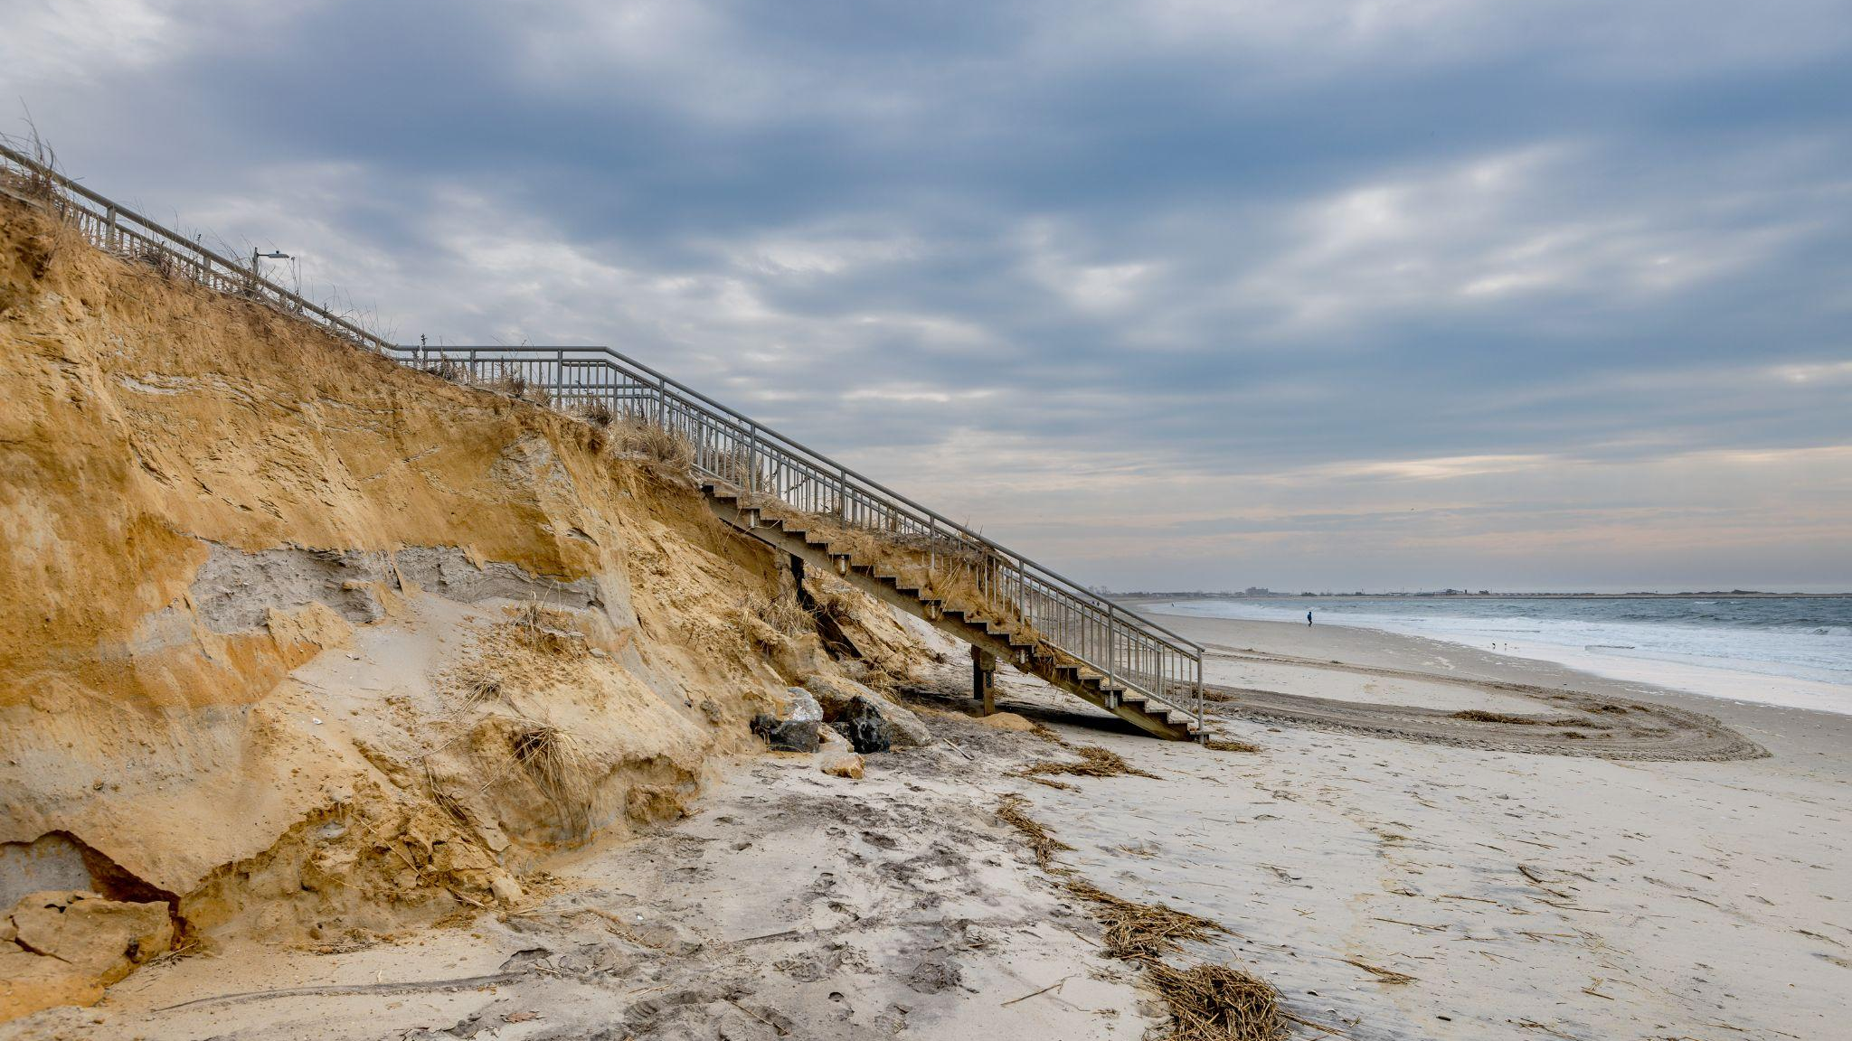
Strong roots help protect against dune erosion…
Erosion

Slide 74
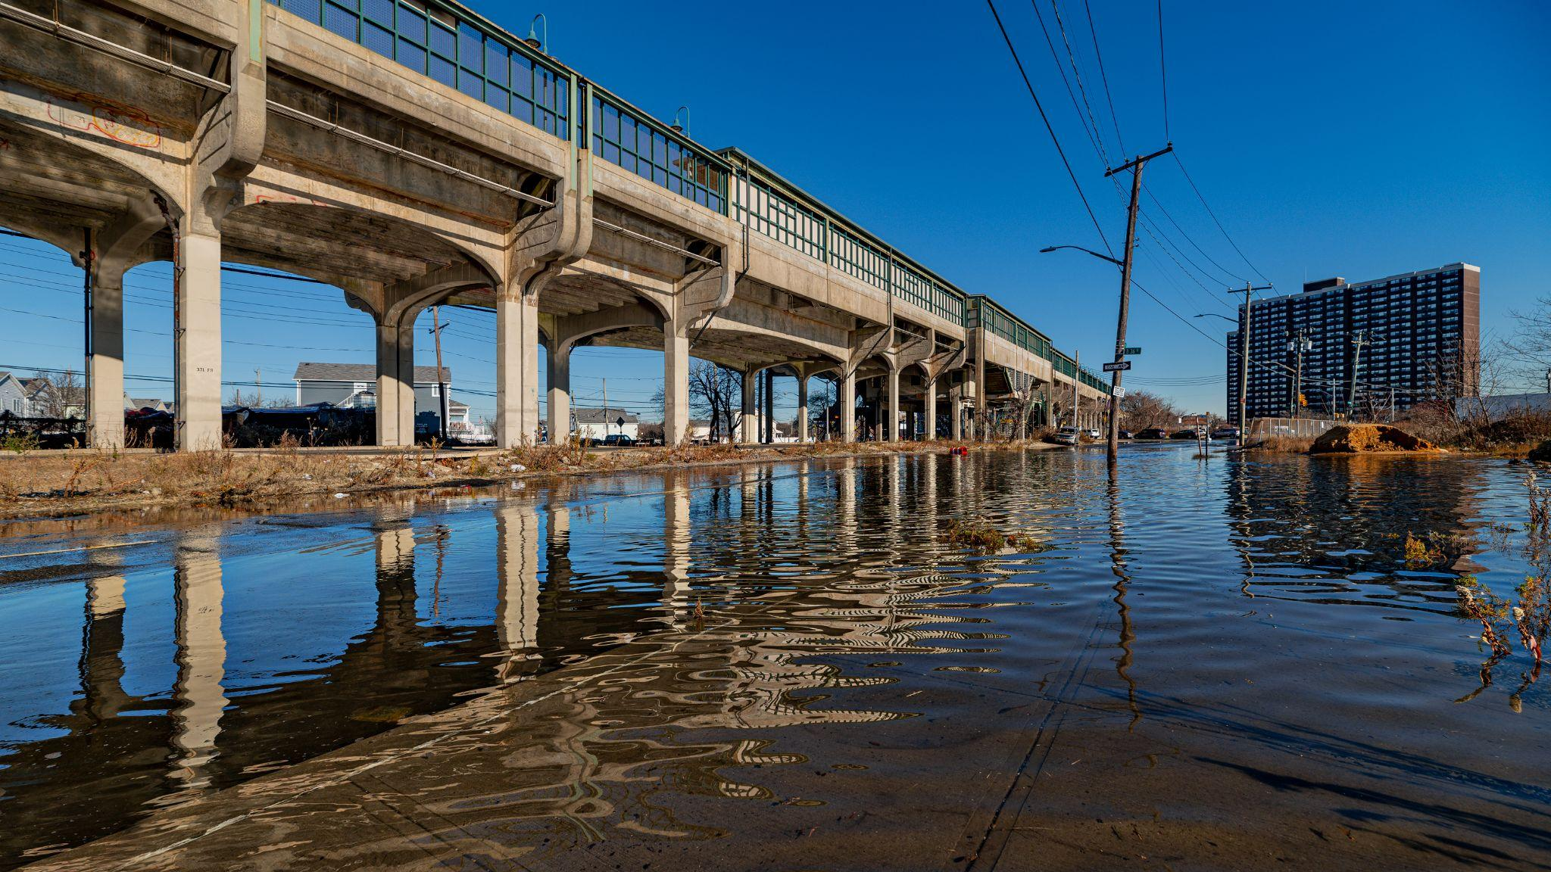
…which protects our community against flooding!

Slide 75
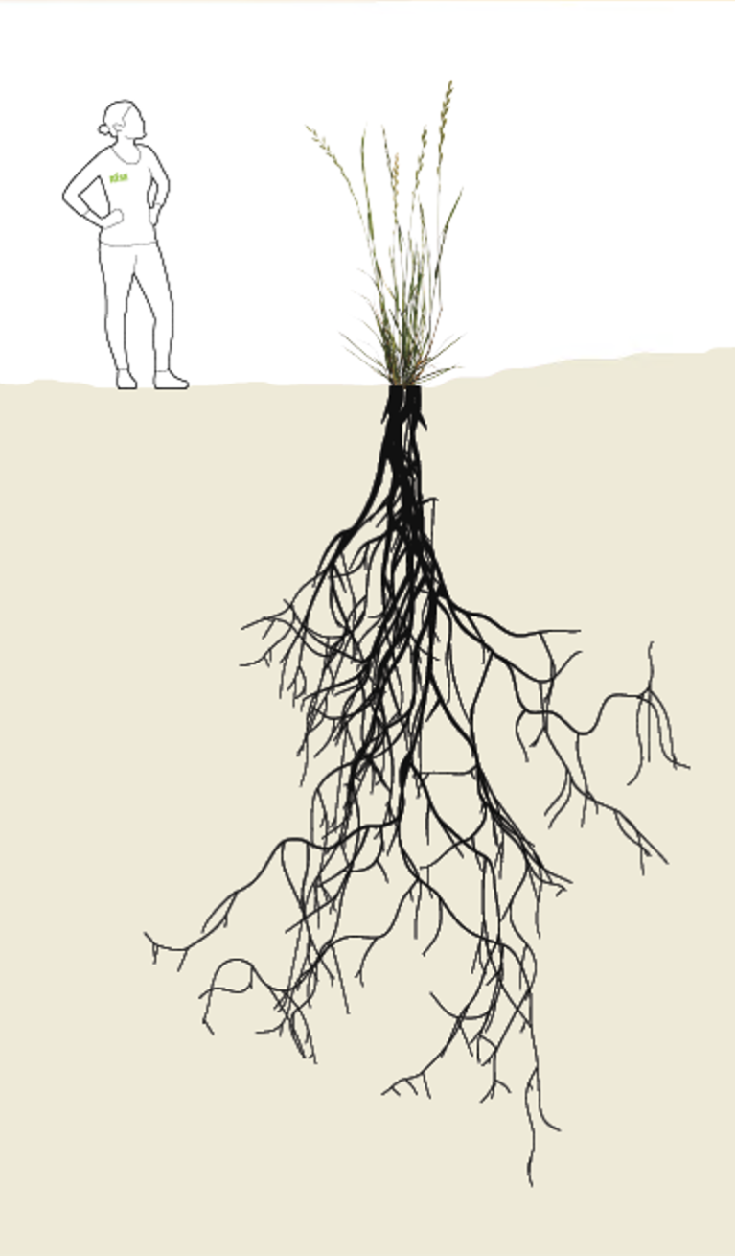
Guess the length of the roots
Roots keep the dunes strong! How long do you think the roots are on this American Beach Grass?

Slide 76
Guess the length of the roots
The roots of this American Beach Grass are 20 feet long.

Slide 77
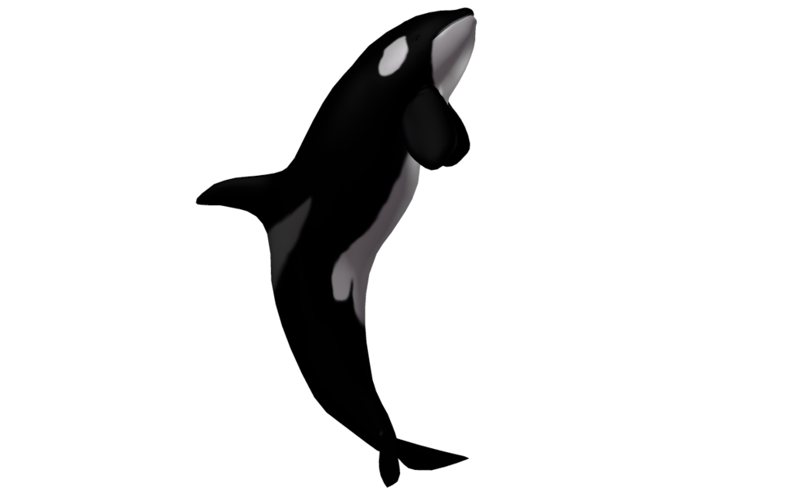
Guess the length of the roots
That’s almost as tall as a killer whale!

Slide 78
How can we work together to take care of our local environment?
Local stewardship

Slide 79
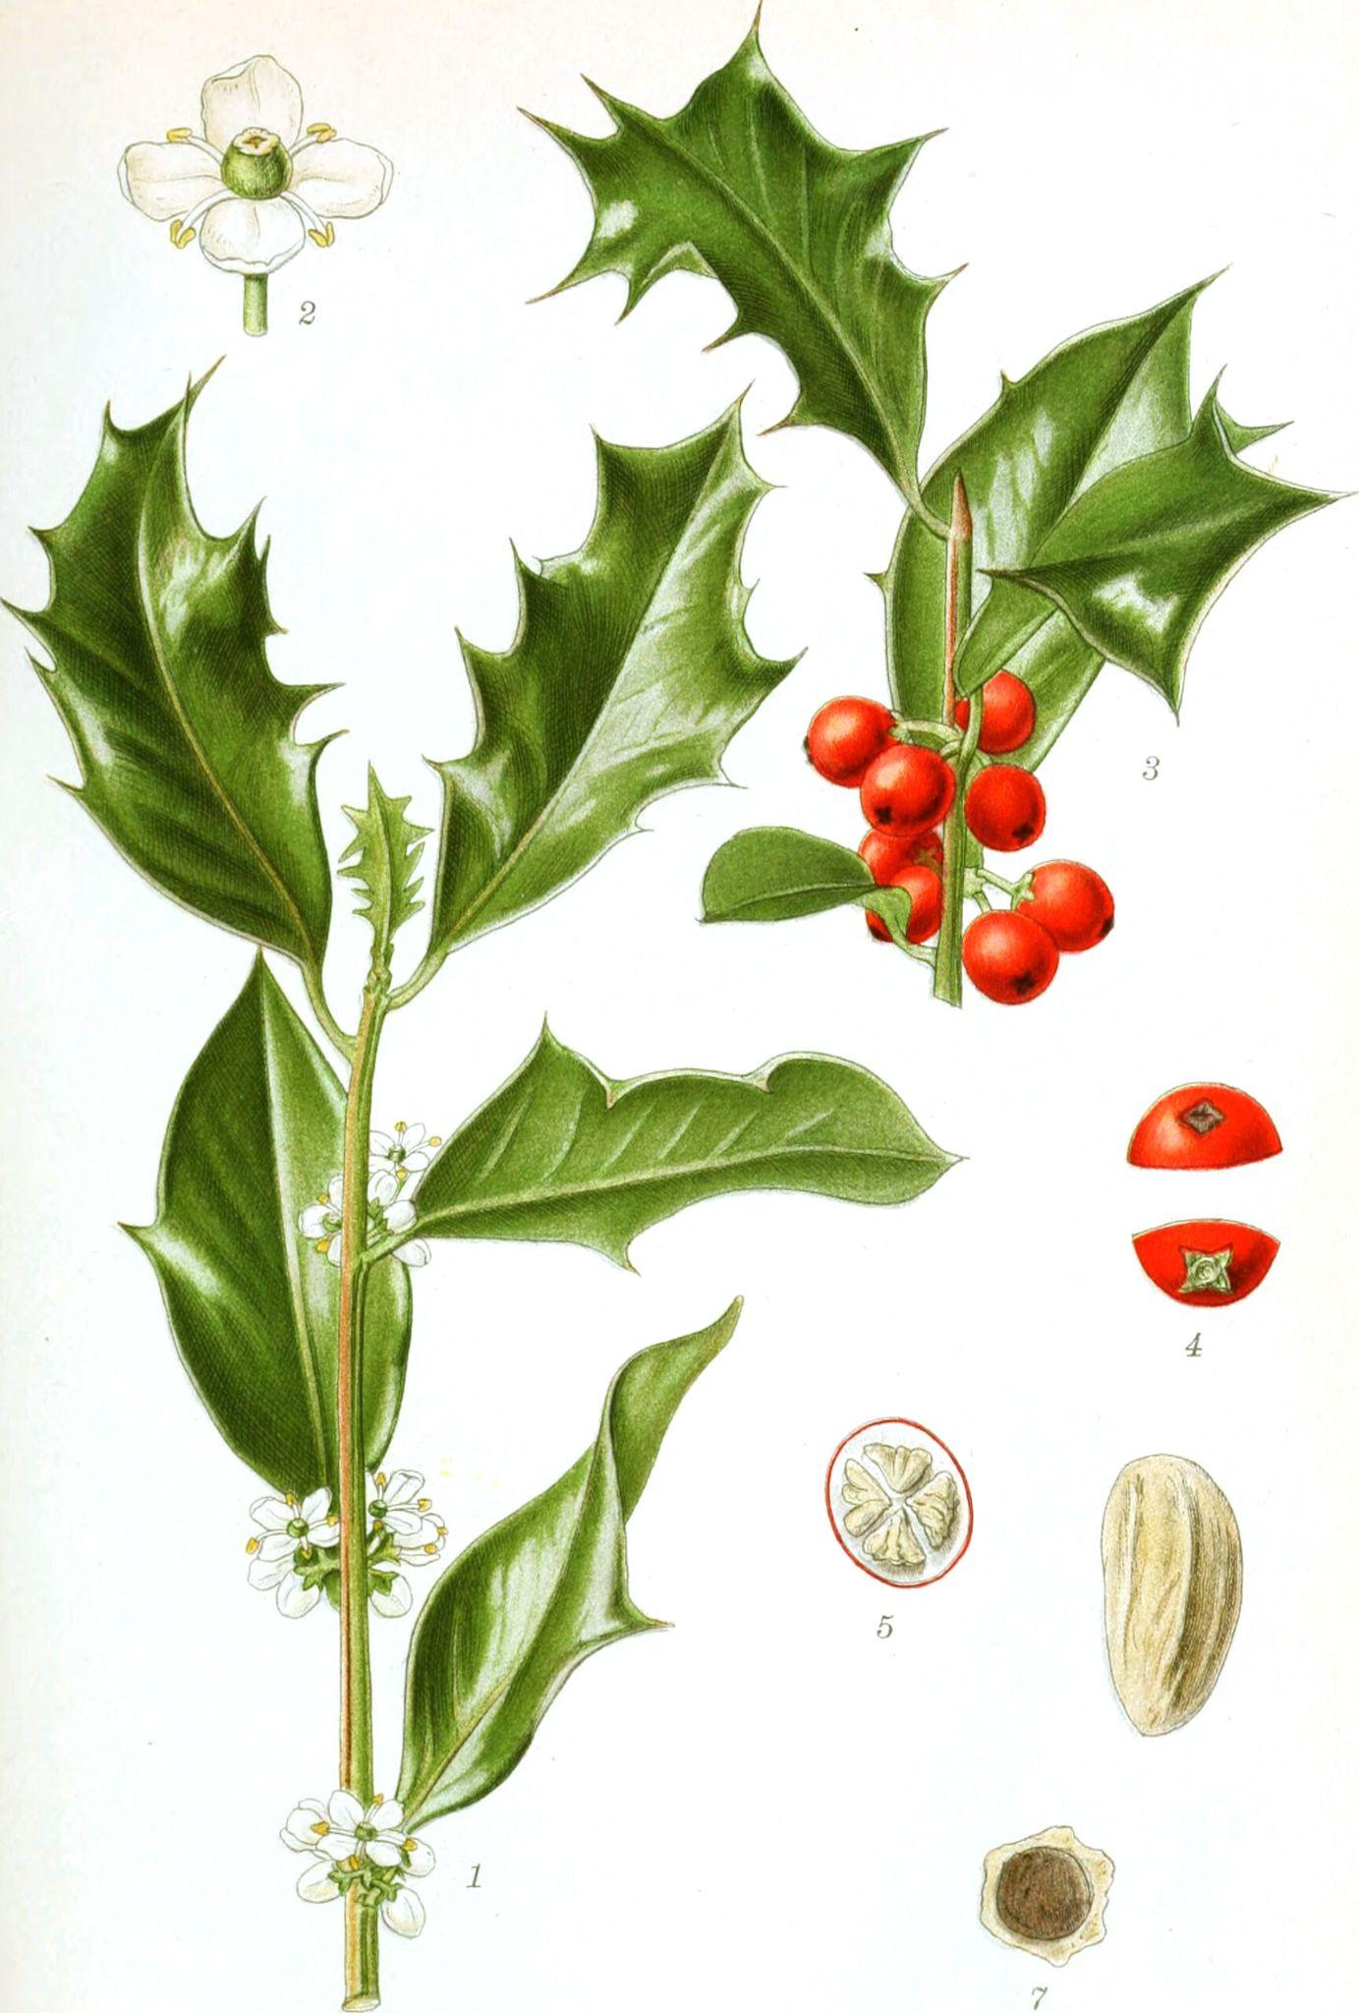
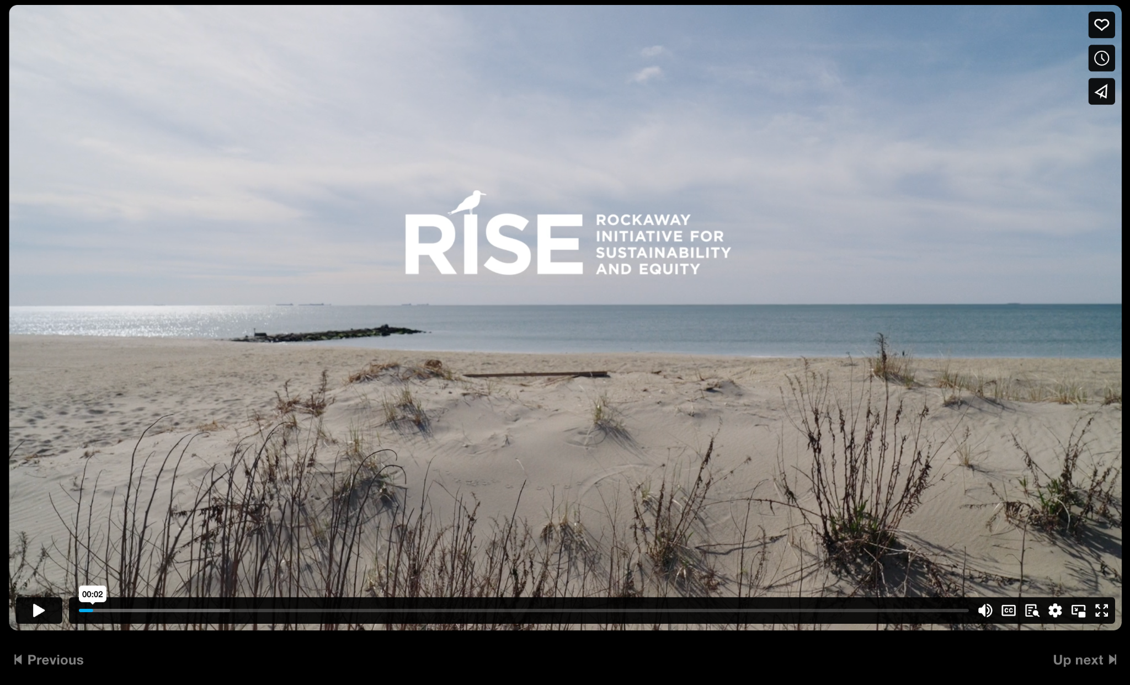
Introduction to Stewardship
Click to play video
(play from 1:28 to end)

Slide 80
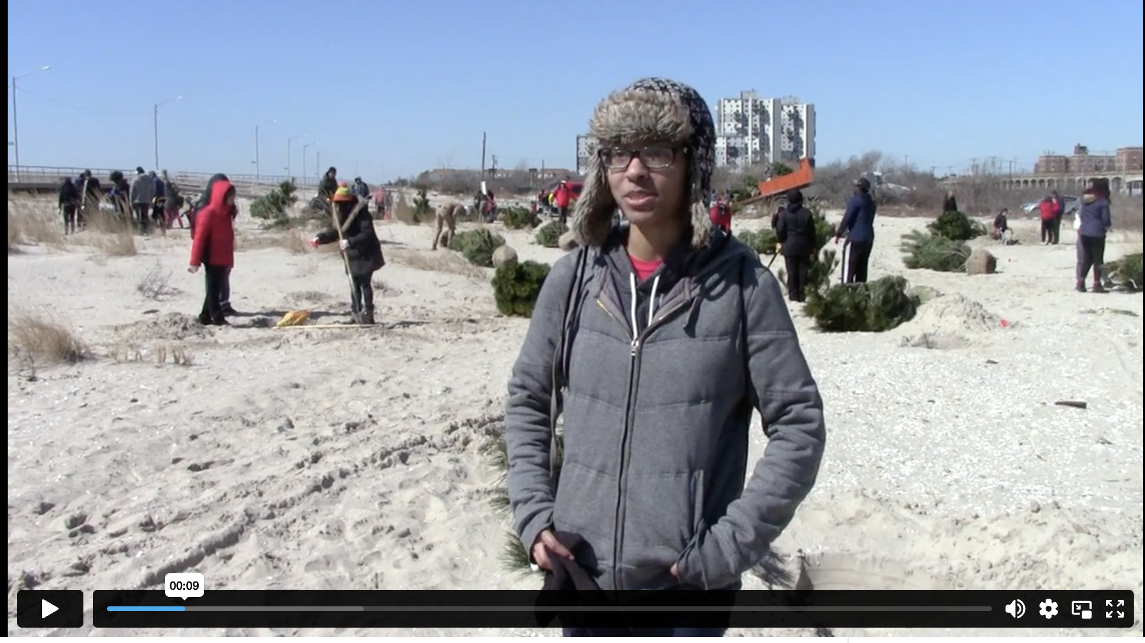
Introduction to Stewardship
Click to play video
(play from beginning to 1:20)

Slide 81
Introduction to Stewardship
Question:
What is stewardship?

Slide 82
Introduction to Stewardship
Question:
What is stewardship?
Stewardship means learning about and taking care of our environment. This might include cleaning up trash or planting native plants.
What other examples of stewardship can you think of?

Slide 83
Reflection

Slide 84
Reflection
Discuss each question with a partner or a small group first. Then, share out big ideas with the whole class.
  What parts of Rockaway are most important to you/what do you value the most about your community?
  Did you learn anything new today about Rockaway’s ecosystem? If so, what?
  How would you want to be involved in stewardship (caring for the environment) in Rockaway?
Notes:
Apple plant drawing stock photos, royalty-free images, vectors, video (adobe.com)

Slide 85
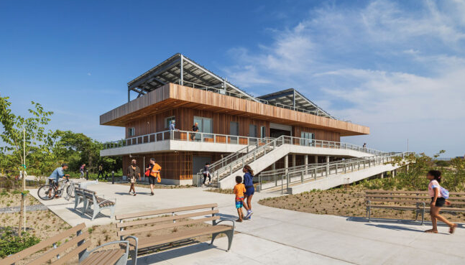
190 Beach 44th St, Queens, NY 11691
Visit the Arverne East Welcome Center to get involved in local stewardship!

Slide 86

Scan this QR code or click on this link to start a virtual reality scavenger hunt!
Can you spot all of these?
Subway line
Beachgrass
Group of students on a field trip
Sand
Arverne East Welcome Center
Bicycle
Recycling bin
What else can you find?

Slide 87
Key Terms
Ecosystem: a community of living things and their physical environment interacting with each other.
Climate change: change in the average conditions in a place over time (temperatures, weather patterns, etc.). Long-term climate change is caused by human activity.
Climate resilience: The ability to prepare for, recover from, and adapt to the impacts of climate change.
Dune: there are multiple kinds of dunes. In Rockaway, we have beach dunes - mounds of sand formed by wind that protect coastal communities from storms.
Native plant: plants that have evolved in / occur naturally in a particular region or ecosystem.
Stewardship: careful, responsible management of the environment.

Slide 88
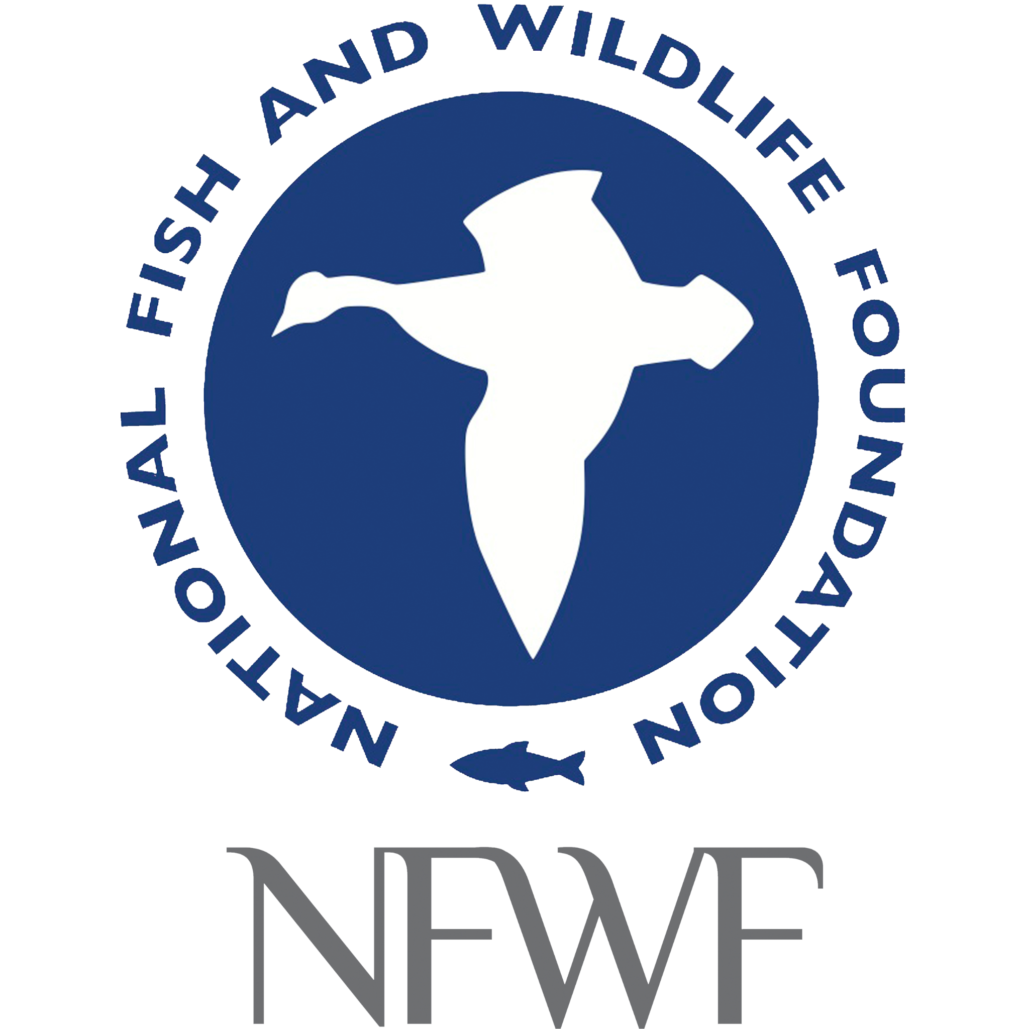
Made possible by the National Fish and Wildlife Foundation
Thank you for participating!

