Slide 1
ROCKAWAY PLANTS AND THEIR ADAPTATIONS
What the Dunes Teach Us

Slide 2
What makes Rockaway a special place?

Slide 3
What makes Rockaway a special place?
Brainstorm some ideas as a class!

Slide 4
What makes Rockaway a special place?
It is a peninsula, a body of land surrounded by water on three sides!

Slide 5
What makes Rockaway a special place?
It is a peninsula
It is located in Queens, one of the most ethnically diverse areas in the world

Slide 6
What makes Rockaway a special place?
It is a peninsula
It is located in Queens, one of the most ethnically diverse areas in the world
That makes Rockaway one of the most diverse coastal communities in the world!

Slide 7
What might make it difficult for a plant to survive along the beach?
Brainstorm some ideas as a class! Then use the clues on the next slides to guess a few more.

Slide 8
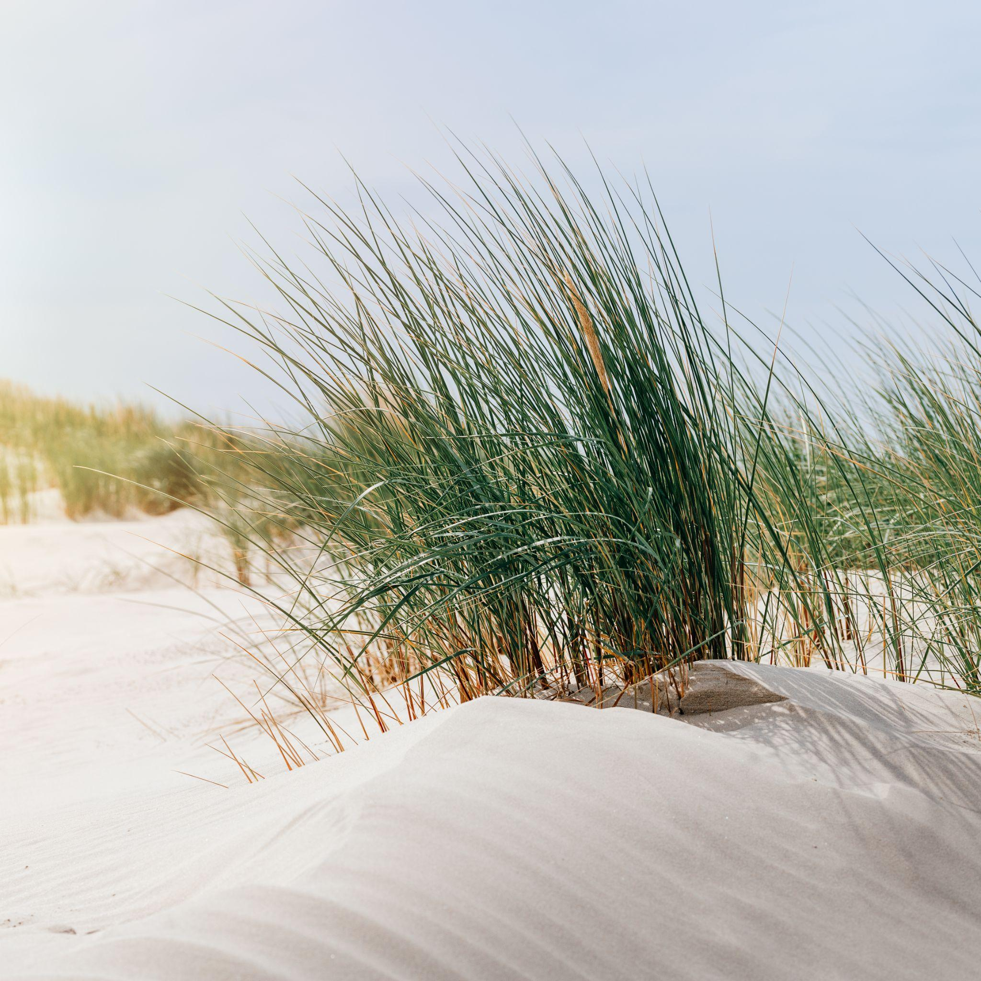
What might make it difficult for a plant to survive along the beach?

Slide 9
What might make it difficult for a plant to survive along the beach?
Buried under sand

Slide 10
What might make it difficult for a plant to survive along the beach?
Buried under sand

Slide 11
What might make it difficult for a plant to survive along the beach?
Buried under sand
Harsh or intense sunlight

Slide 12
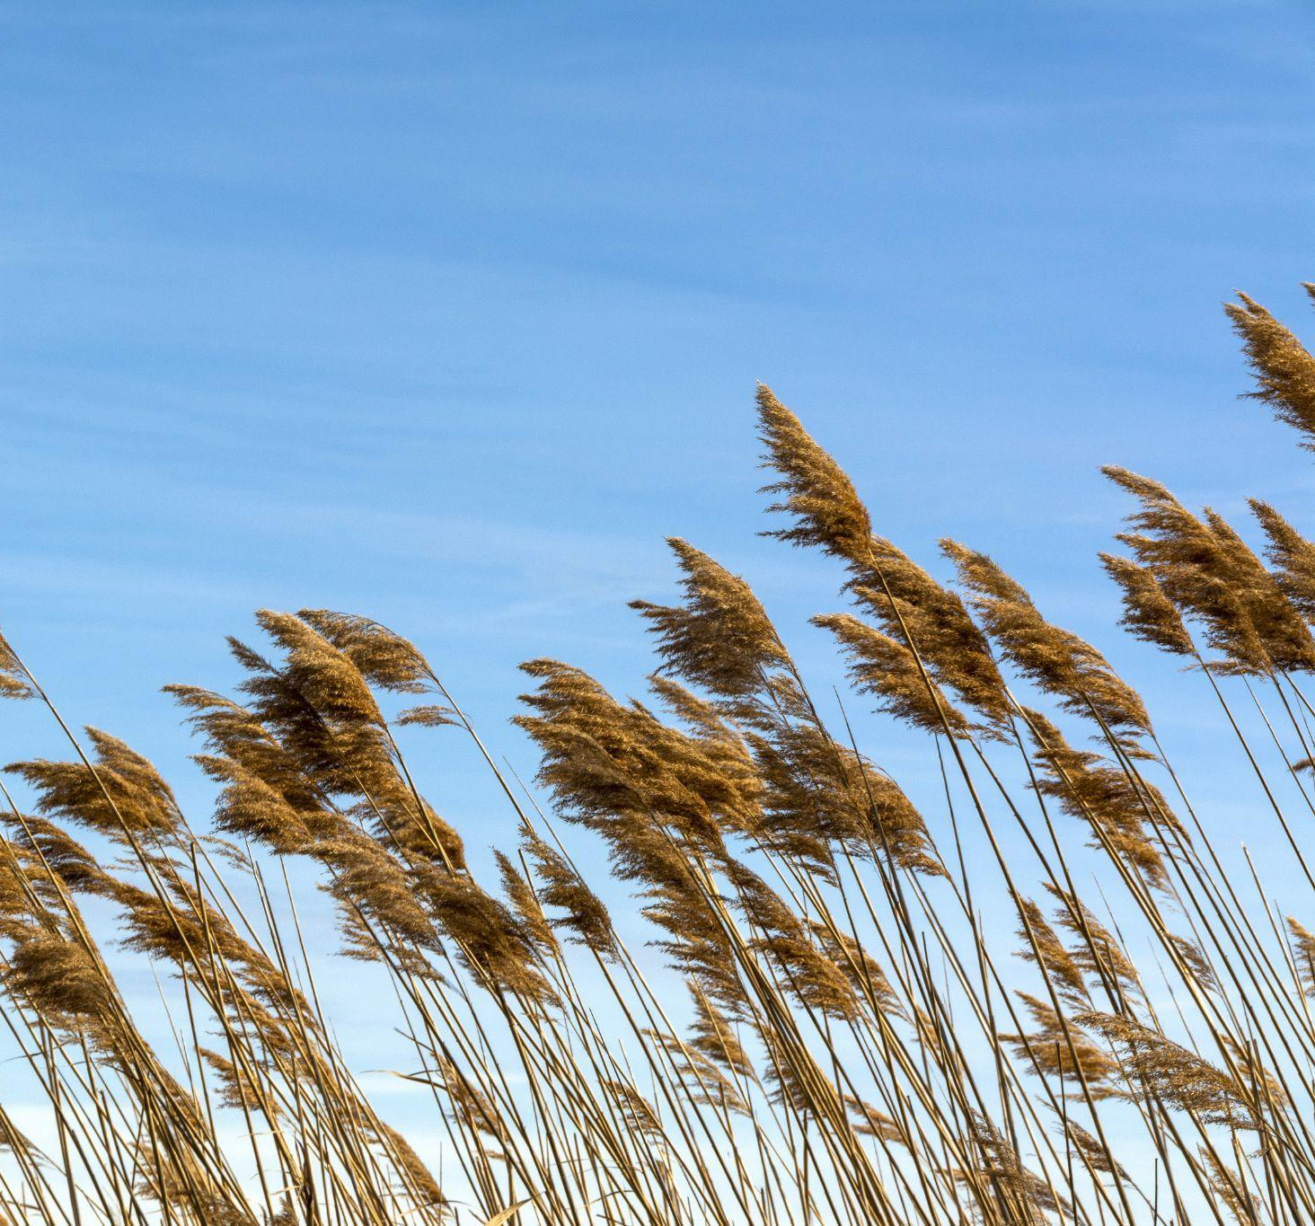
What might make it difficult for a plant to survive along the beach?
Buried under sand
Harsh or intense sunlight

Slide 13
What might make it difficult for a plant to survive along the beach?
Buried under sand
Harsh or intense sunlight
Wind

Slide 14
What are plant adaptations?

Slide 15
What are plant adaptations?
Adaptations are like super powers that allow plants to meet their needs.

Slide 16
What are plant adaptations?
Adaptations are like super powers that allow plants to meet their needs.
Adaptations are inherited, and evolve over time in response to particular conditions.

Slide 17
What are plant adaptations?
Adaptations are like super powers that allow plants to meet their needs.
Adaptations are inherited, and evolve over time in response to particular conditions.
Adaptations make it easier for plants to survive in their specific habitat and reproduce, passing those traits on to their offspring.

Slide 18
Many dune plants are being attacked by challenges.
With each battle, your job is to help identify which adaptation superpower each plant is using to fight the challenger.
GAME TIME!
GAME TIME!
GAME TIME!

Slide 19
Learn about different types of adaptations!

Slide 20
Learn about different types of adaptations!
Let’s get some volunteers to read each of the adaptations on the next slides. You’ll need to know these to win the game!

Slide 21
Learn about different types of adaptations!
Salt glands that process and pump out salt from salty seawater.

Slide 22
Learn about different types of adaptations!
Salt glands that process and pump out salt from salty seawater.
Growth enzyme released when covered by sand.

Slide 23
Learn about different types of adaptations!
Salt glands that process and pump out salt from salty seawater.
Growth enzyme released when covered by sand.
Growth enzyme released when covered by sand.
Regeneration after damage through ability to sprout from trunk and branches, not just seed.

Slide 24
Learn about different types of adaptations!
Salt glands that process and pump out salt from salty seawater.
Waxy leaves help the plant to protect itself from water damage.
Growth enzyme released when covered by sand.
Growth enzyme released when covered by sand.
Regeneration after damage through ability to sprout from trunk and branches, not just seed.

Slide 25
Learn about different types of adaptations!
Salt glands that process and pump out salt from salty seawater.
Waxy leaves help the plant to protect itself from water damage.
Growth enzyme released when covered by sand.
Dense foliage, or lots of leaves and stems, help to protect from winds or storms.
Growth enzyme released when covered by sand.
Regeneration after damage through ability to sprout from trunk and branches, not just seed.

Slide 26
Learn about different types of adaptations!
Salt glands that process and pump out salt from salty seawater.
Waxy leaves help the plant to protect itself from water damage.
Growth enzyme released when covered by sand.
Dense foliage, or lots of leaves and stems, help to protect from winds or storms.
Growth enzyme released when covered by sand.
Regeneration after damage through ability to sprout from trunk and branches, not just seed.
Spikes help to keep away hungry animals.

Slide 27
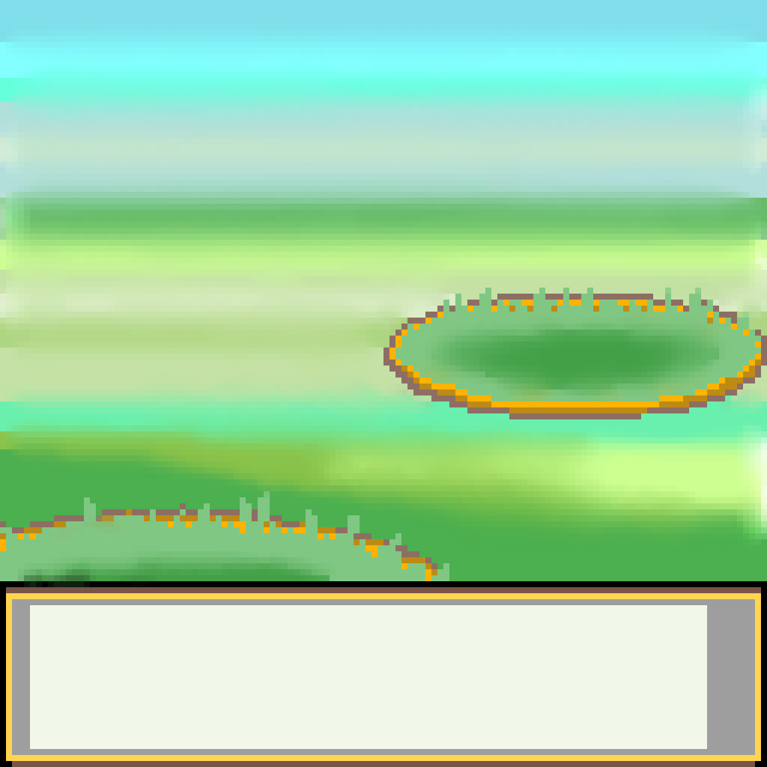
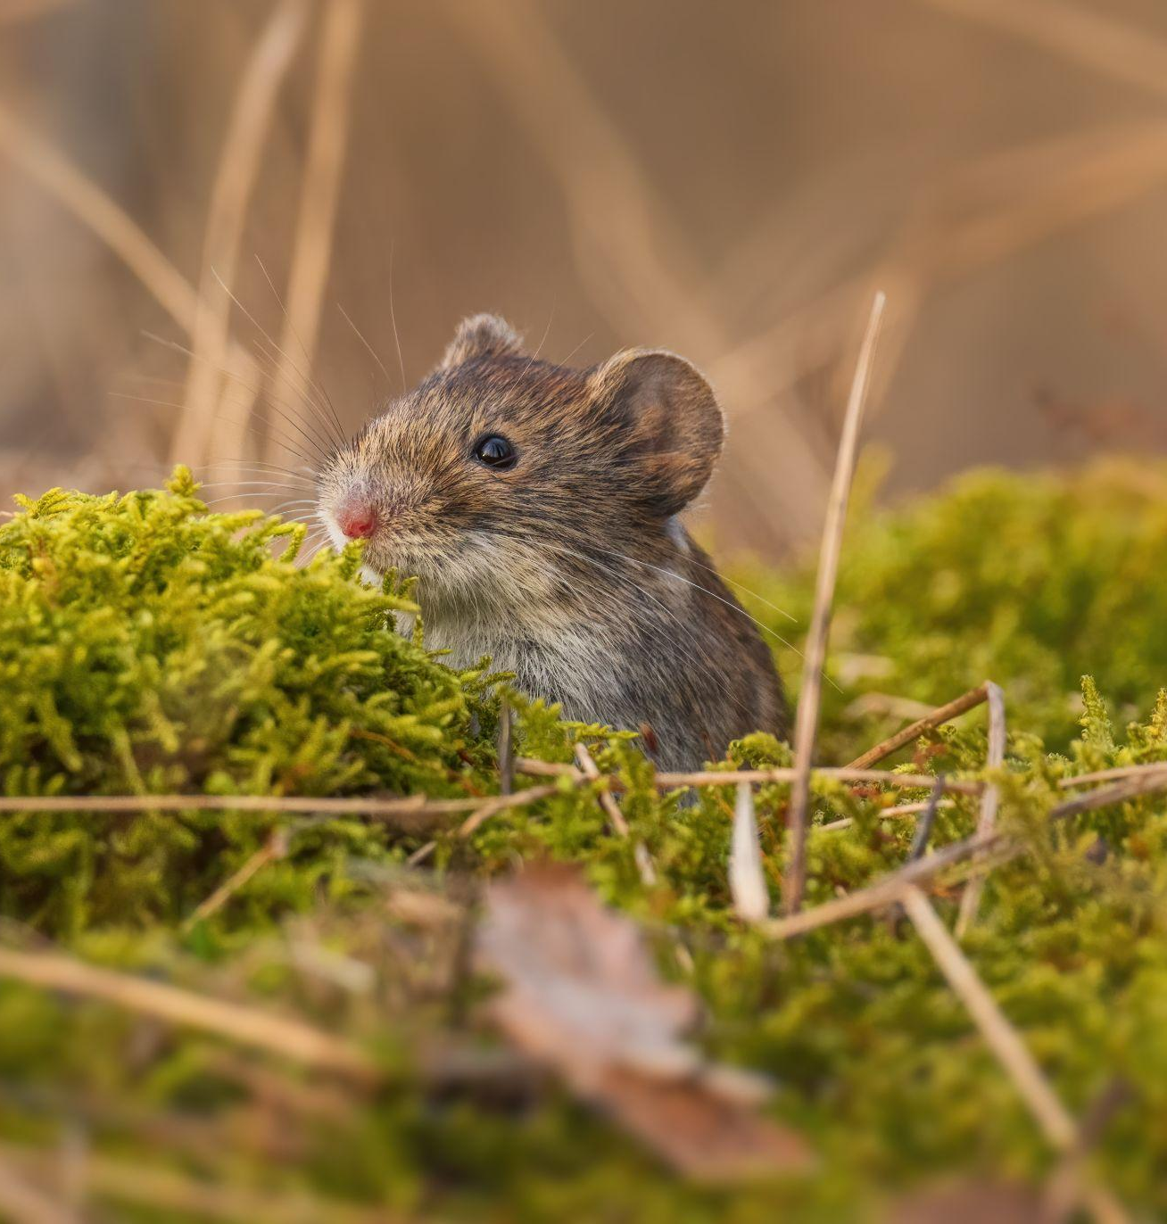
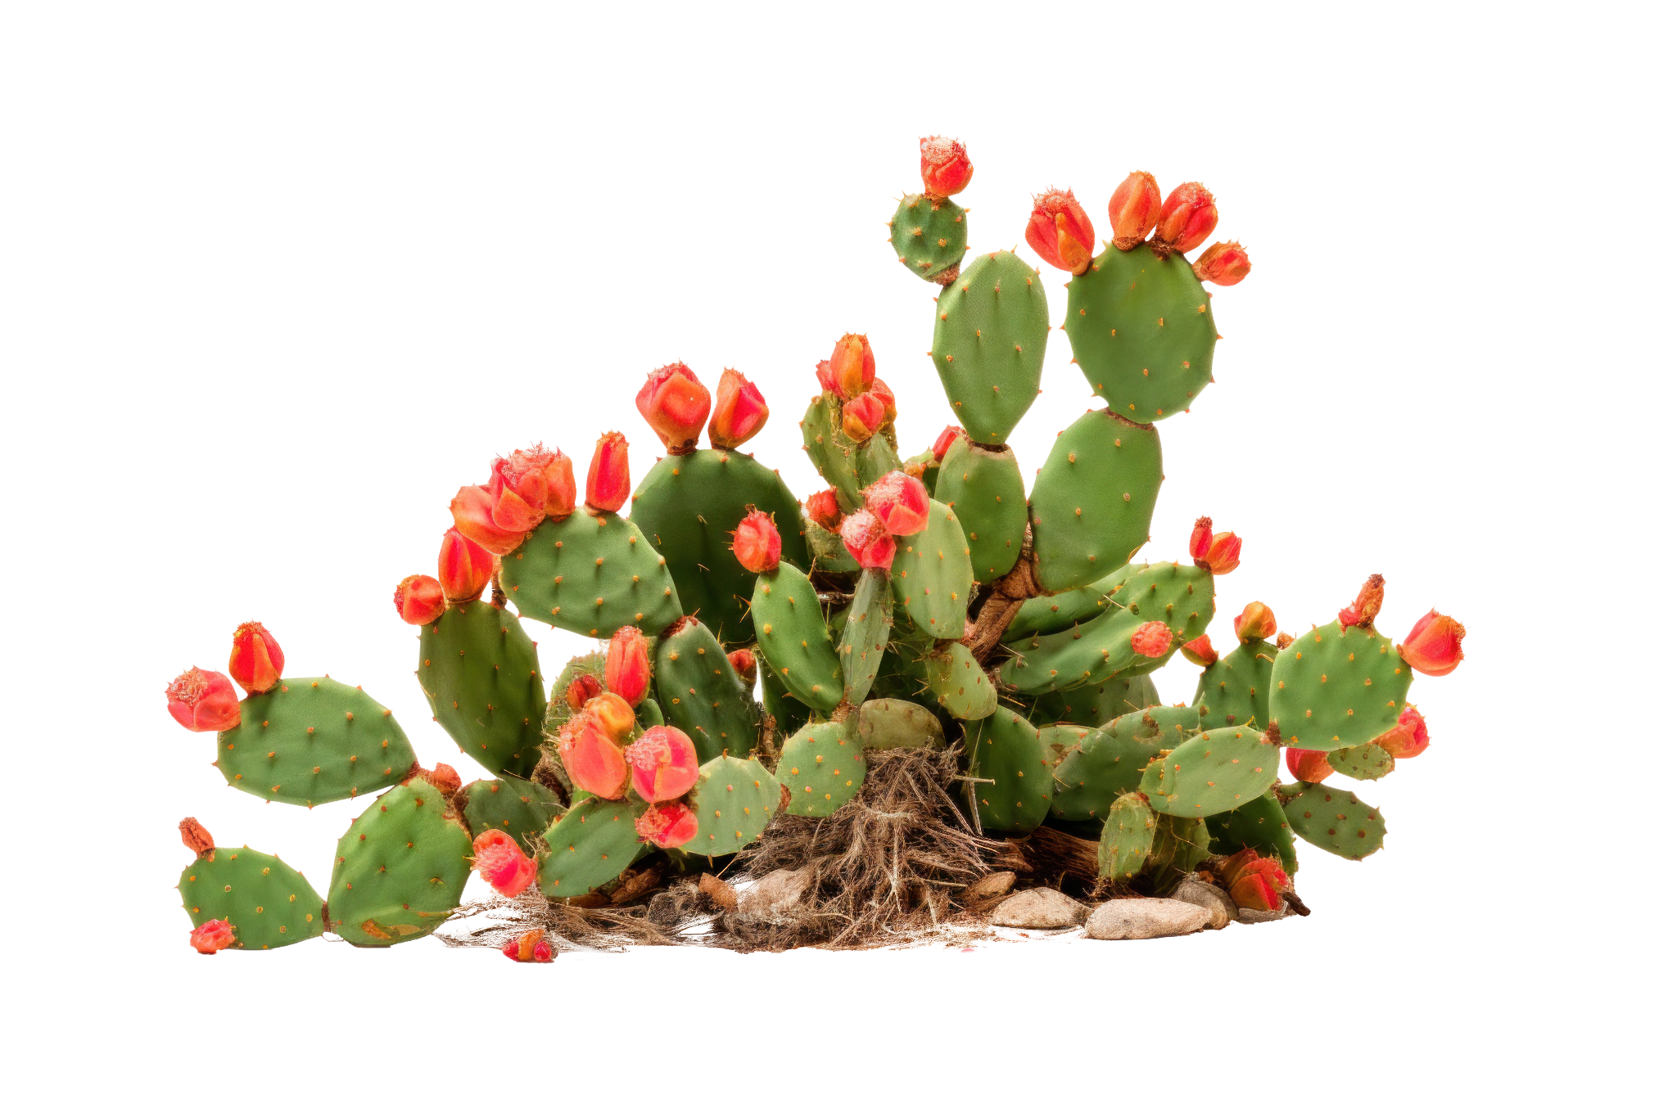
PLANT VS CHALLENGE BATTLE ROUND 6
CHALLENGE
Meadow vole
PLANT
Prickly Pear
Meadow vole is thirsty and hungry and sees the Prickly Pear…

Slide 28
PLANT VS CHALLENGE BATTLE ROUND 6
CHALLENGE
Meadow vole
PLANT
Prickly Pear
But Prickly Pear uses its secret adaptation and survives!

Slide 29
Which adaptation power did this plant use?
Salt glands
Waxy leaf
Growth enzyme
Dense foliage
Regrow from trunk and stems
Spikes

Slide 30
Which adaptation power did this plant use?
Salt glands
Waxy leaf
Growth enzyme
Dense foliage
Regrow from trunk and stems
Spikes help to keep away hungry animals.

Slide 31
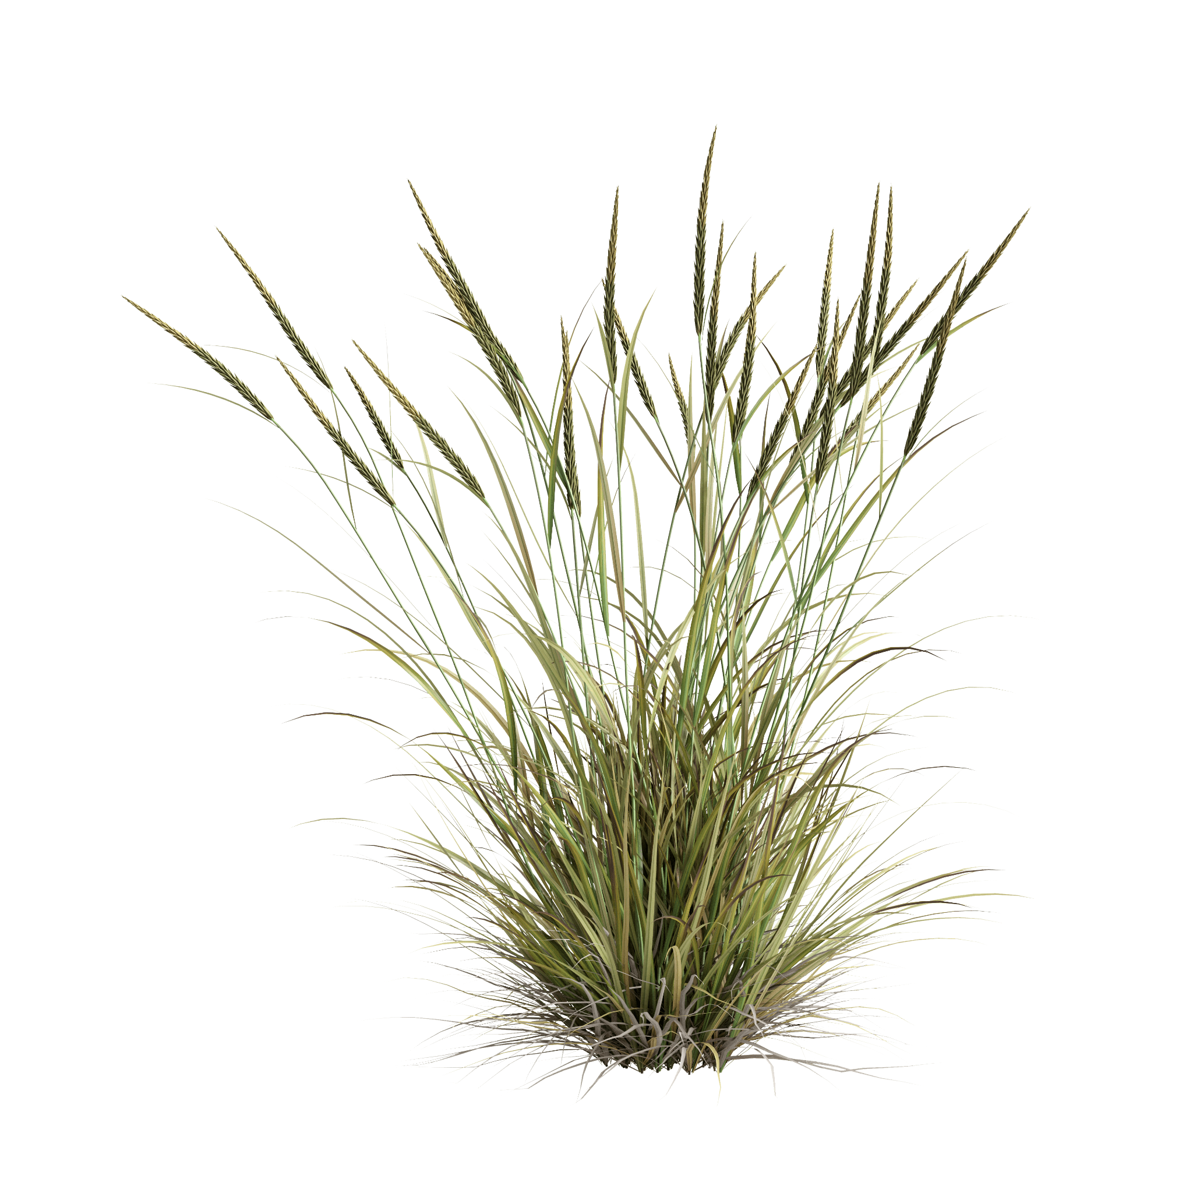
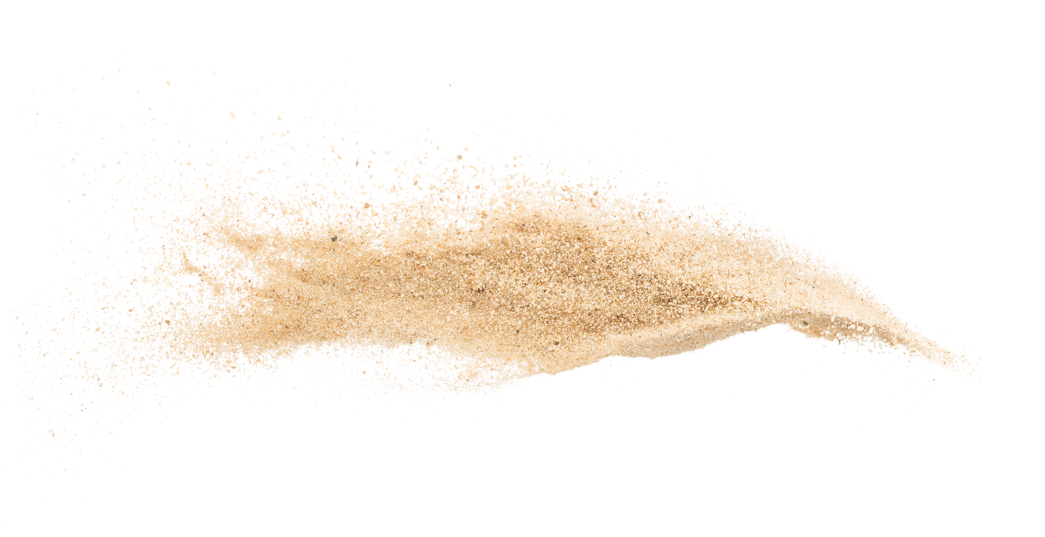
PLANT VS CHALLENGE BATTLE ROUND 1
CHALLENGE
Sand
PLANT
Beach Grass
It was a summer day and a strong gust of wind blew Sand all over Beach Grass.
Notes:
Grass Bush White Transparent, Ammophila Brevilugatta Grass Bush On Transparent Background, Grass, Bush, Plant Png PNG Image For Free Download (pngtree.com)
Adobe stock

Slide 32
PLANT VS CHALLENGE BATTLE ROUND 1
CHALLENGE
Sand
PLANT
Beach Grass
However, a few days later, Beach Grass was taller and bigger than before it was buried in Sand!

Slide 33
Which adaptation power did Beach Grass use?
Salt glands
Waxy leaf
Growth enzyme
Dense foliage
Regrow from trunk and stems
Spikes

Slide 34
Which adaptation power did Beach Grass use?
Salt glands
Waxy leaf
Growth enzyme released when covered by sand.
Dense foliage
Regrow from trunk and stems
Spikes

Slide 35
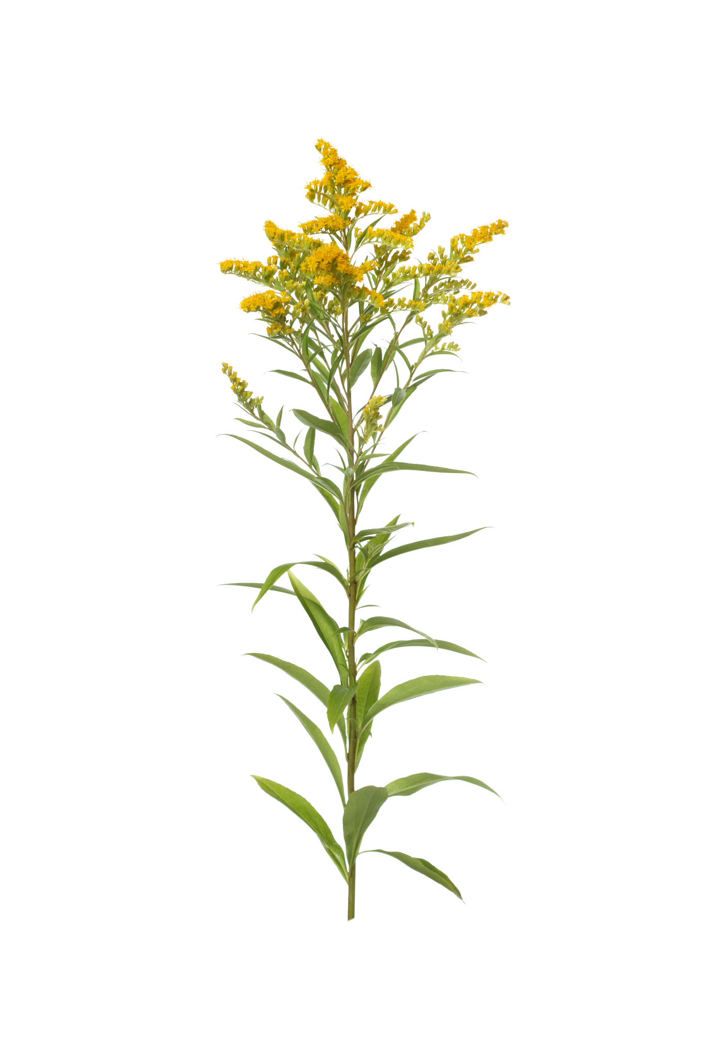
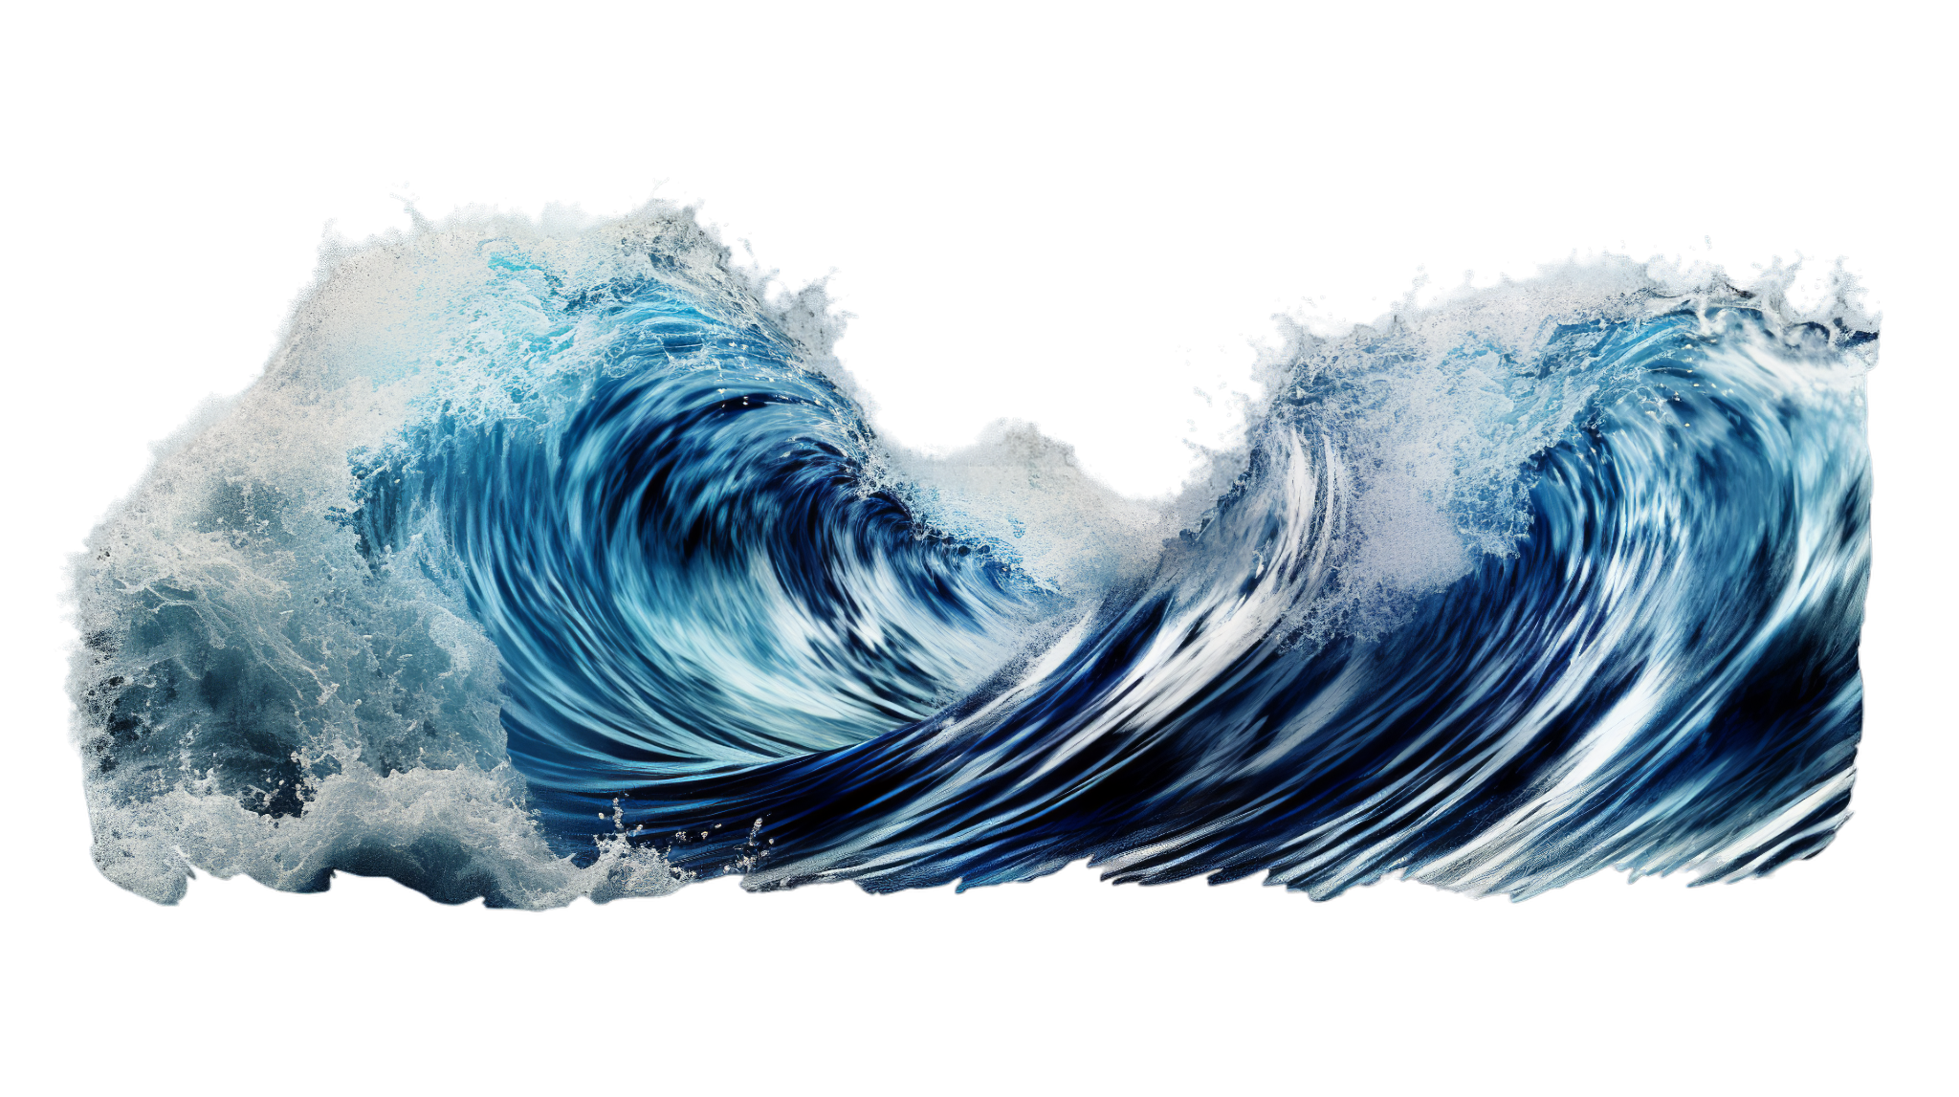
PLANT VS CHALLENGE BATTLE ROUND 2
CHALLENGE
Seawater
PLANT
Seaside Goldenrod
Seaside Goldenrod gets attacked by Seawater.

Slide 36
PLANT VS CHALLENGE BATTLE ROUND 2
CHALLENGE
Seawater
PLANT
Seaside Goldenrod
However, Seaside Goldenrod is able to defend itself with its adaptation power.

Slide 37
Which adaptation power did this plant use?
Salt glands
Waxy leaf
Growth enzyme
Dense foliage
Regrow from trunk and stems
Spikes

Slide 38
Which adaptation power did this plant use?
Salt glands
Waxy leaves help the plant to protect itself from water damage.
Growth enzyme
Dense foliage
Regrow from trunk and stems
Spikes

Slide 39
PLANT VS CHALLENGE BATTLE ROUND 3
CHALLENGE
Wind
PLANT
Eastern Red Cedar
The weather has been super turbulent. Eastern Red Cedar loses HP points as it is ambushed by Wind.
Notes:
Adobe stock

Slide 40
PLANT VS CHALLENGE BATTLE ROUND 3
CHALLENGE
Wind
PLANT
Eastern Red Cedar
But, Eastern Red Cedar is able to gain back health using its adaptation power.

Slide 41
Which adaptation power did this plant use?
Salt glands
Waxy leaf
Growth enzyme
Dense foliage
Regrow from trunk and stems
Spikes

Slide 42
Which adaptation power did this plant use?
Salt glands
Waxy leaf
Growth enzyme
Dense foliage, or lots of leaves and stems, help to protect from winds or storms.
Regrow from trunk and stems
Spikes

Slide 43
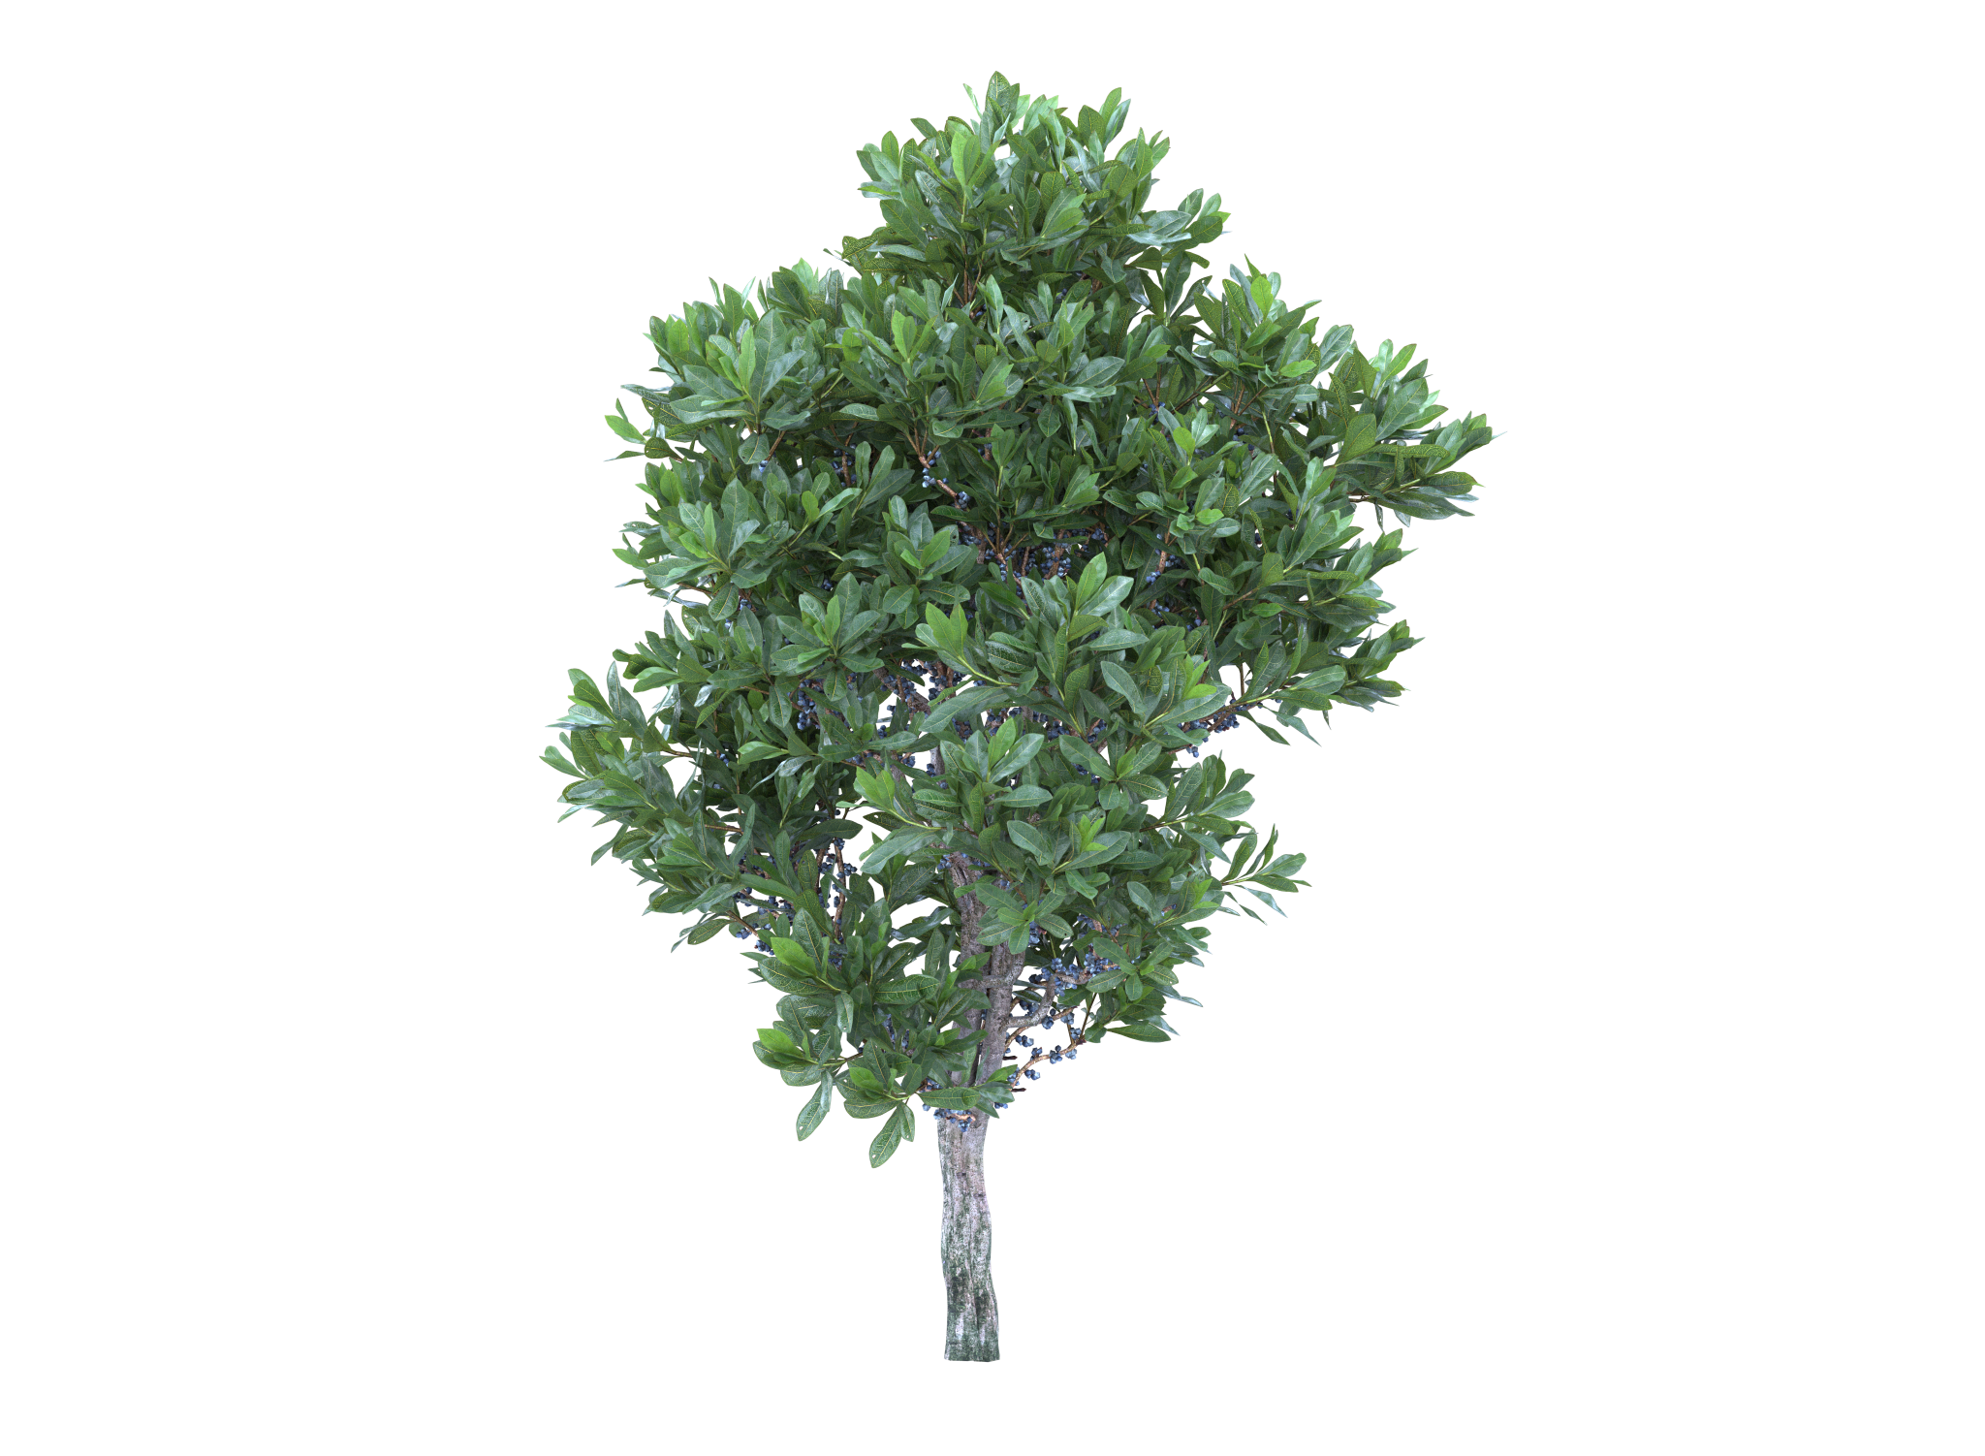
PLANT VS CHALLENGE BATTLE ROUND 4
CHALLENGE
Seawater
PLANT
Bayberry
Seawater is back and ready to fight again!This time seawater attacks Bayberry!

Slide 44
PLANT VS CHALLENGE BATTLE ROUND 4
CHALLENGE
Seawater
PLANT
Northern Bayberry
Northern Bayberry fights back with their ultimate adaption power!

Slide 45
Which adaptation power did this plant use?
Salt glands
Waxy leaf
Growth enzyme
Dense foliage
Regrow from trunk and stems
Spikes

Slide 46
Which adaptation power did this plant use?
Salt glands
Waxy leaf
Growth enzyme
Dense foliage
Regrow from trunk and stems
Spikes help to keep away hungry animals!

Slide 47
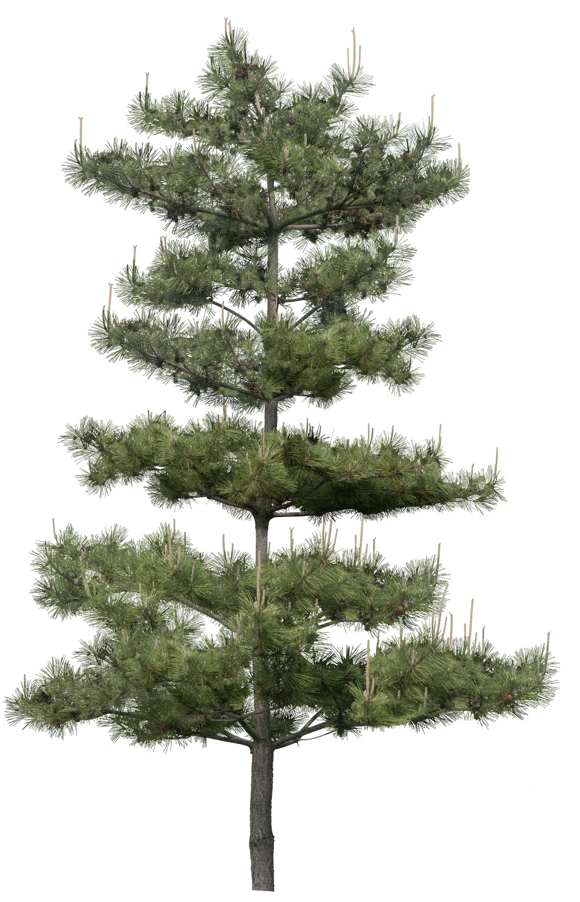
PLANT VS CHALLENGE BATTLE ROUND 5
CHALLENGE
Storms
PLANT
Pitch Pine
Pitch Pine has been hit by Storms and loses many of its branches as a result.

Slide 48
PLANT VS CHALLENGE BATTLE ROUND 3
CHALLENGE
Storms
PLANT
Pitch Pine
But, to Storm’s surprise, during the battle, Pitch Pine starts to grow back.

Slide 49
Which adaptation power did this plant use?
Salt glands
Waxy leaf
Growth enzyme
Dense foliage
Regrow from trunk and stems
Spikes

Slide 50
Which adaptation power did this plant use?
Salt glands
Waxy leaf
Growth enzyme
Dense foliage
Regeneration after damage through ability to sprout from trunk and branches, not just seeds!
Spikes

Slide 51
PLANT VS CHALLENGE BATTLE ROUND 6
CHALLENGE
Seawater
PLANT
Spartina Alterniflora
Seawater is BACK AGAIN! This time stronger than before.It sneak attacks the salt marsh plant Spartina.

Slide 52
PLANT VS CHALLENGE BATTLE ROUND 6
CHALLENGE
Seawater
PLANT
Spartina Alterniflora
But Spartina uses its secret adaptation and survives!

Slide 53
Which adaptation power did this plant use?
Salt glands
Waxy leaf
Growth enzyme
Dense foliage
Regrow from trunk and stems
Spikes

Slide 54
Which adaptation power did this plant use?
Salt glands that process and pump out salt from salty seawater.
Waxy leaf
Growth enzyme
Dense foliage
Regrow from trunk and stems
Spikes

Slide 55
CONGRATULATIONS ON DEFEATING THE FINAL CHALLENGER!
YOU DID A GREAT JOB!
GAME OVER!
GAME OVER!
GAME OVER!

Slide 56
Made possible by the National Fish and Wildlife Foundation
Thank you for participating!

