Slide 1
ROCKAWAY PLANTS AND THEIR SEEDS
What the Dunes Teach Us

Slide 2

Let’s learn the “Parts of a Plant” song!
Don’t be shy, get on your feet and stretch out your arms!

Slide 3
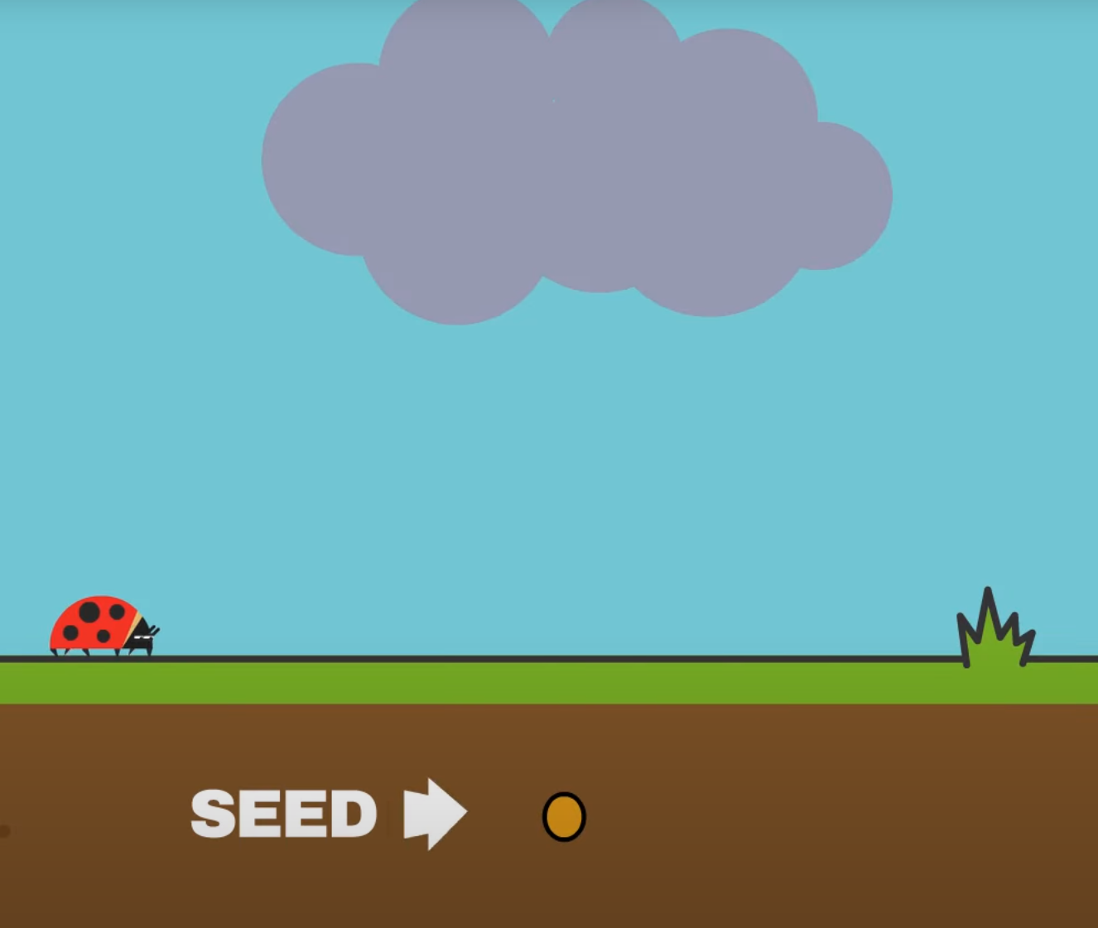
What did we learn from the “Parts of a Plant” song?
Question:
Can you name the parts of the plant?
Hint:
From a seed
From a branch
From a leaf

Slide 4
What did we learn from the “Parts of a Plant” song?
Question:
How does a plant first start to grow?
Hint:
From a seed
From a branch
From a leaf

Slide 5
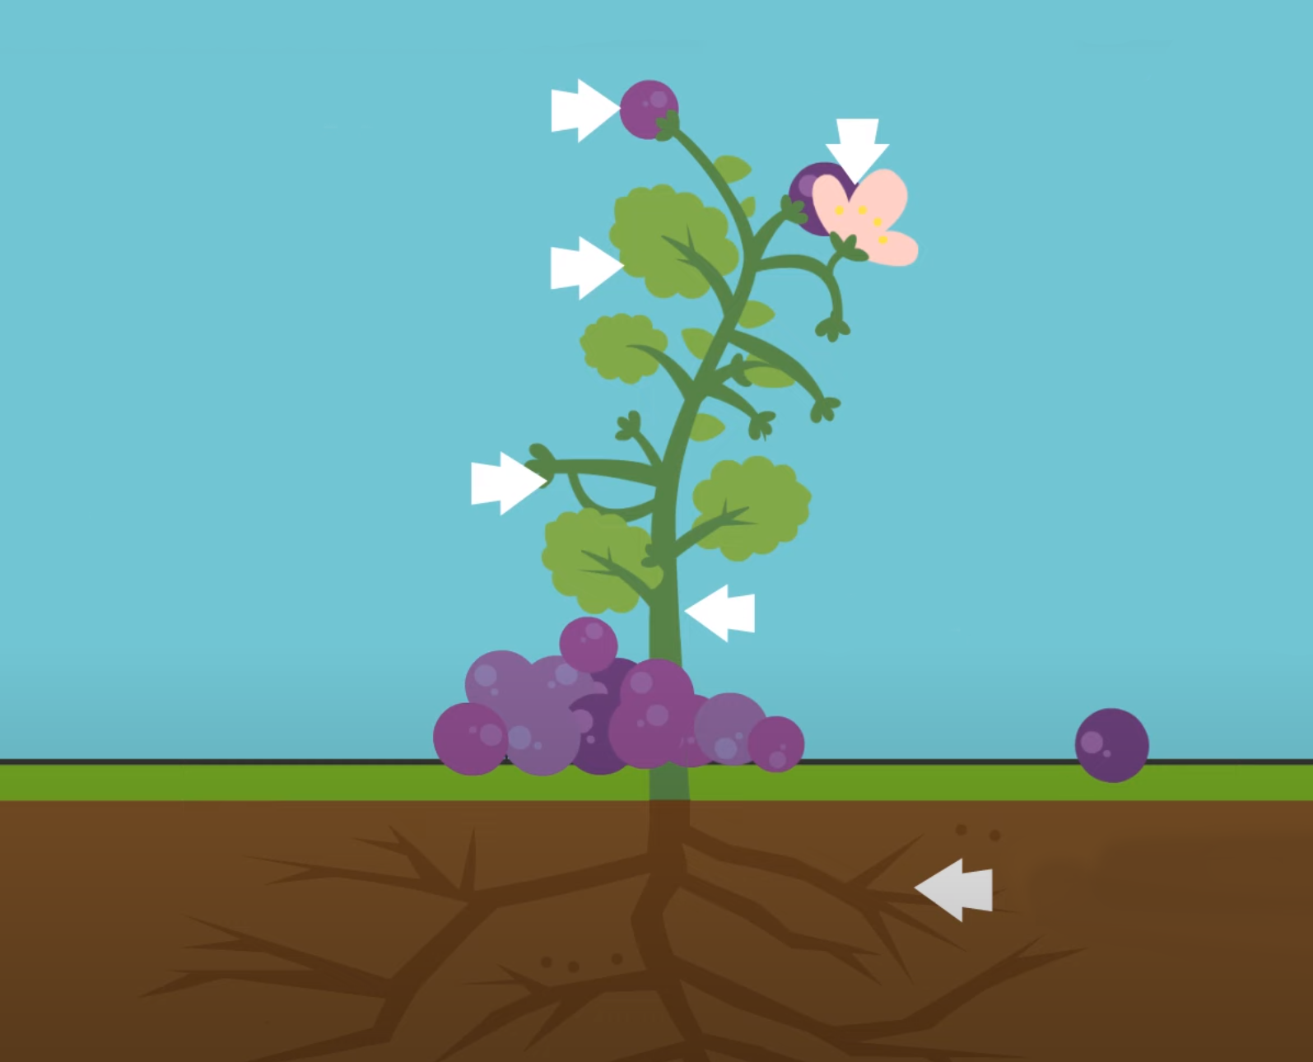
What did we learn from the “Parts of a Plant” song?
Question:
Can you name the parts of the plant?

Slide 6
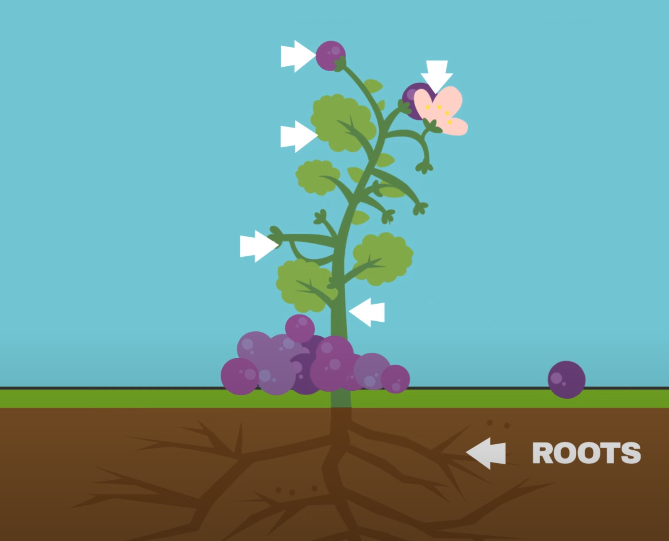
What did we learn from the “Parts of a Plant” song?
Question:
Can you name the parts of the plant?

Slide 7
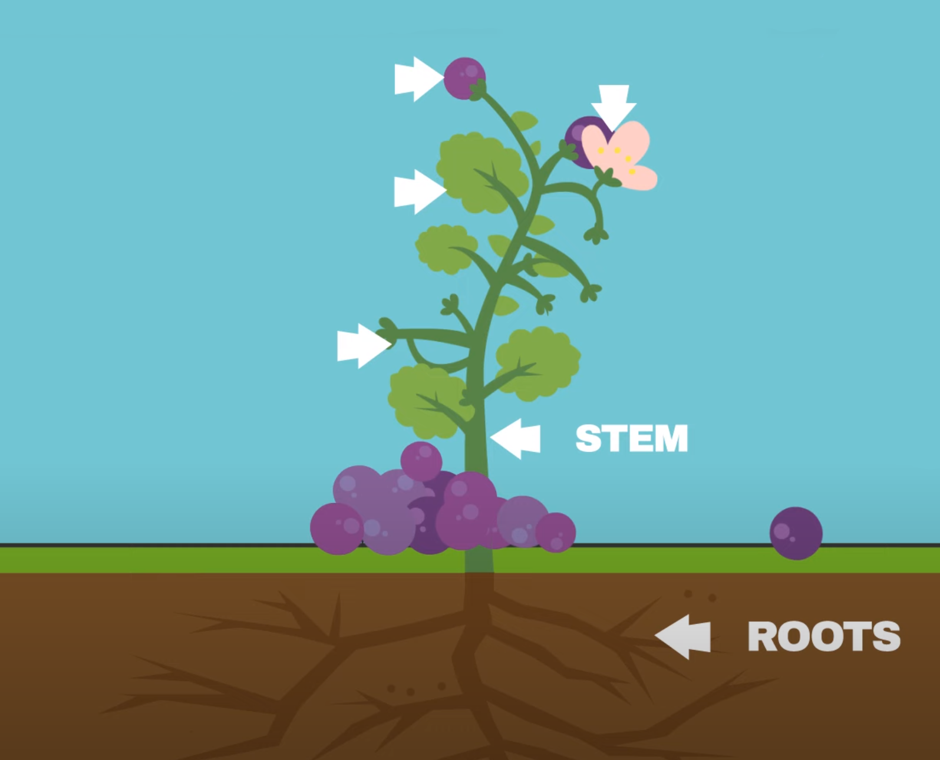
What did we learn from the “Parts of a Plant” song?
Question:
Can you name the parts of the plant?

Slide 8
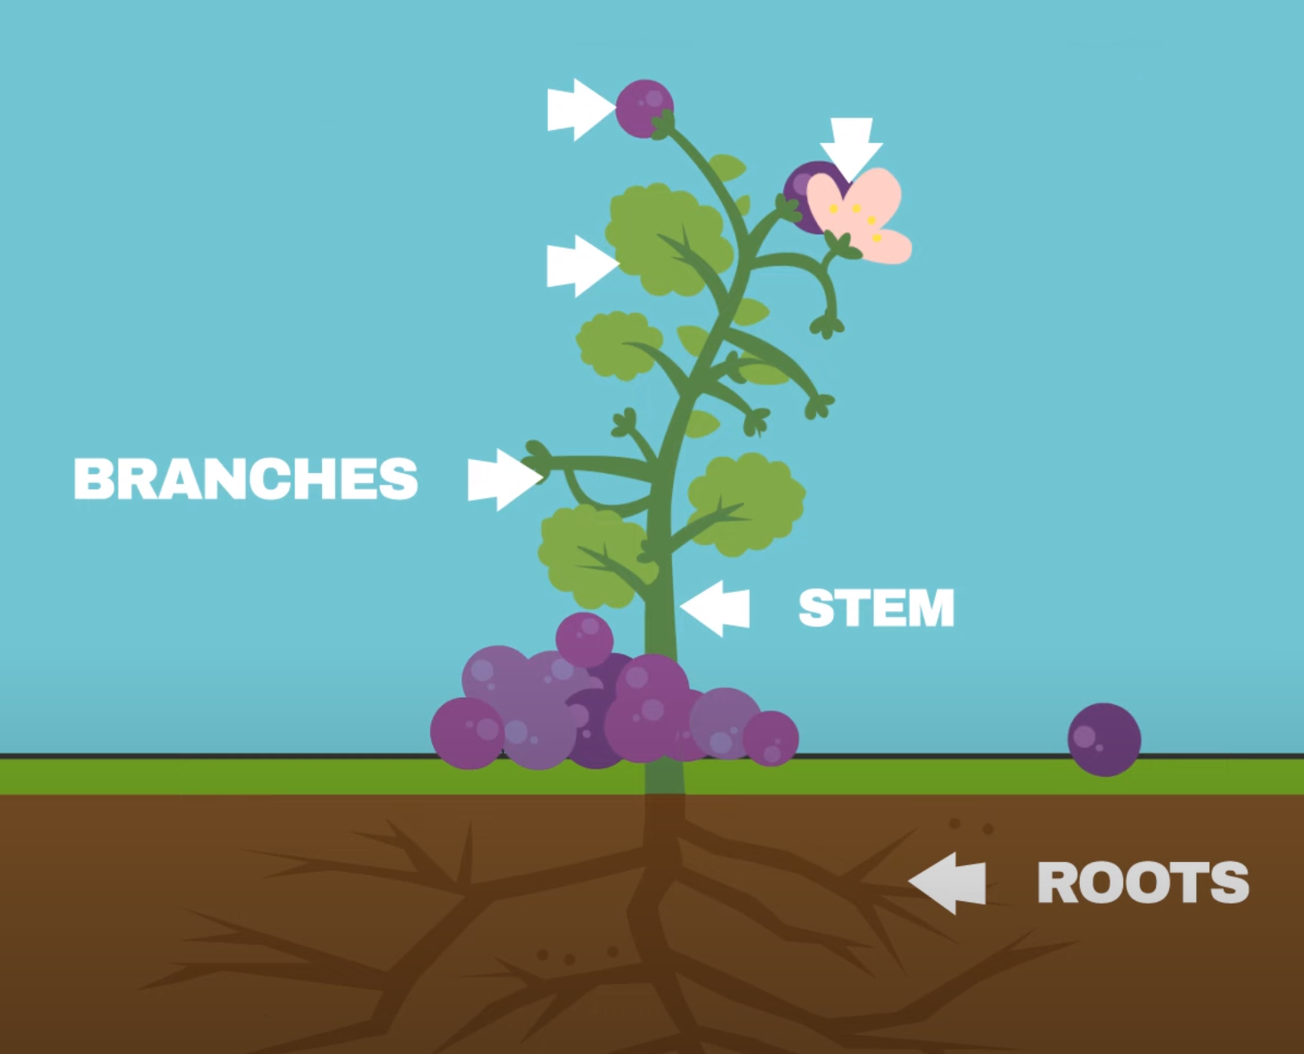
What did we learn from the “Parts of a Plant” song?
Question:
Can you name the parts of the plant?

Slide 9
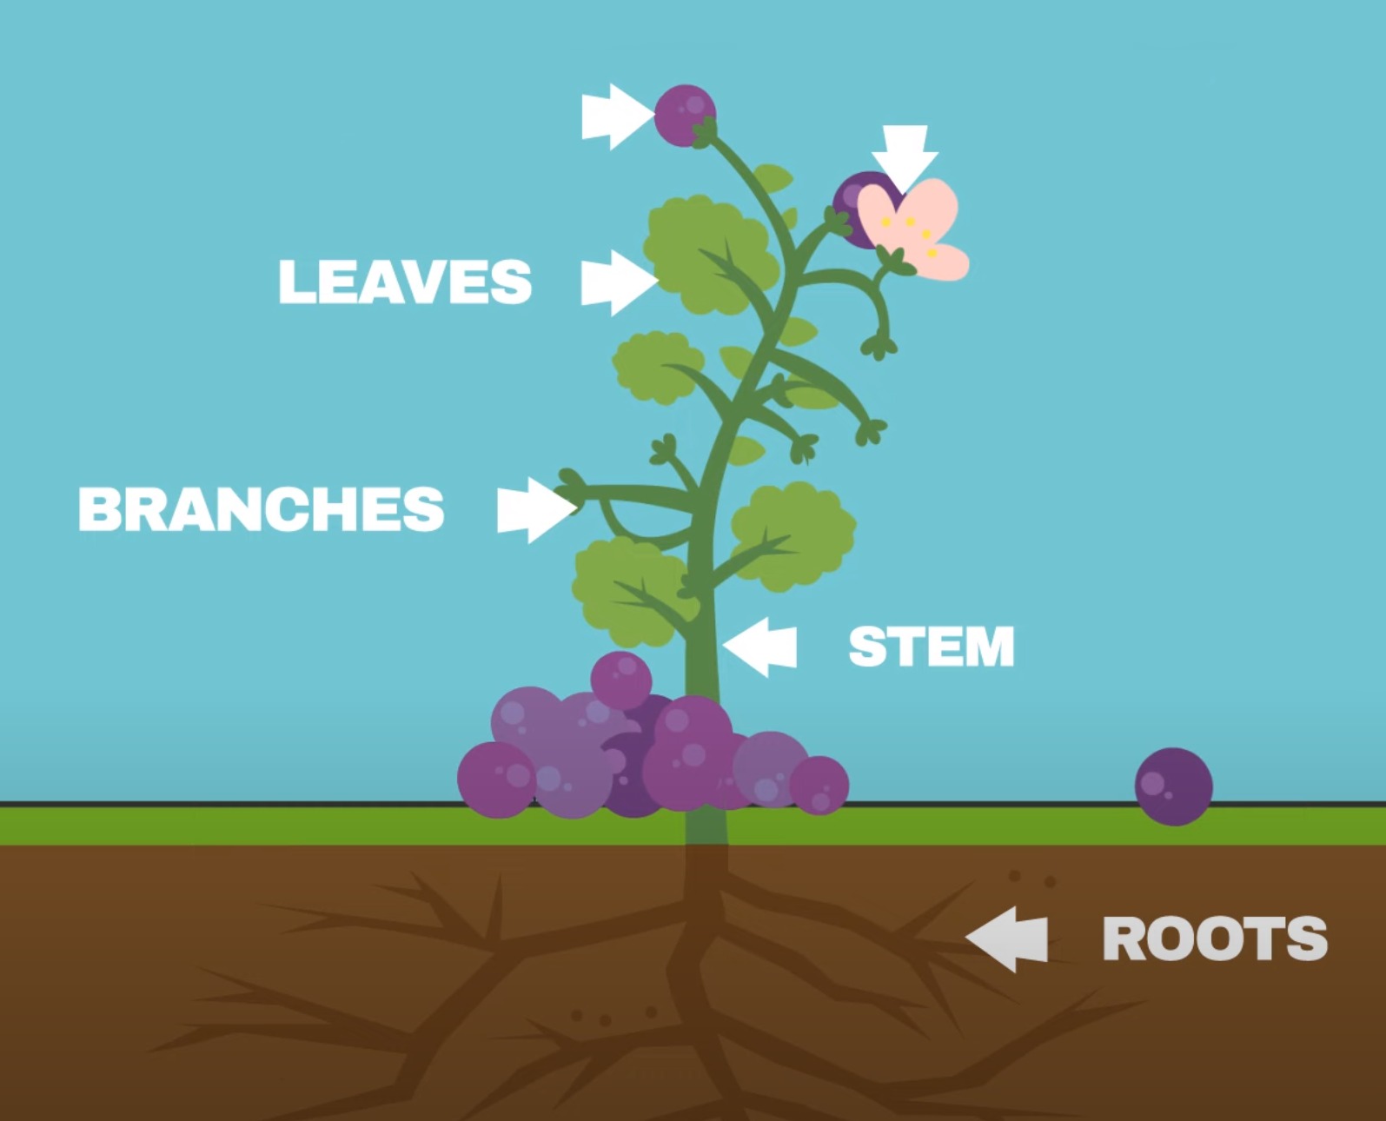
What did we learn from the “Parts of a Plant” song?
Question:
Can you name the parts of the plant?

Slide 10
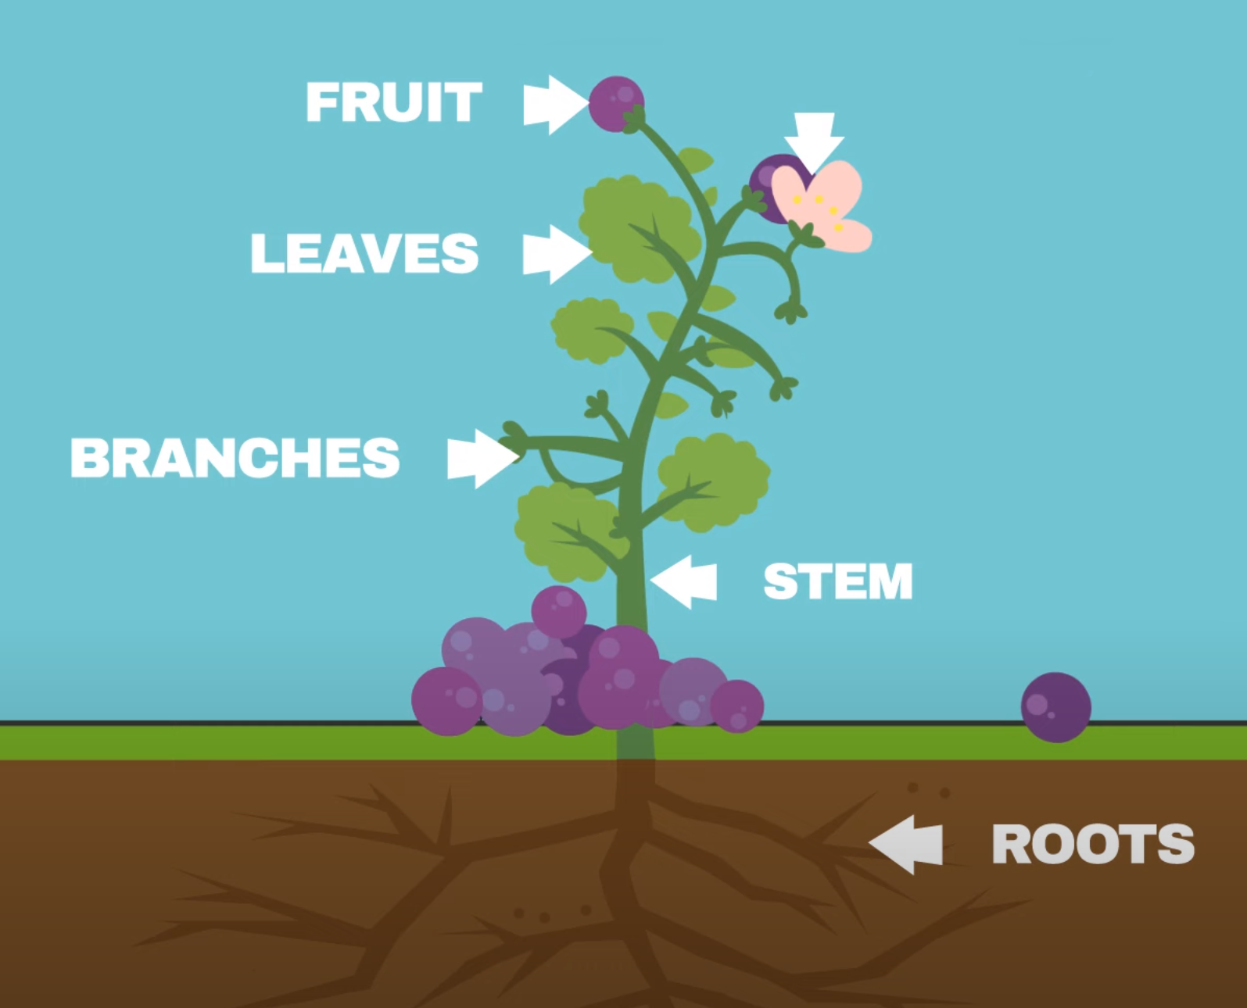
What did we learn from the “Parts of a Plant” song?
Question:
Can you name the parts of the plant?

Slide 11
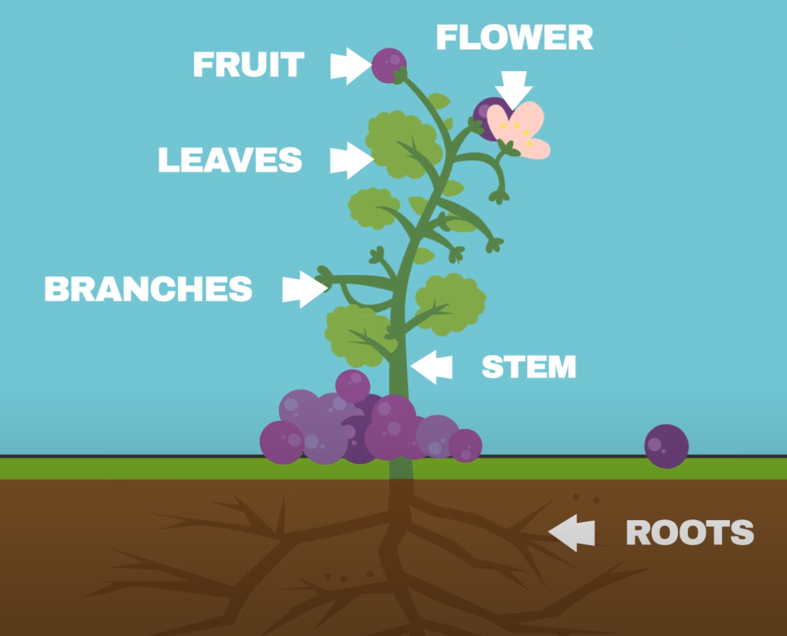
What did we learn from the “Parts of a Plant” song?
Question:
Can you name the parts of the plant?

Slide 12
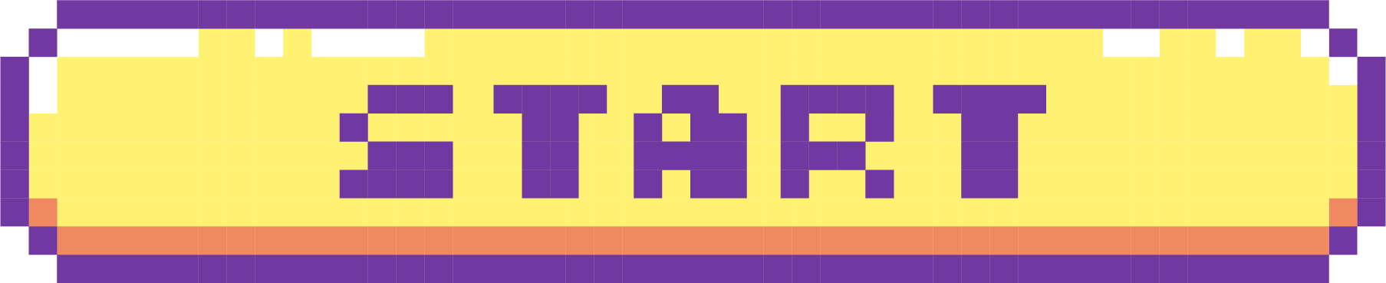
Try to answer as many questions as you can about the plants you see and their seeds.
GAME TIME!
GAME TIME!
GAME TIME!

Slide 13


Choose your level of difficulty:
Beginner
Advanced
Expert
You may choose more than one level of difficulty.

Slide 14

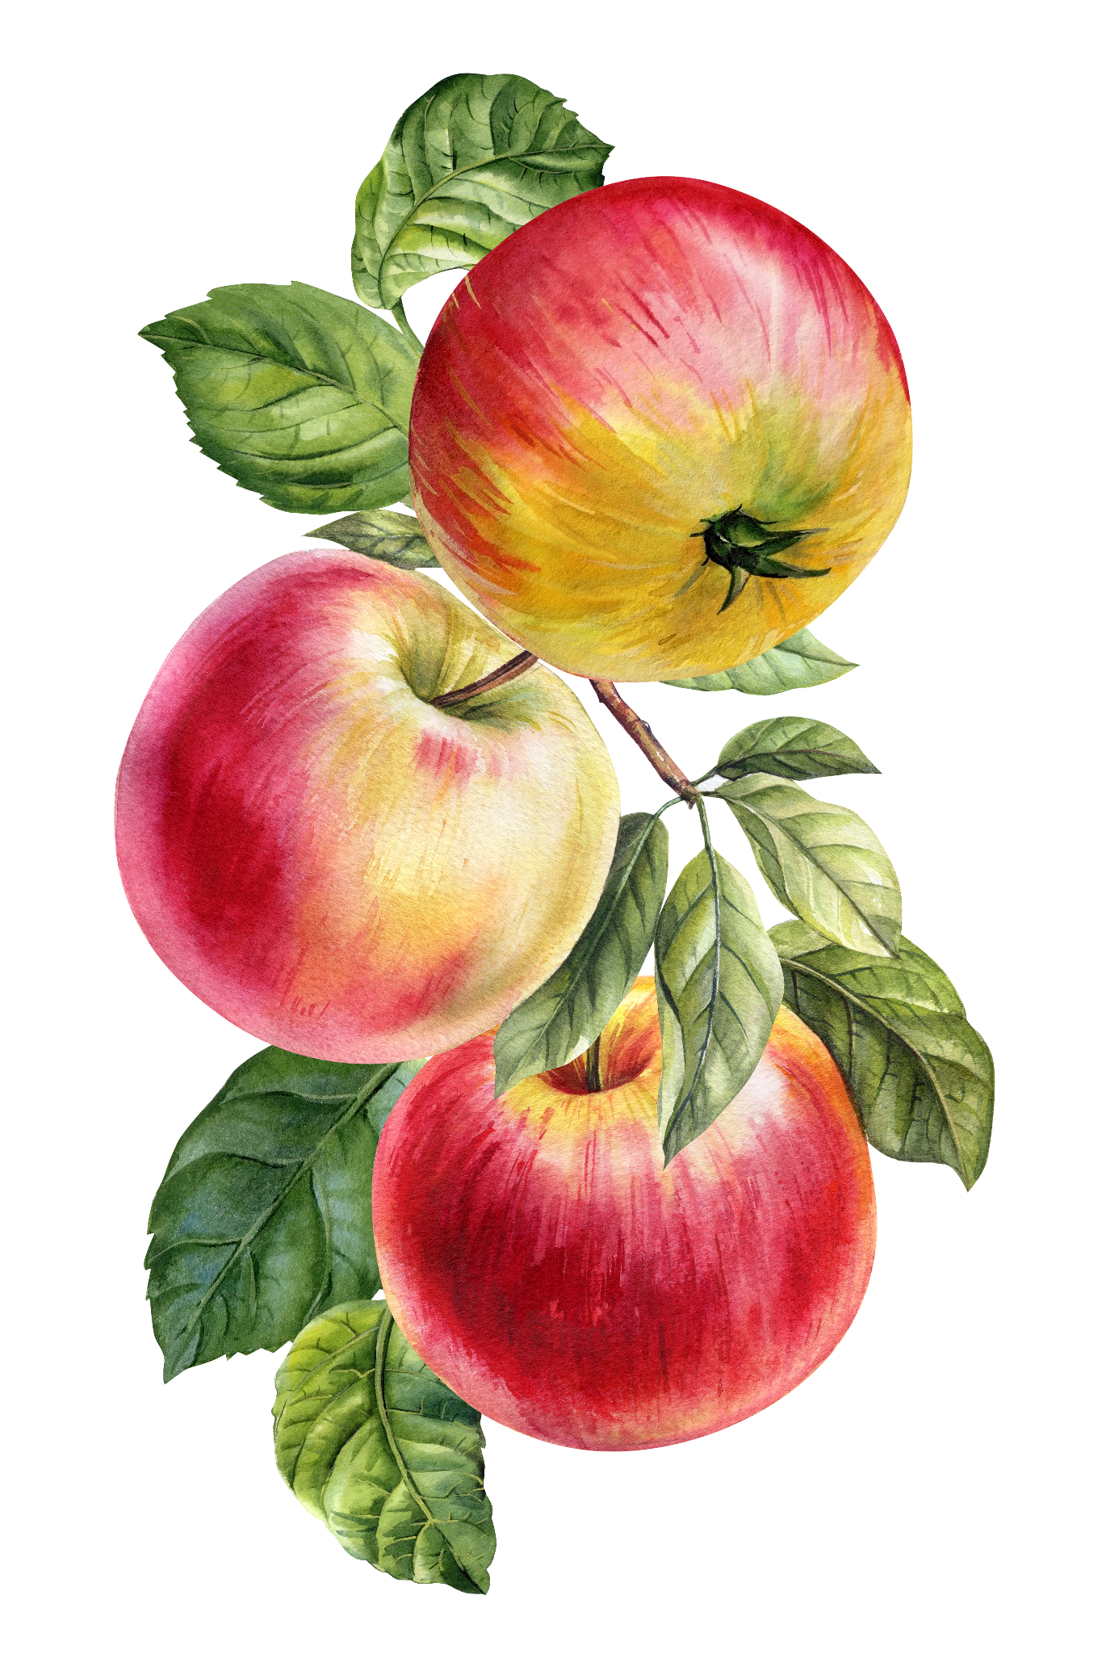
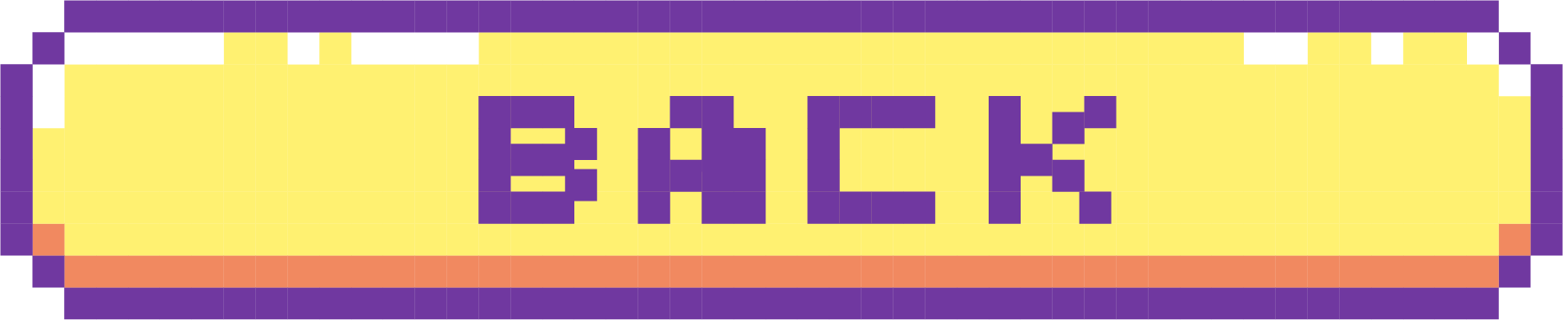
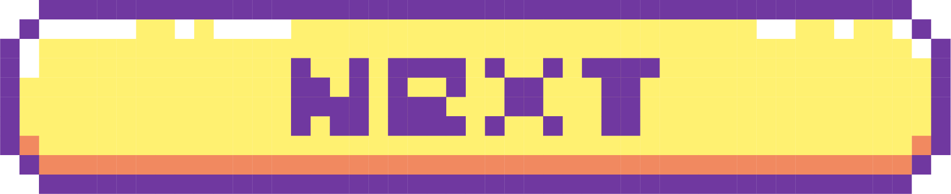
Questions:
Identity the colors of this plant.
Guess the name of this plant.
Guess the size of this plant’s seed.
Notes:
Apple plant drawing stock photos, royalty-free images, vectors, video (adobe.com)

Slide 15


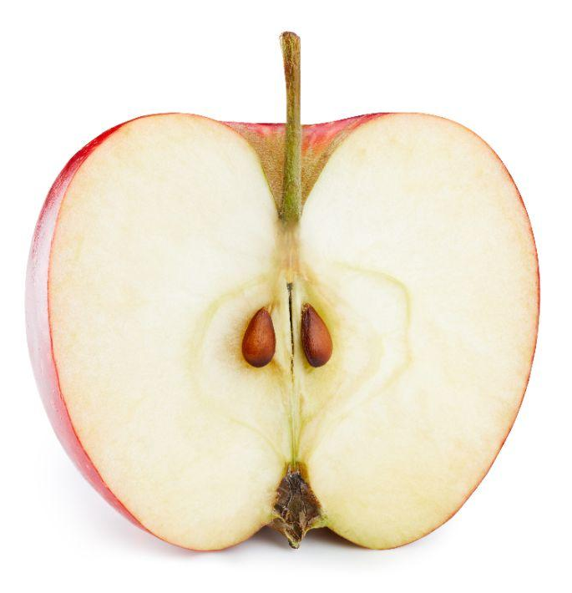
Answers:
An apple seed is usually less than 0.5 inches.
APPLE
Notes:
Adobe stock

Slide 16

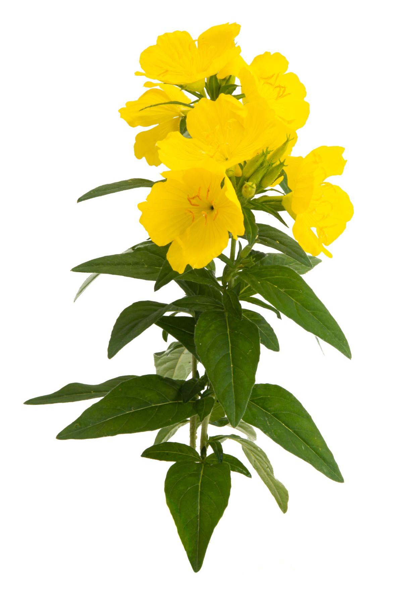
Questions:
This is a native dune plant!
Identity the colors of this plant.
Guess the name of this plant.
Guess the size of this plant’s seed.
Notes:
Evening primrose stock photos, royalty-free images, vectors, video (adobe.com)

Slide 17
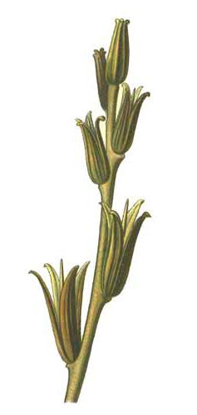
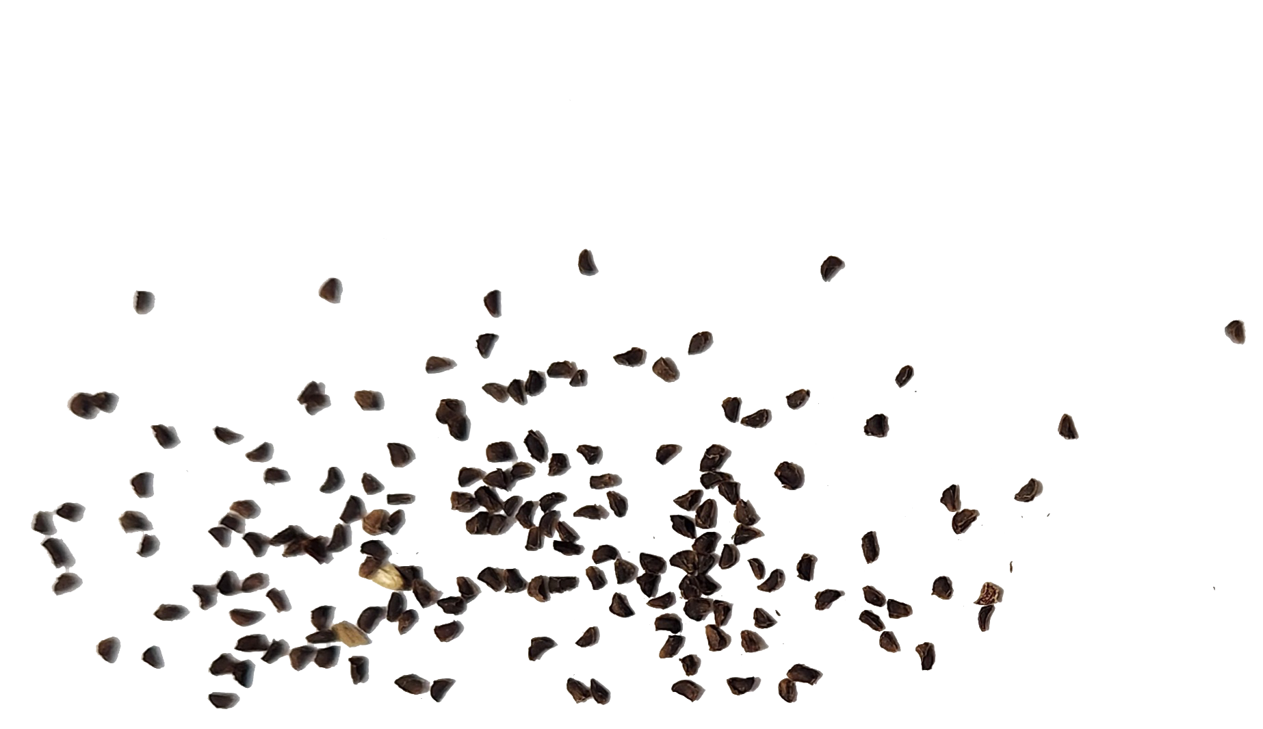
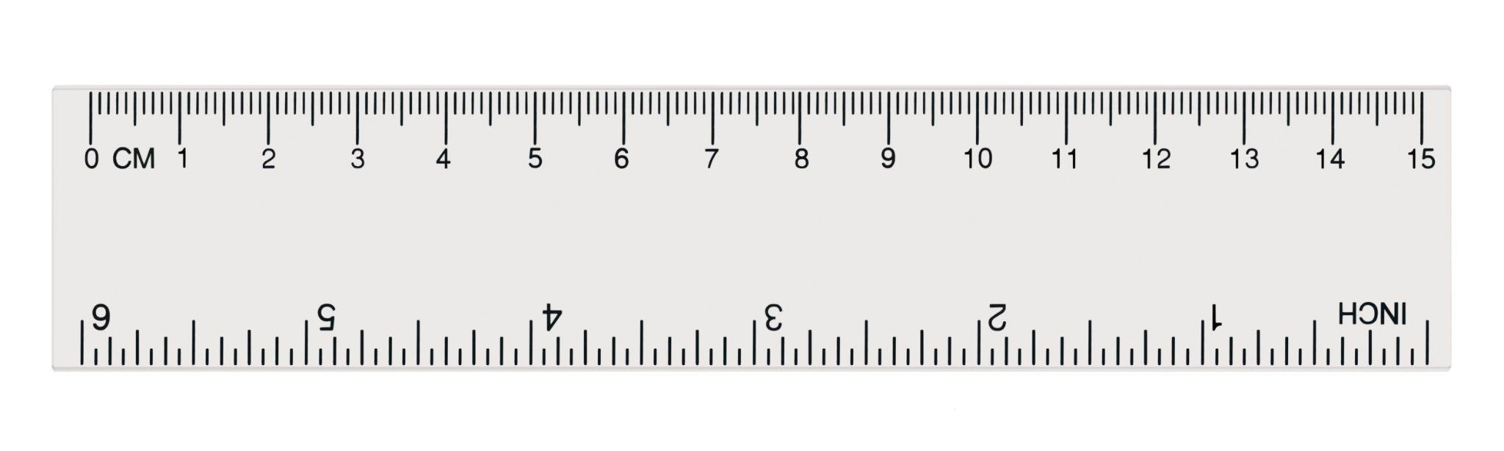
Answers:
Individual seeds are lined up inside the seed pods in the flower.
EVENING PRIMROSE
Notes:
Evening primrose stock photos, royalty-free images, vectors, video (adobe.com)

Slide 18
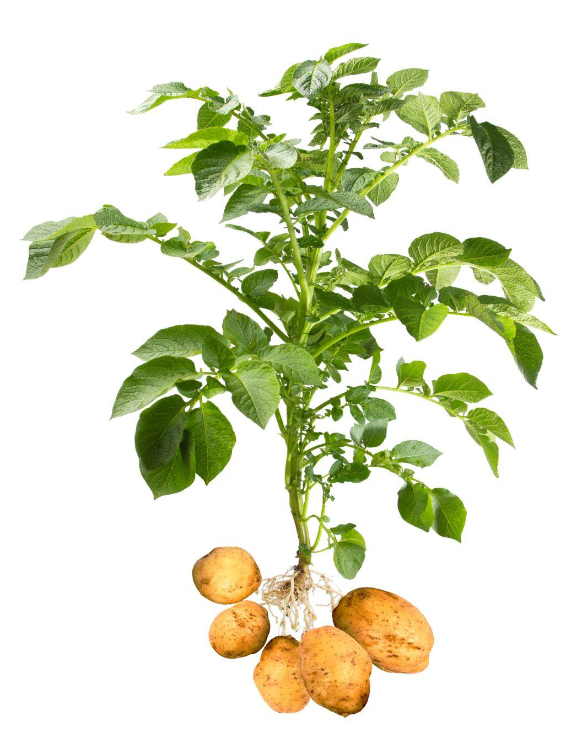
Questions:
Identity the colors of this plant.
Guess the name of this plant.
Guess the size of this plant’s seed.

Slide 19
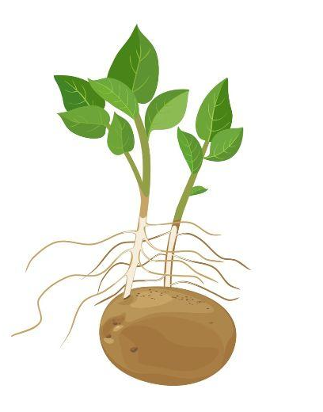
Answers:
The seed of the potato plant is the potato itself!
POTATO PLANT

Slide 20
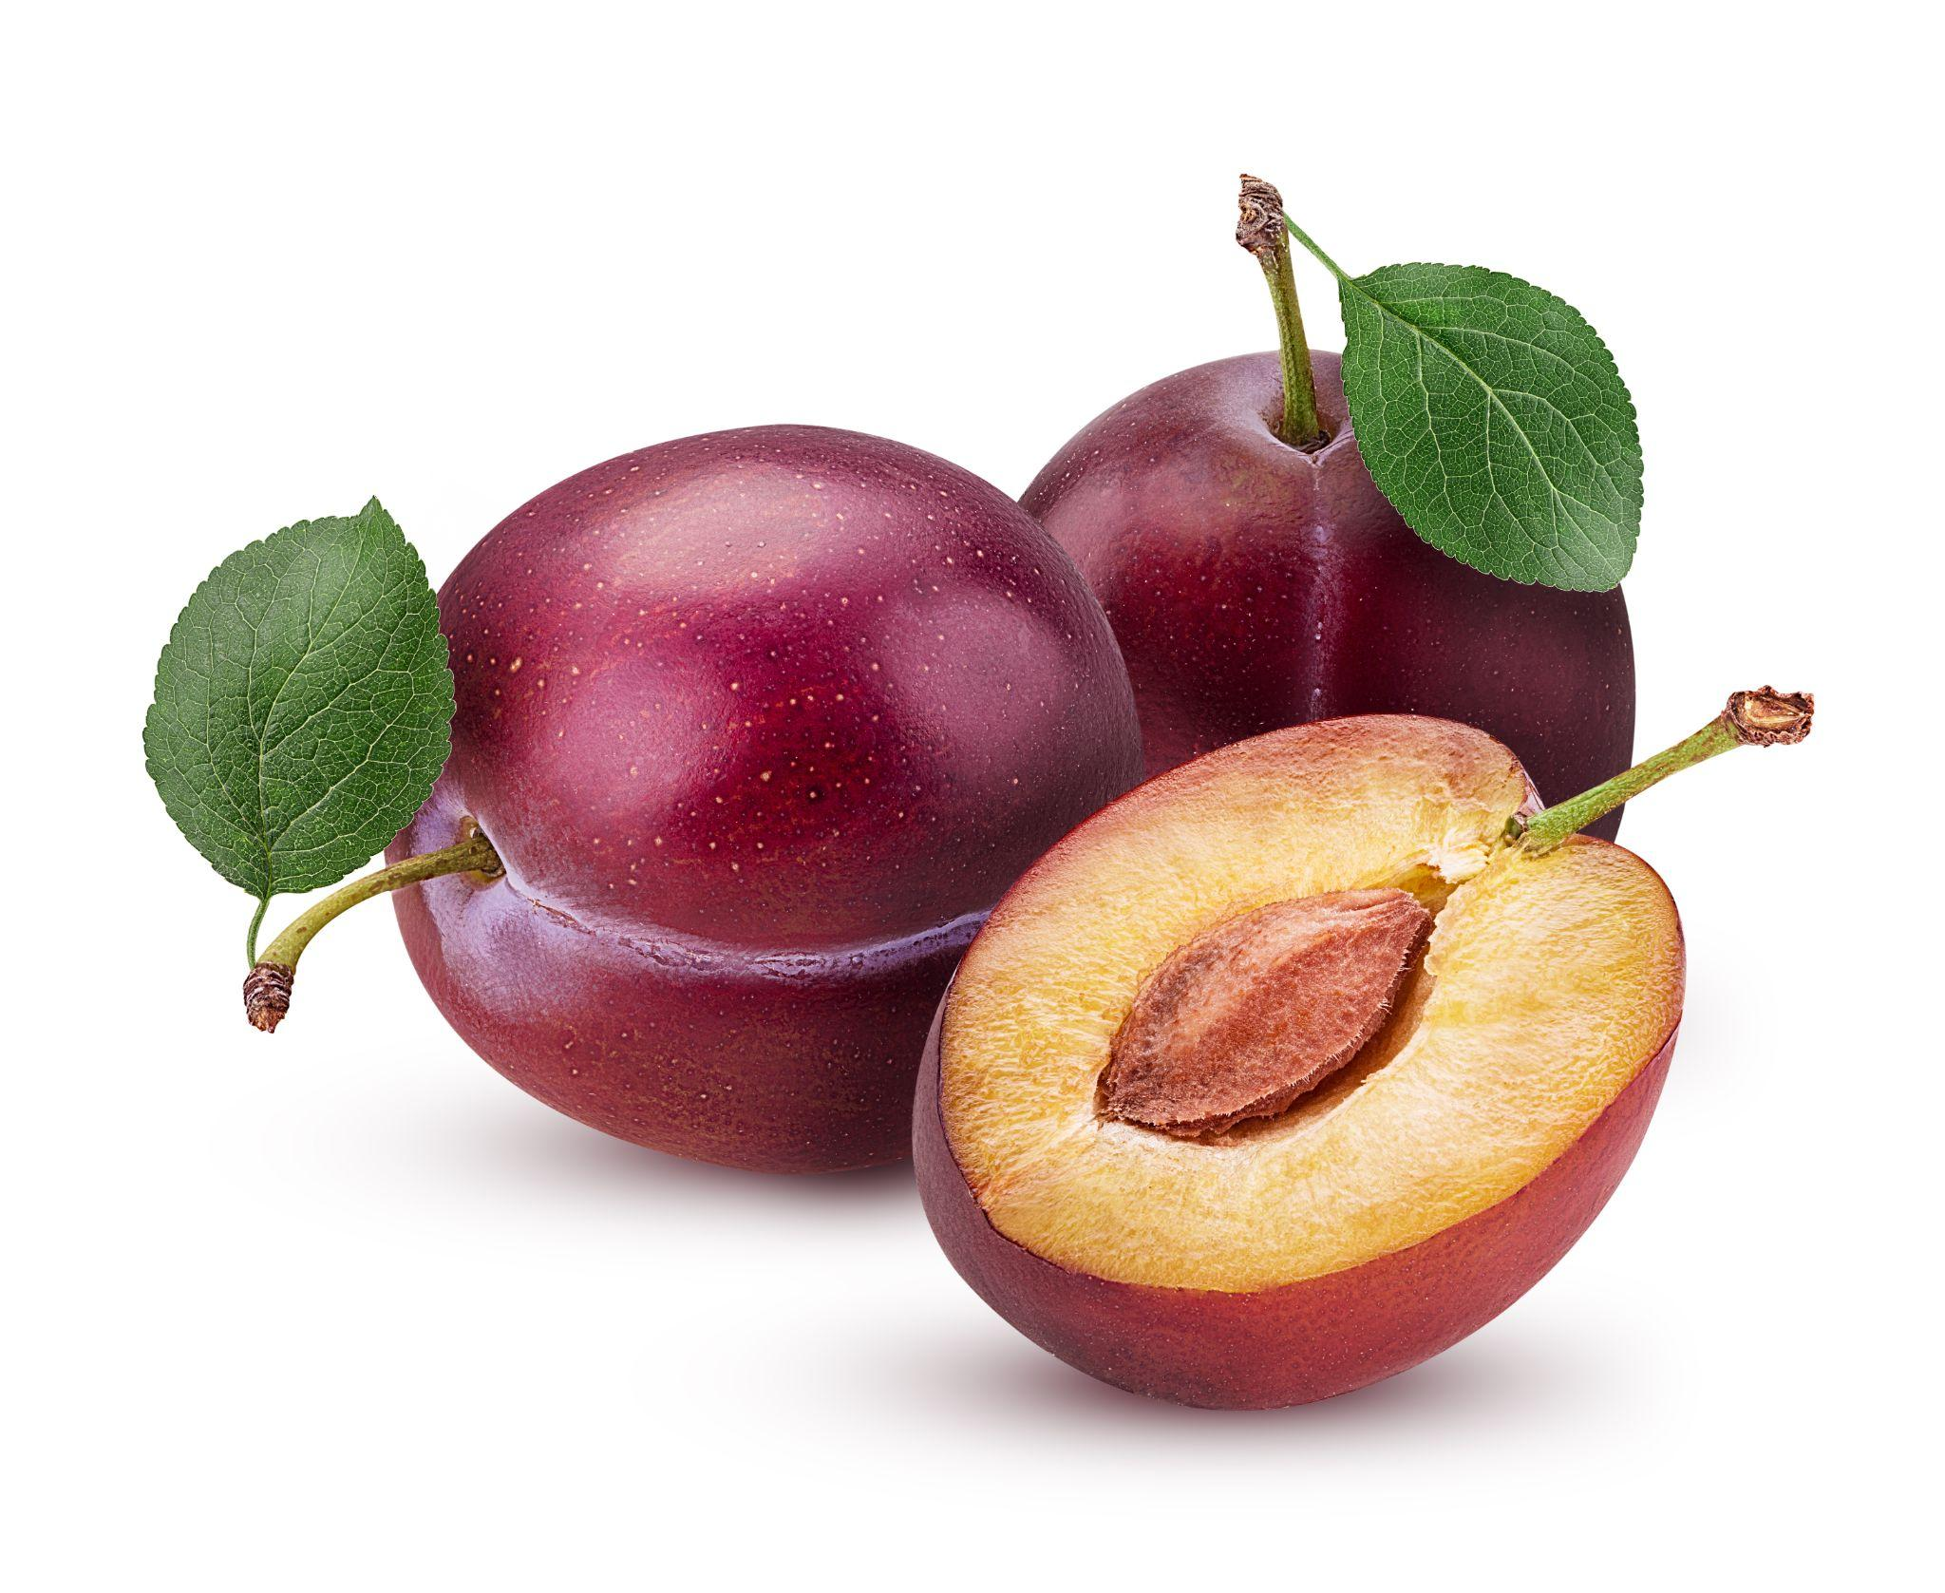
Questions:
This is a native dune plant!
Identity the colors of this plant.
Guess the name of this plant.
Guess the size of this plant’s seed.
Notes:
Plum Images – Browse 517,640 Stock Photos, Vectors, and Video | Adobe Stock

Slide 21
Answers:
The seed of the beach plum is inside the plum and it is called the pit!
BEACH PLUM

Slide 22
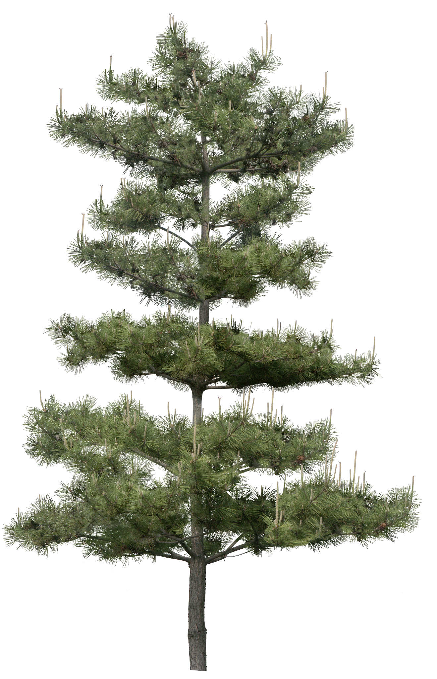
Questions:
This is a native dune plant!
Identity the colors of this plant.
Guess the name of this plant.
Guess the size of this plant’s seed.
Notes:
Nature - Christmas Black And White - CleanPNG / KissPNG

Slide 23
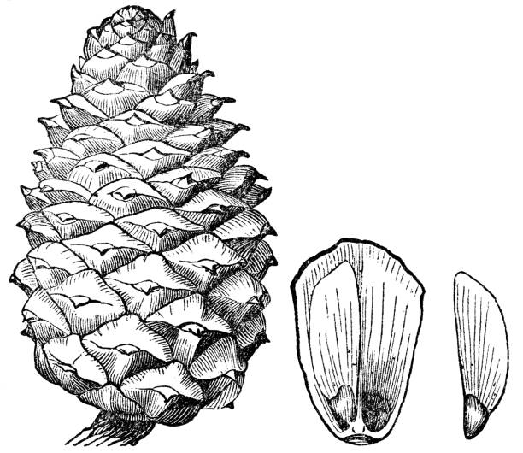
Answers:
The seed of the pitch pine can only be released or accessed when the pine cone opens up.
PITCH PINE
Notes:
Nature - Christmas Black And White - CleanPNG / KissPNG
https://media.istockphoto.com/id/1423436384/vector/pitch-pine-tree-pine-cone-seperated-scale-seed-19th-century.jpg?s=612x612&w=0&k=20&c=JLGyPDI1MqiF9QcvKB_mUZAFy_5Qa6Pb-ap9ltswYJg=

Slide 24
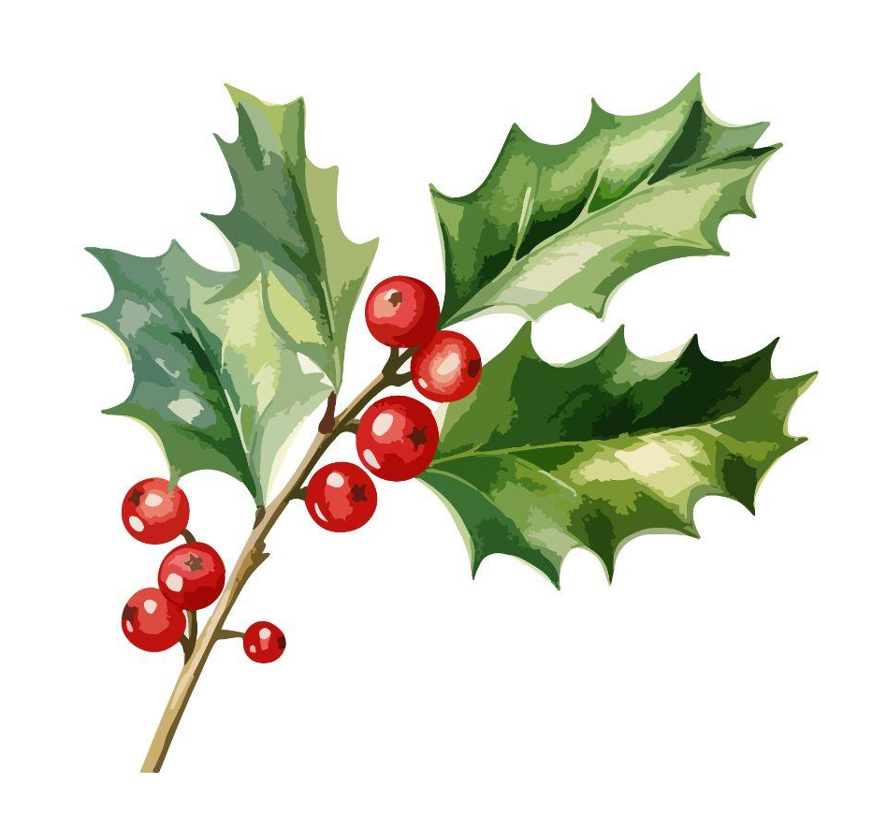
Questions:
This is a native dune plant!
Identity the colors of this plant.
Guess the name of this plant.
Guess the size of this plant’s seed.
Notes:
American holly stock photos, royalty-free images, vectors, video (adobe.com)

Slide 25
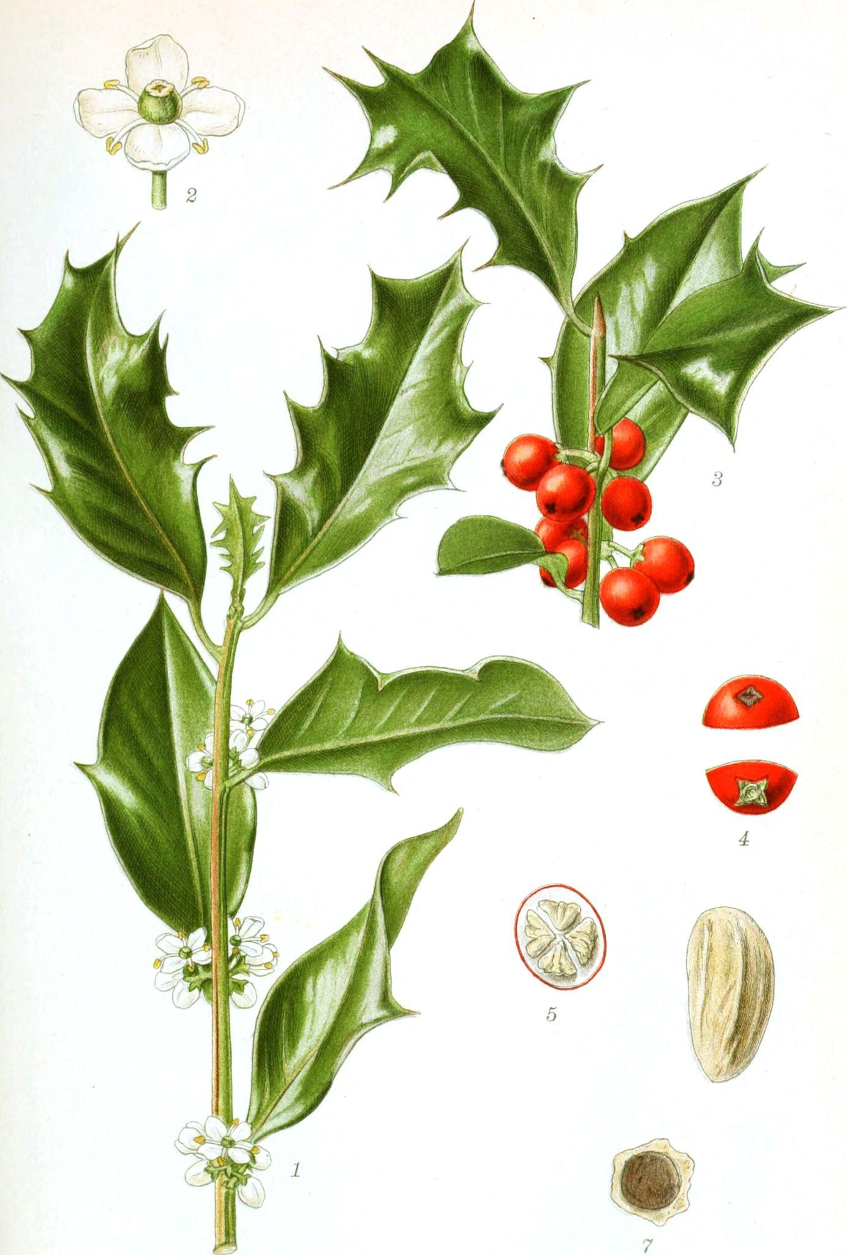
Answers:
The seed of an american holly plant is tiny!
AMERICAN HOLLY

Slide 26
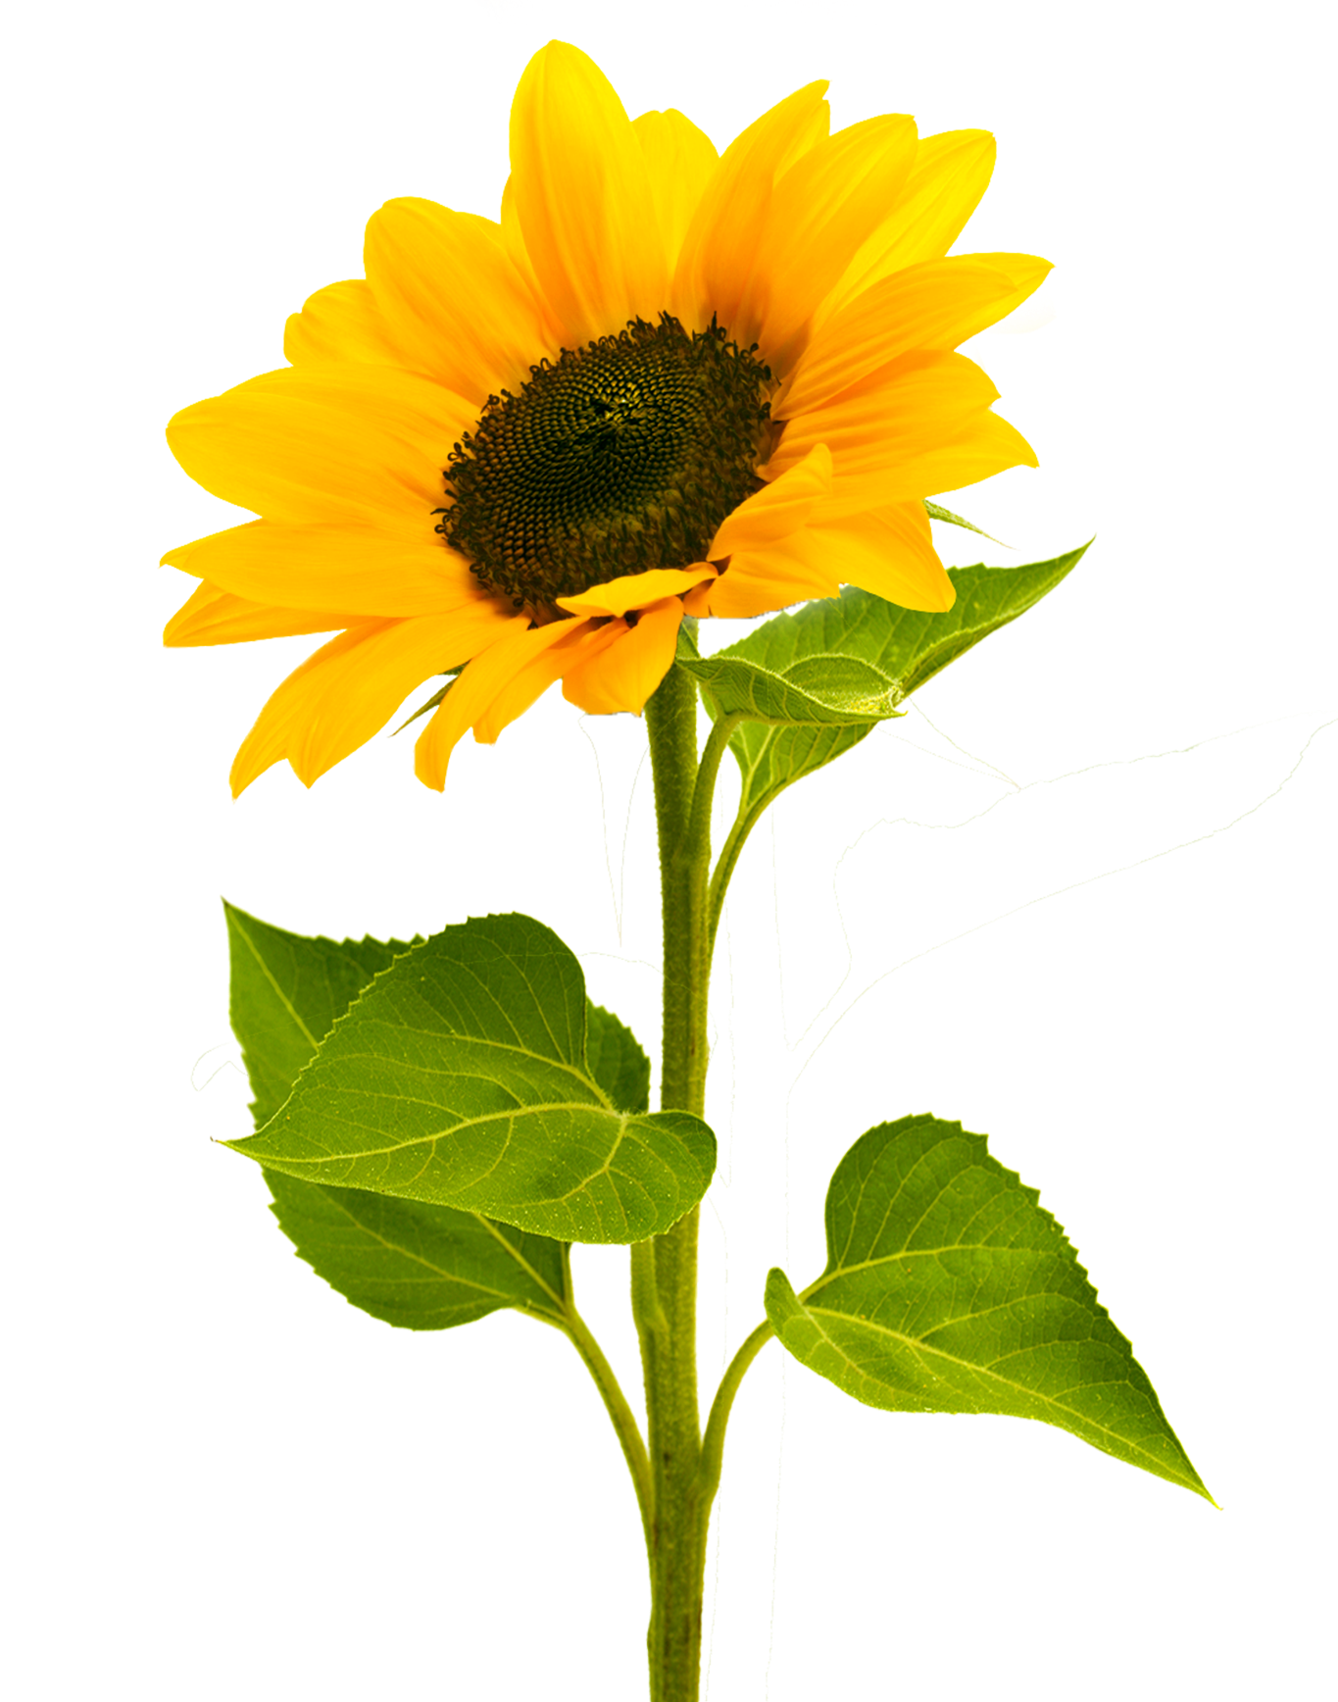
Questions:
Identity the colors of this plant.
Guess the name of this plant.
Guess the size of this plant’s seed.

Slide 27
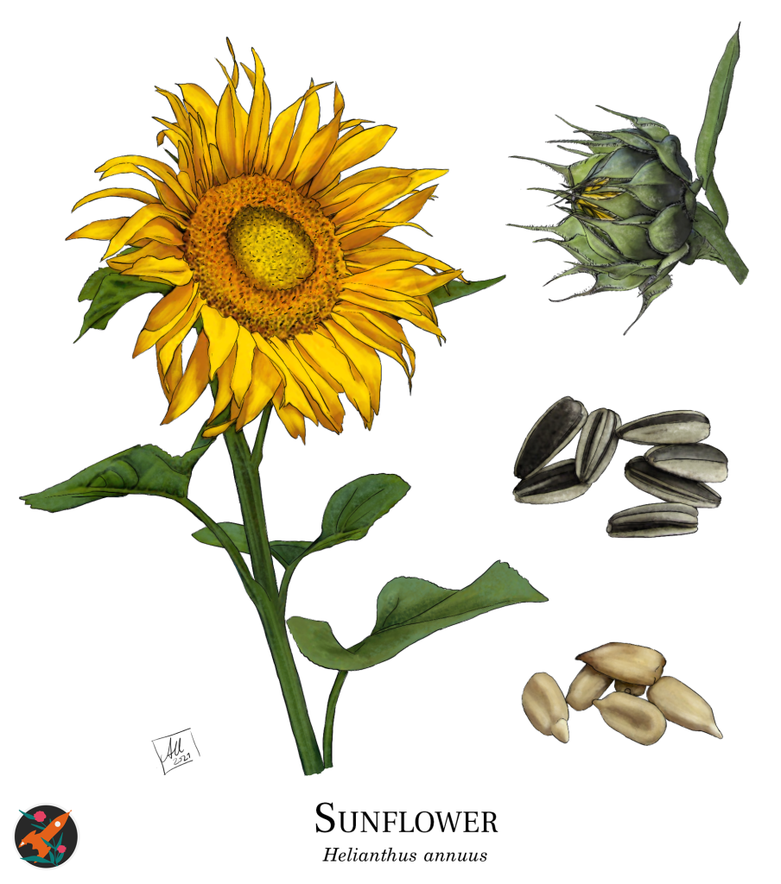
Answers:
Fun fact: You can eat sunflower seeds!
SUNFLOWER

Slide 28
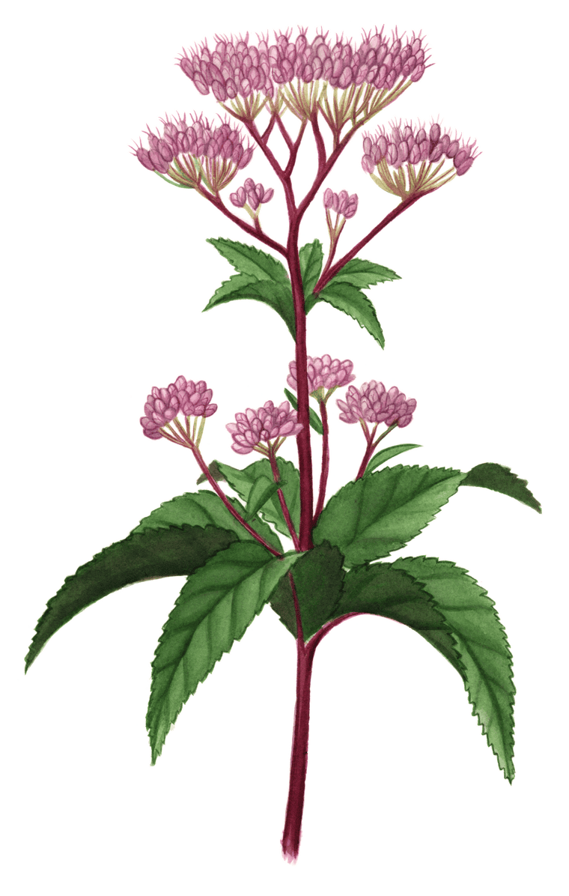
Questions:
This is a native dune plant!
Identity the colors of this plant.
Guess the name of this plant.
Guess the size of this plant’s seed.

Slide 29
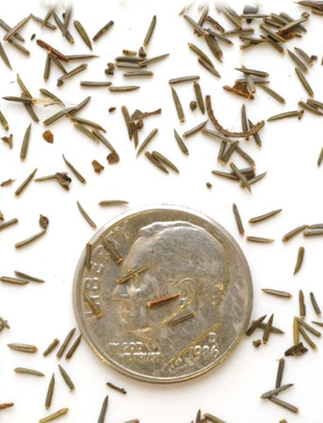
Answers:
The seed of spotted joe pye weed plant is tiny!
SPOTTED JOE PYE WEED
Notes:
Spotted Joe Pye Weed - Maine Native Plants

Slide 30
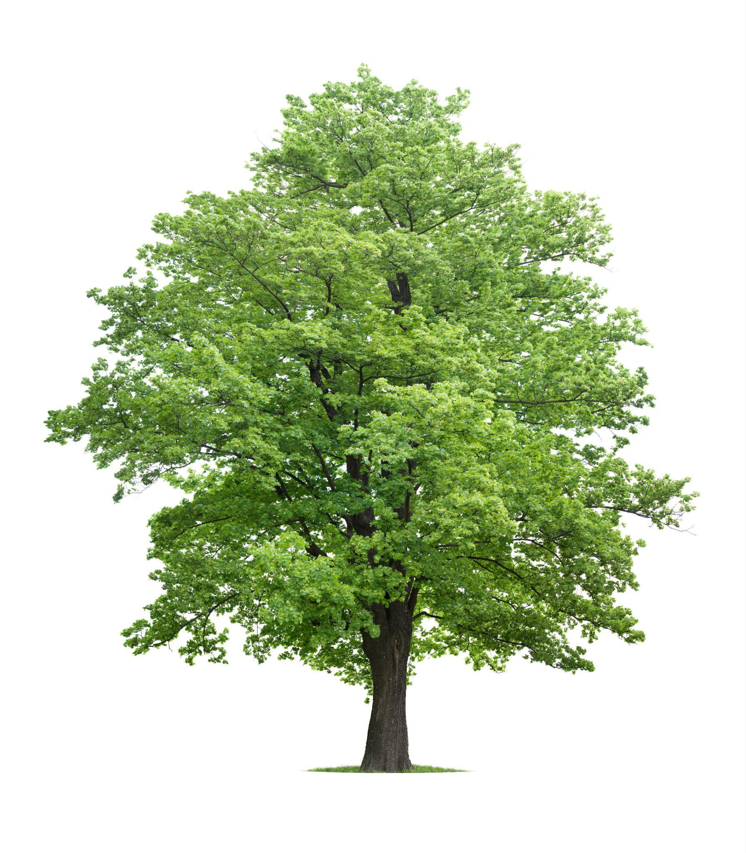
Questions:
Identity the colors of this plant.
Guess the name of this plant.
Guess the size of this plant’s seed.
Image credit: Lizzie Harper
Notes:
Pic from adobe stock

Slide 31
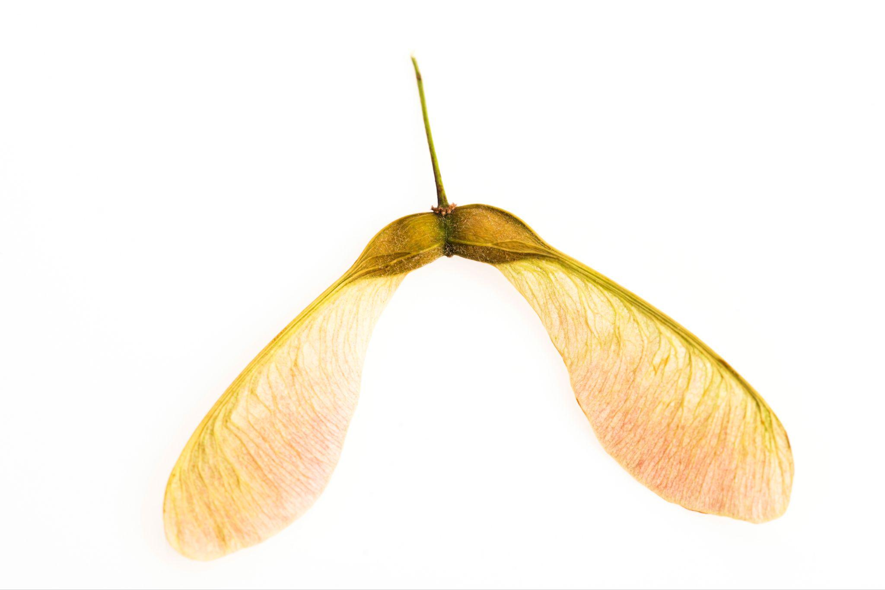
Answers:
Maple seeds are shaped like helicopter wings and spin as they fall to the ground.
SUGAR MAPLE TREE
Notes:
Pics from adobe stock

Slide 32
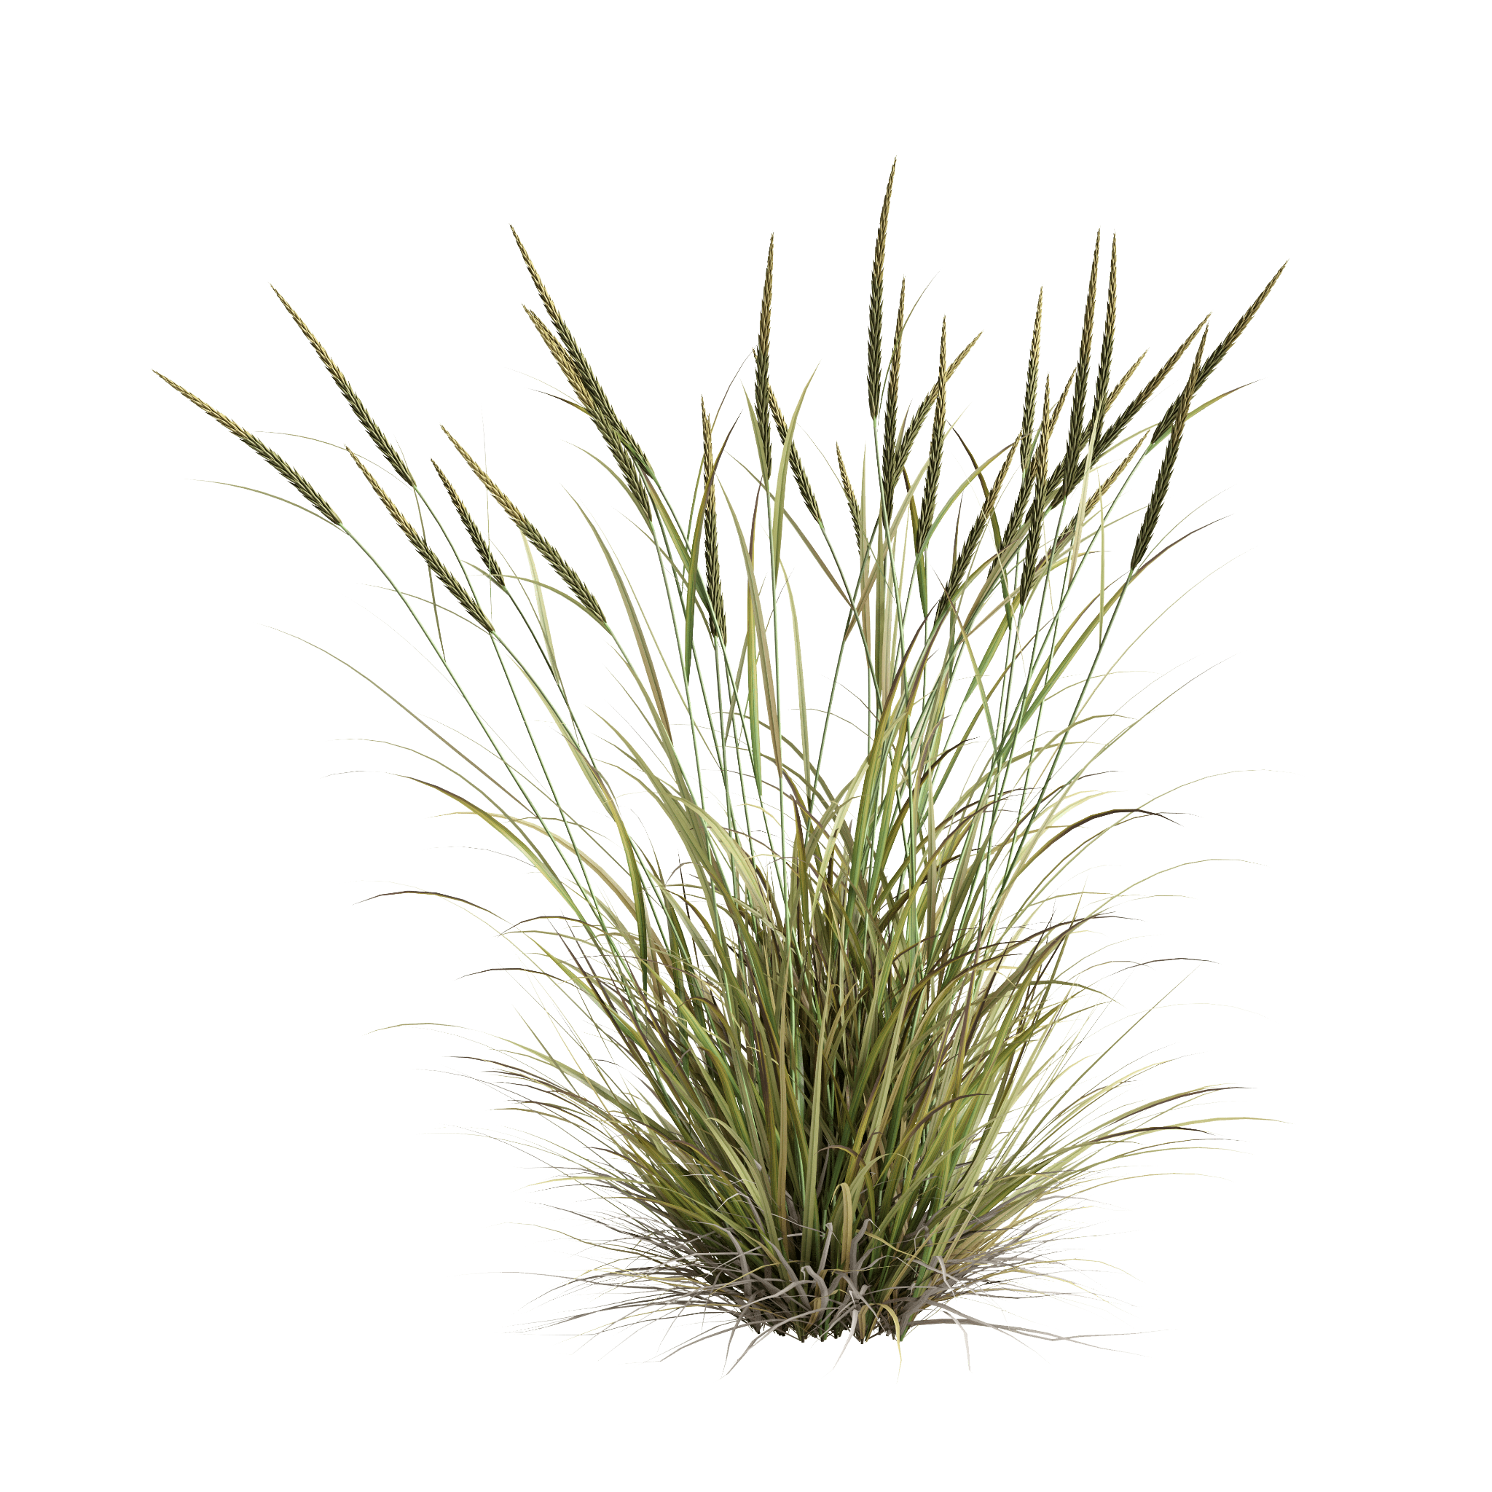
Questions:
This is a native dune plant!
Identity the colors of this plant.
Guess the name of this plant.
Guess the size of this plant’s seed.

Slide 33
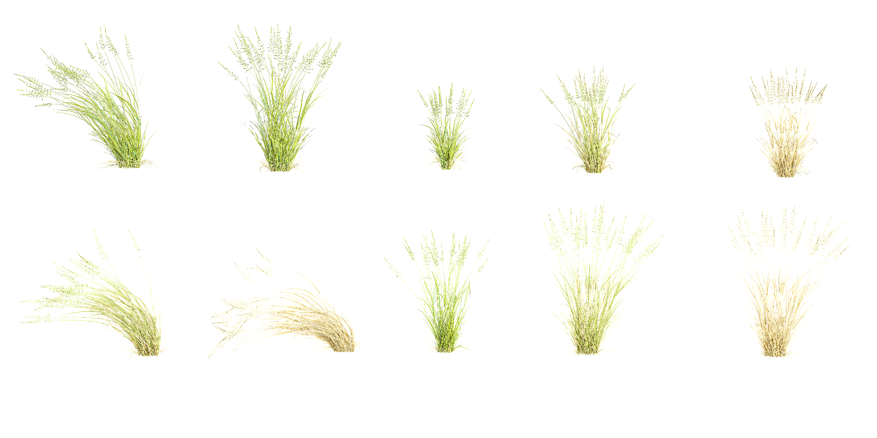
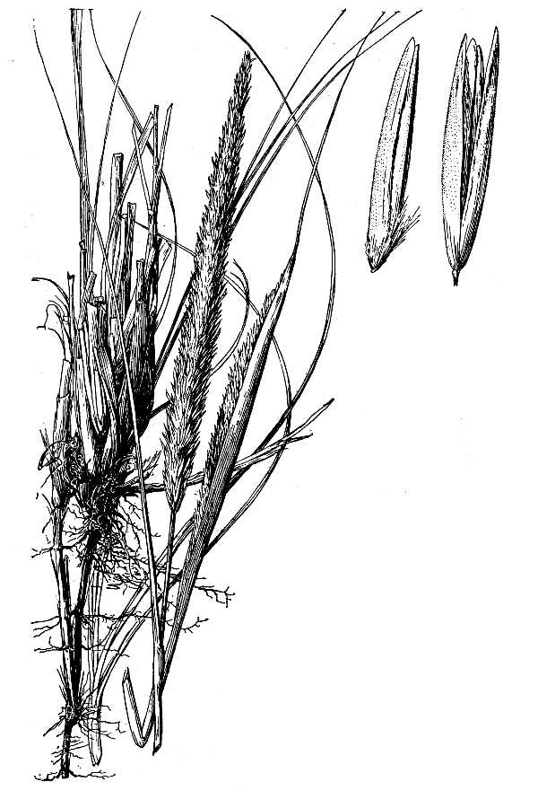
Answers:
The seedhead emerges in late July or August as a spike-like cluster at the tips of long stalks.
AMERICAN BEACH GRASS
Notes:
Grass Bush White Transparent, Ammophila Brevilugatta Grass Bush On Transparent Background, Grass, Bush, Plant Png PNG Image For Free Download (pngtree.com)
Ammophila breviligulata Fernald - American beachgrass (luirig.altervista.org)

Slide 34
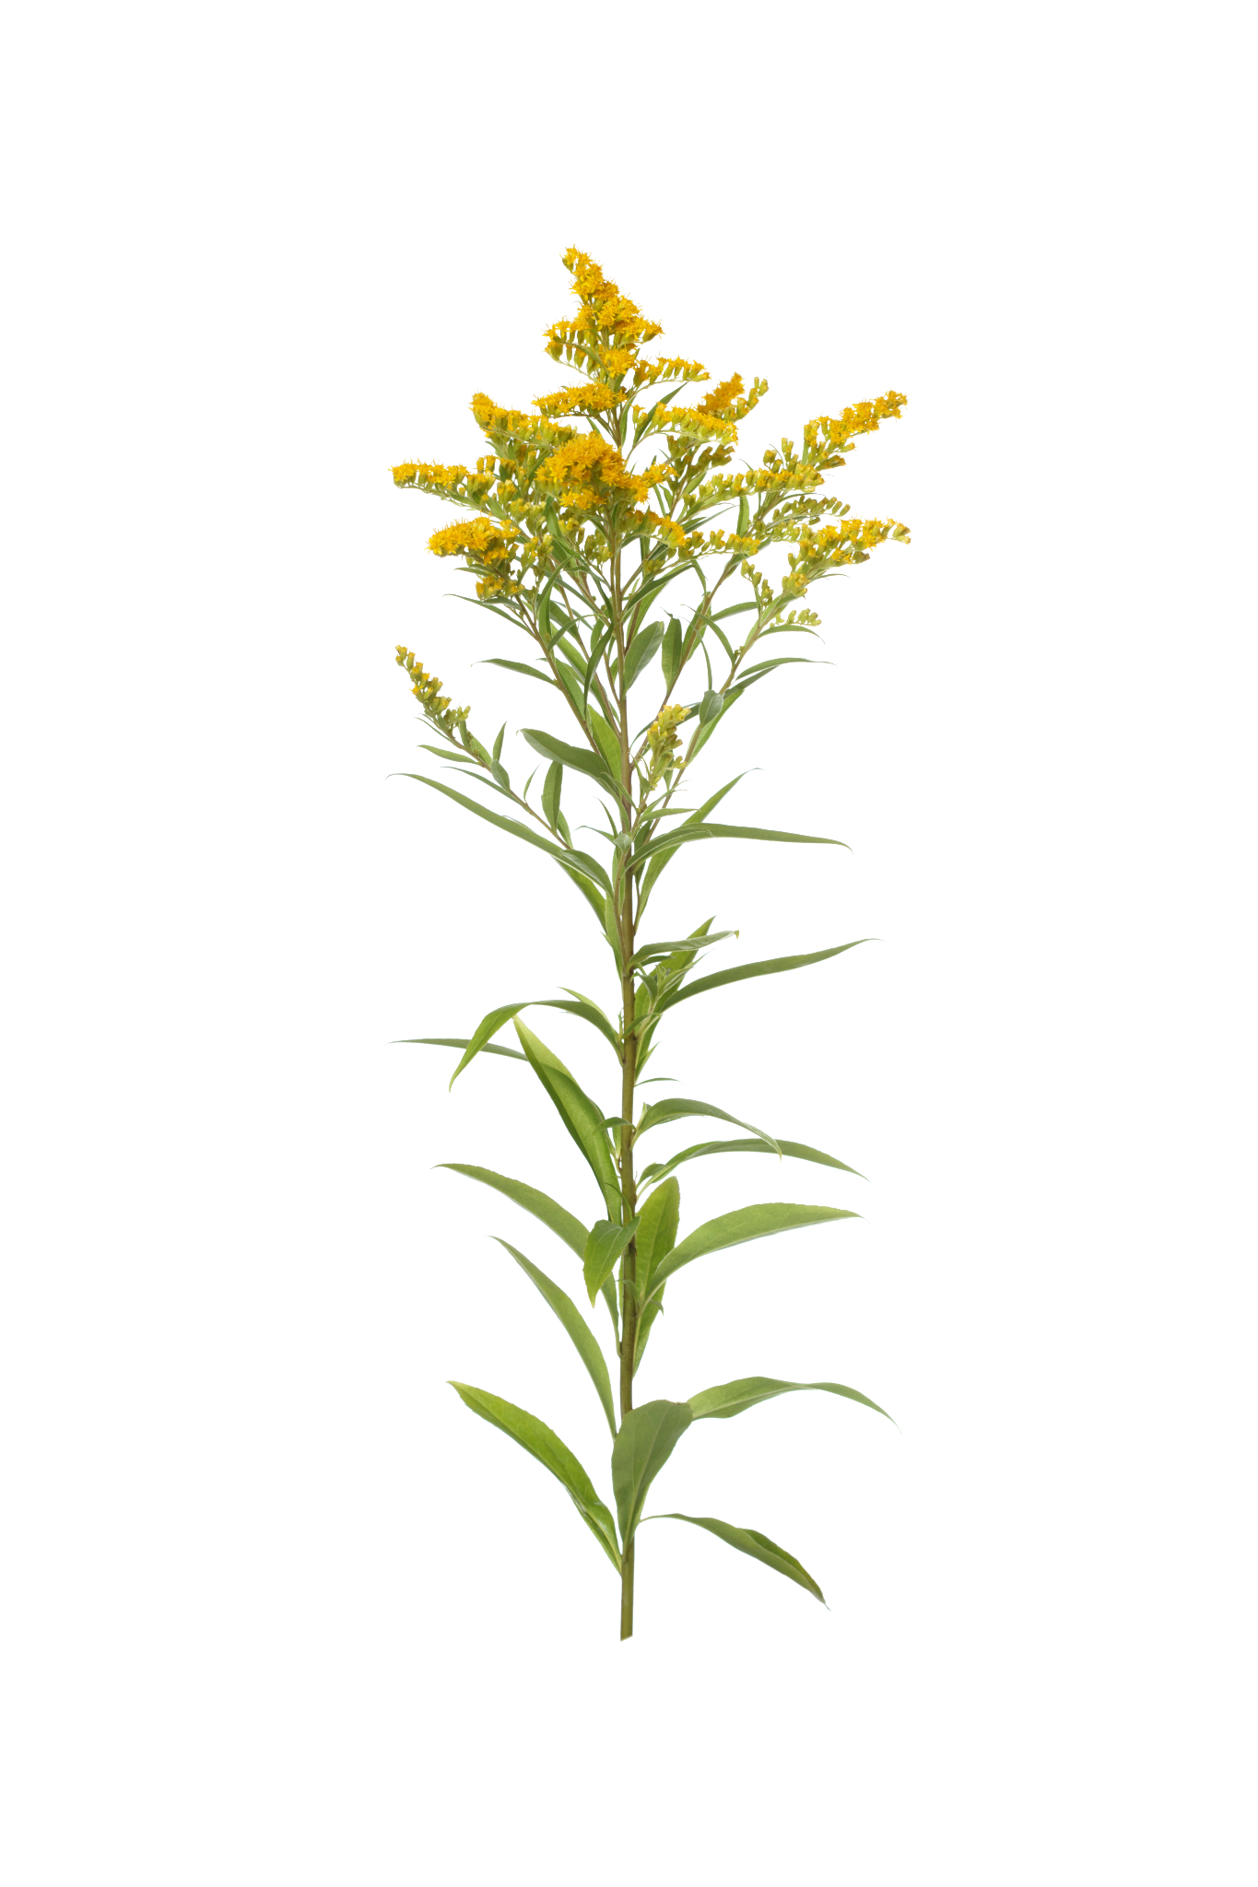
Questions:
This is a native dune plant!
Identity the colors of this plant.
Guess the name of this plant.
Guess the size of this plant’s seed.
Notes:
Image source from adobe stock

Slide 35
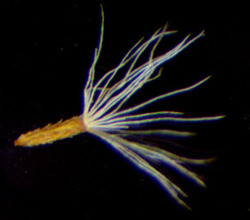
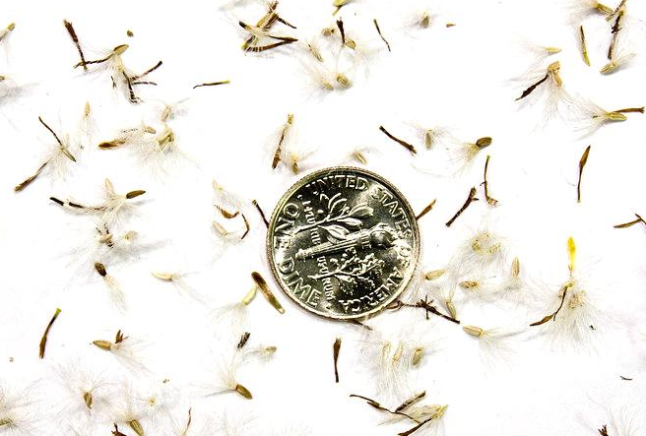
Answers:
The seed of seaside goldenrod plant is tiny!
SEASIDE GOLDENROD
Notes:
https://www.google.com/url?sa=i&url=https%3A%2F%2Fwww.oceanproperty.co.th%2F%3Fq%3Dsolidago-canadensis-canada-goldenrod-minnesota-wildflowers-ee-R1yGVLUW&psig=AOvVaw2bpXV5ZPpKExS-Y_hrOOJ4&ust=1714145825413000&source=images&cd=vfe&opi=89978449&ved=0CBIQjRxqFwoTCLDjk_HY3YUDFQAAAAAdAAAAABA4
https://www.google.com/url?sa=i&url=https%3A%2F%2Fwww.oceanproperty.co.th%2F%3Fq%3Dsolidago-sempervirens-seaside-goldenrod-cabi-compendium-ee-wYaezdhm&psig=AOvVaw2bpXV5ZPpKExS-Y_hrOOJ4&ust=1714145825413000&source=images&cd=vfe&opi=89978449&ved=0CBIQjRxqFwoTCLDjk_HY3YUDFQAAAAAdAAAAABBG

Slide 36
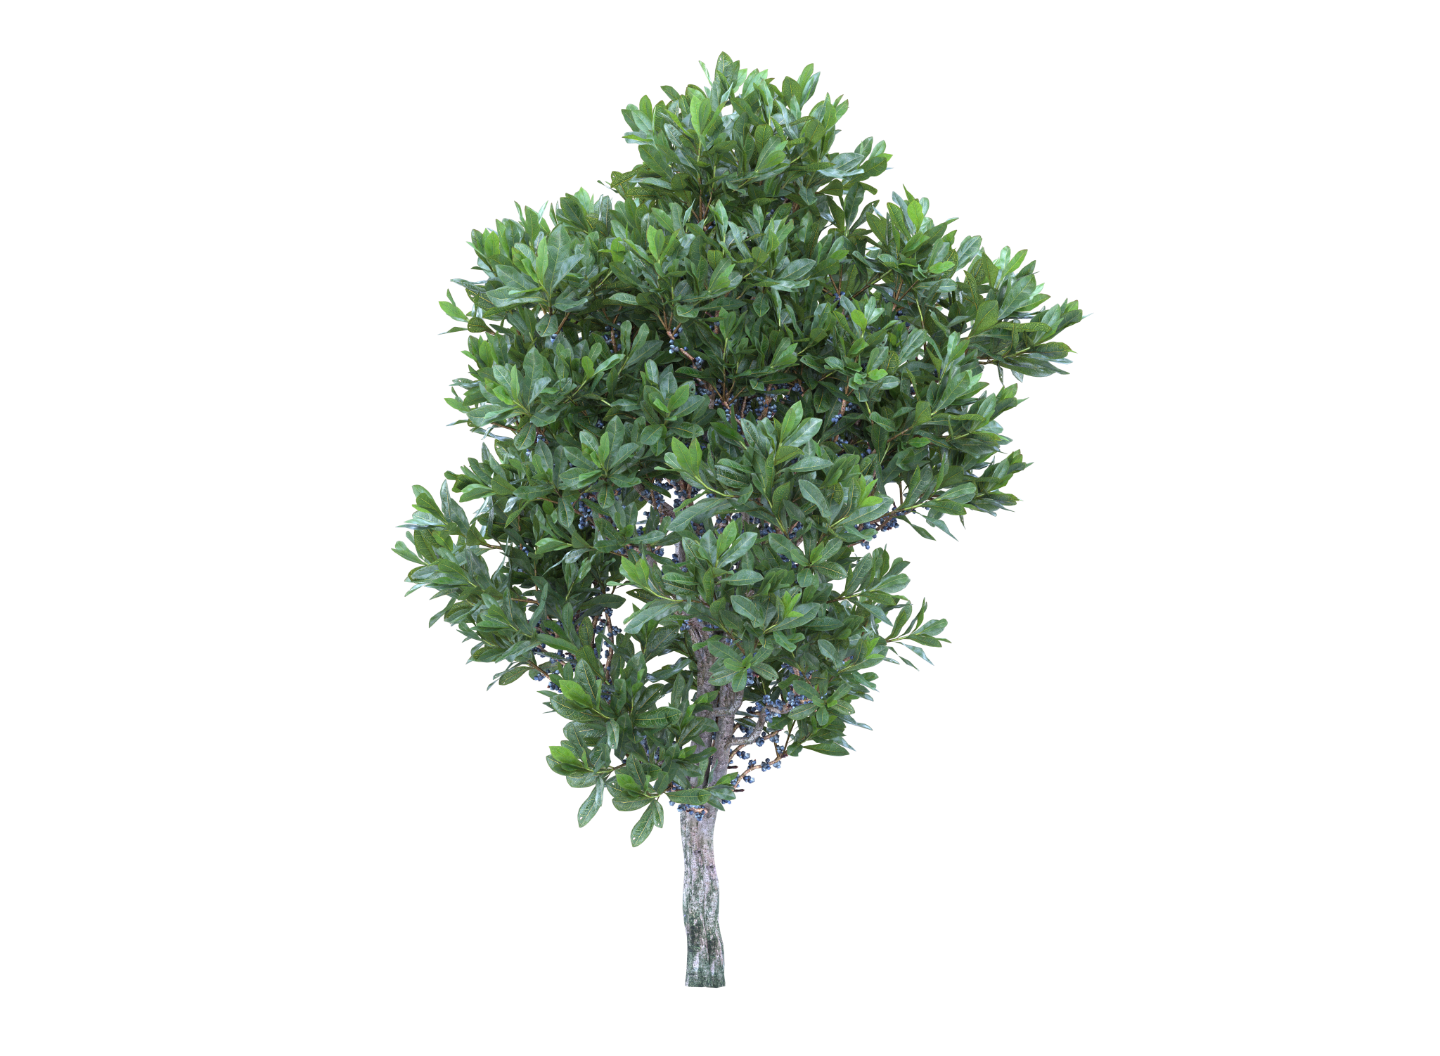
Questions:
This is a native dune plant!
Identity the colors of this plant.
Guess the name of this plant.
Guess the size of this plant’s seed.
Notes:
Adobe stock

Slide 37
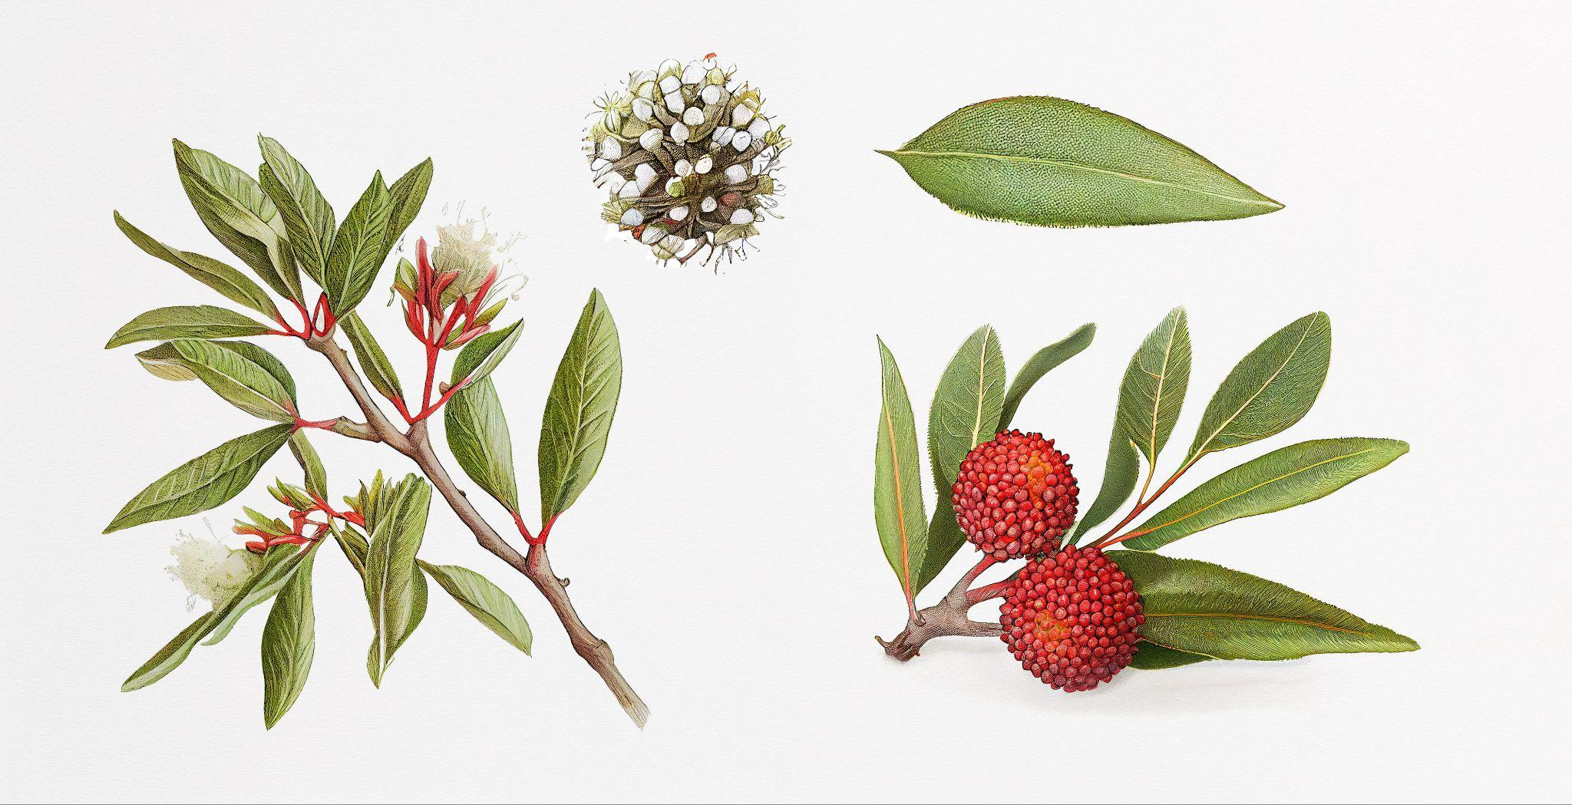
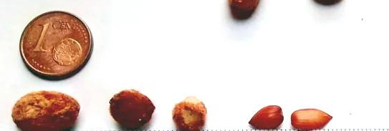
Answers:
Removing the waxy coating from the seeds will greatly increase the germination rate.
NORTHERN BAYBERRY
Notes:
Adobe stock

Slide 38

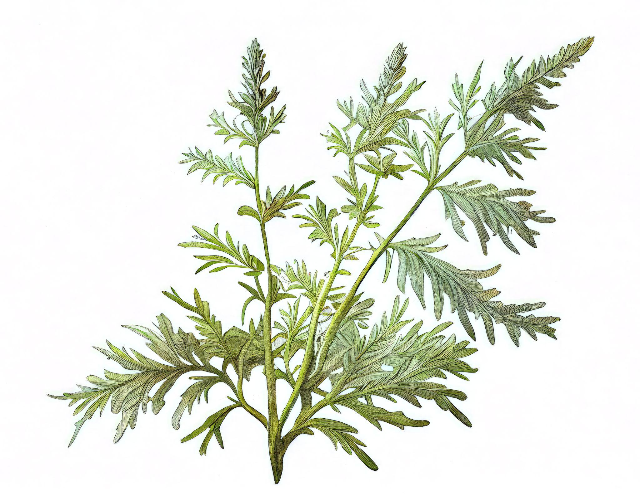
Questions:
This is an invasive plant!
Identity the colors of this plant.
Guess the name of this plant.
Guess the size of this plant’s seed.
Notes:
Adobe stock

Slide 39
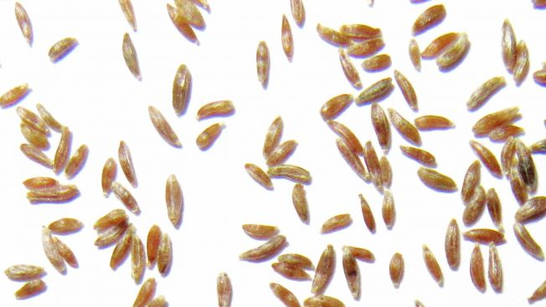
Answers:
The seed of the mugwort plant is tiny!
MUGWORT

Slide 40
CONGRATULATIONS ON FINISHING THE GAME! YOU DID A GREAT JOB!
GAME OVER!
GAME OVER!
GAME OVER!

Slide 41
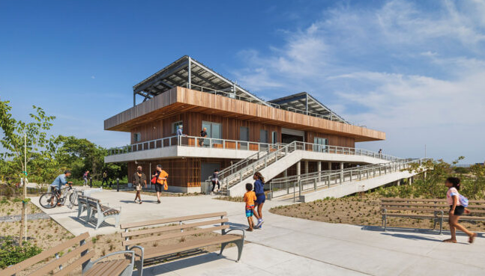
190 Beach 44th St, Queens, NY 11691
Visit the Arverne East Welcome Center to see more of these plants!

Slide 42
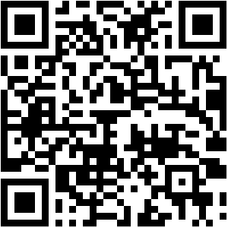
Scan this QR code or click on this link to start a virtual reality scavenger hunt!
Can you spot all of these?
Subway line
Beachgrass
Group of students on a field trip
Sand
Arverne East Welcome Center
Bicycle
Recycling bin
What else can you find?

Slide 43

Made possible by the National Fish and Wildlife Foundation
Thank you for participating!

